Slide 1

Workshop 1
(Prague, 30/Sep - 01/Oct 2019)
INITIAL GEOPHYSICAL SURVEYING OF ARCHAEOLOGICAL SITES IN ARMENIA
Jaroslav Jirku and Tomas Belov
Topic 1 (Developing a common ground)

Slide 2

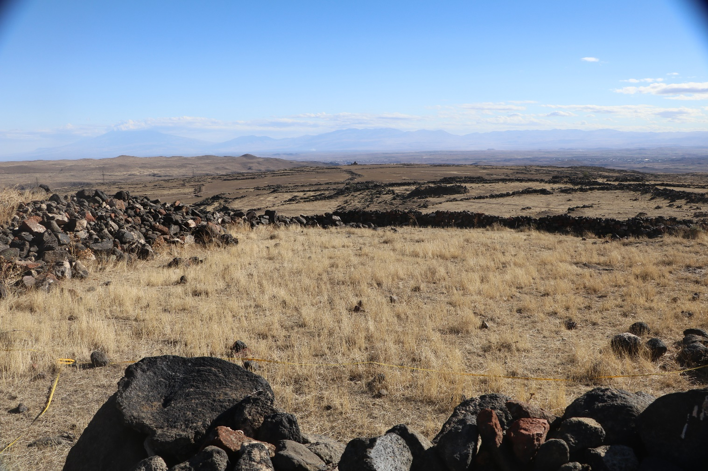
Acknowledgements
Chironium Ltd.
Institute of Archaeology in Prague
Institute of Archaeology in Yerevan

Slide 3
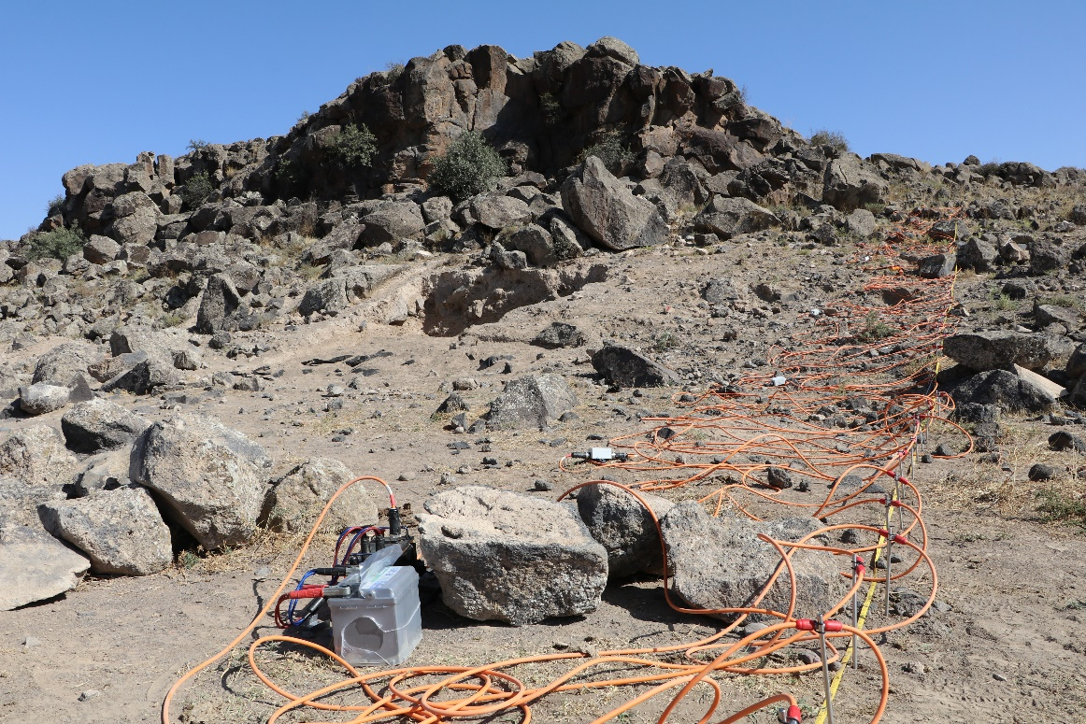
Aim & Objectives
The aim
Apostolus expeditions 2016 - 2018
several archaeological sites in Armenia – 3 shown
geophysical measurements, methods of field archaeology - gathering information about hidden archaeological features at the sites
future protection of the sites

Slide 4
Aim & Objectives
3 sites of interest - according to the needs of the Archaeological Institute of the Academy of Science of the Czech Republic + Institute of Archaeology and Ethnography of the National Academy of Sciences of Armenia
Detailed geophysical survey + archaeological sketches etc.
Armavir region (gubernia) - thickness of the historical sediments and describing overall archaeological features situ

Slide 5
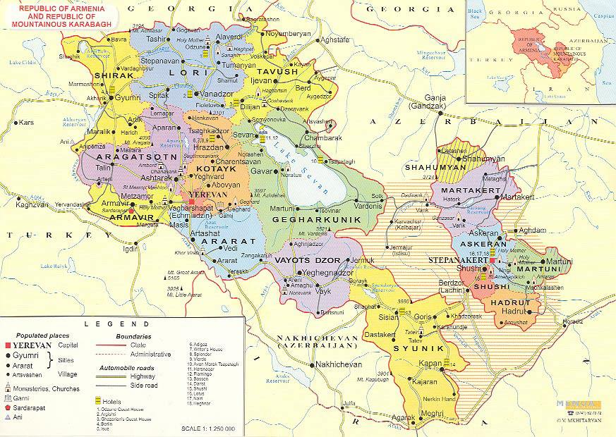
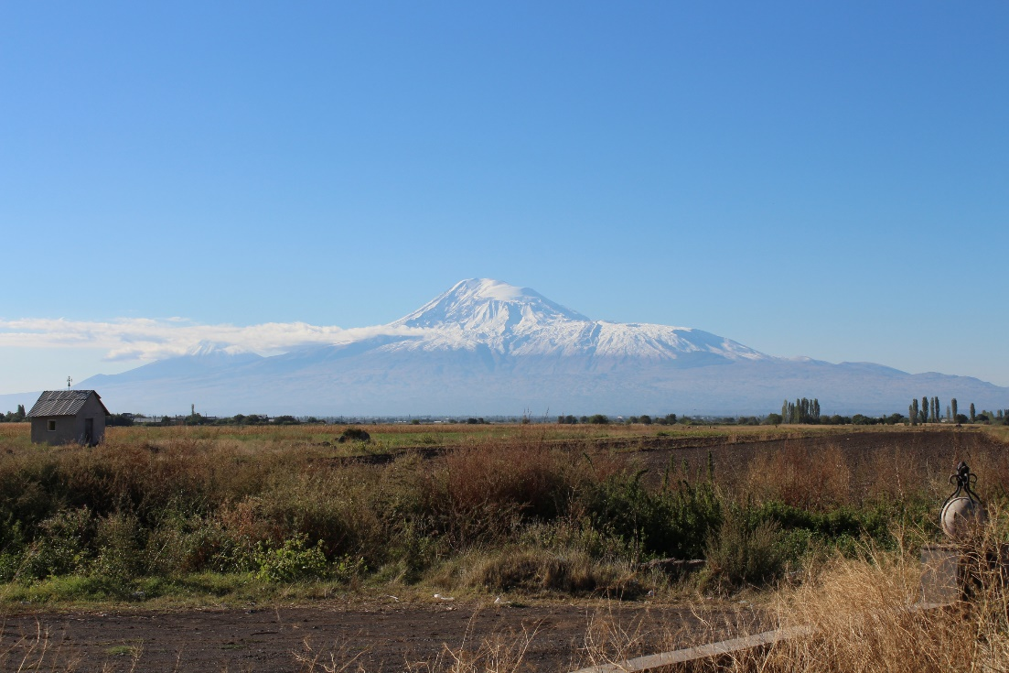
Aim & Objectives
Armavir Guberniya

Slide 6
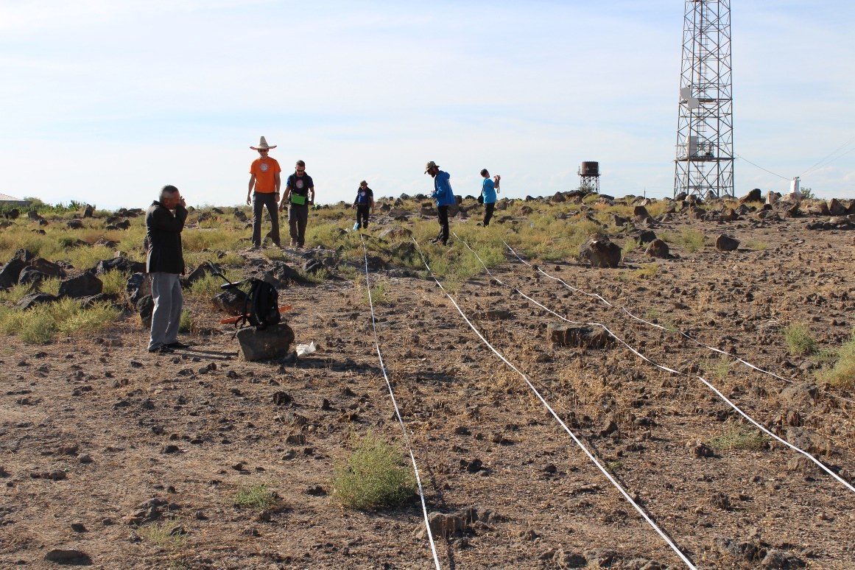
Geophysical methods
Methodology
Two phases
  Quick scanning methods – entire area, 2D spatial network
    Magnetometry, dipole electromagnetic profiling (DEMP)
  Detailed surveying of selected anomalies
    Electrical resistivity tomography (ERT)

Slide 7
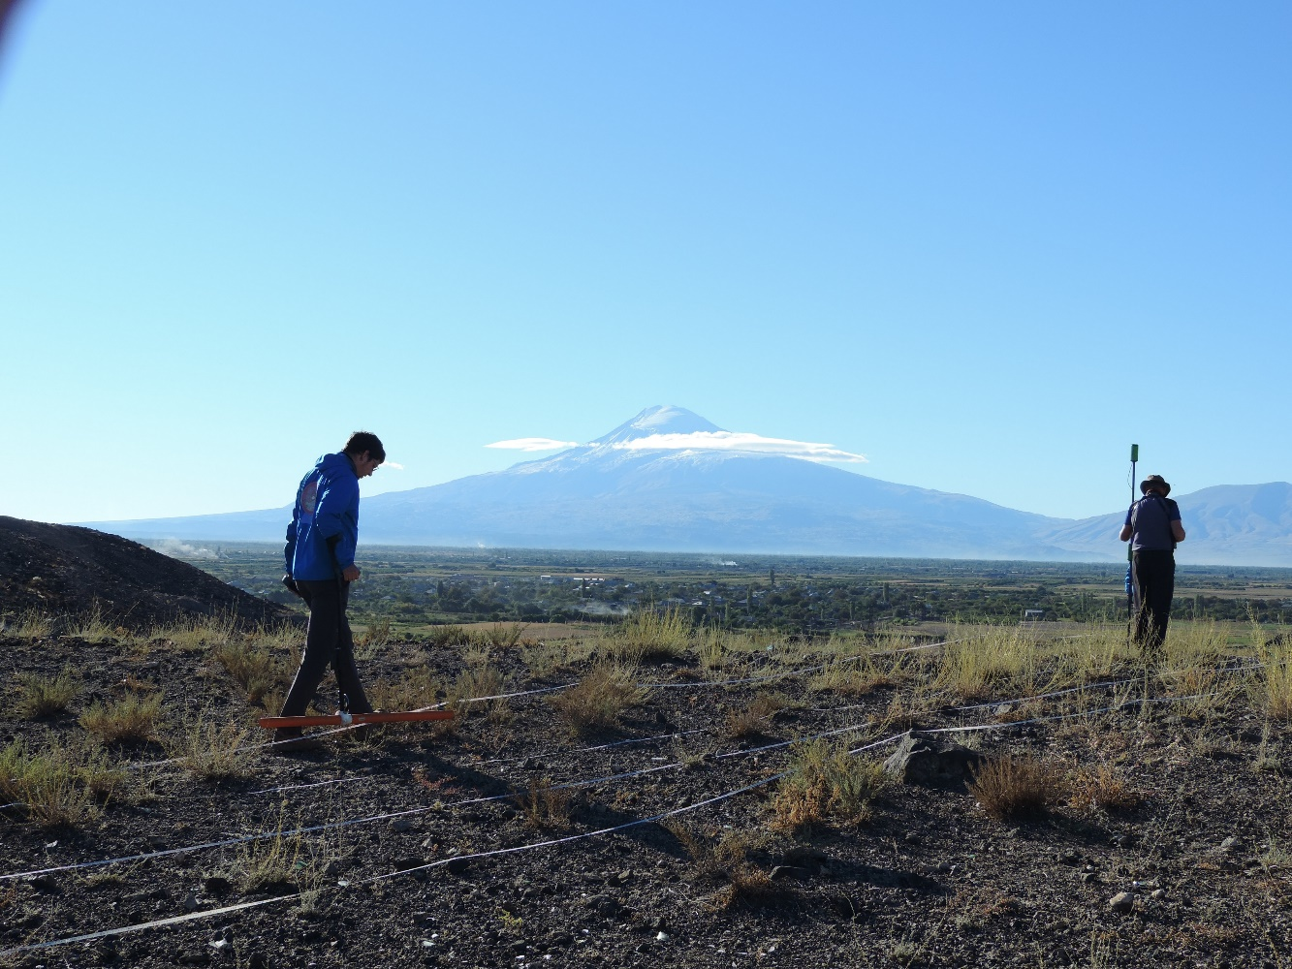
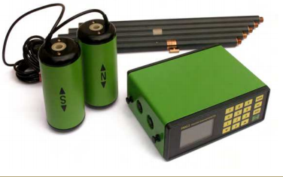
Geophysical methods
Magnetometry
- classical method of archaeological geophysics
PMG-1, SatisGeo
1m gradient

Slide 8
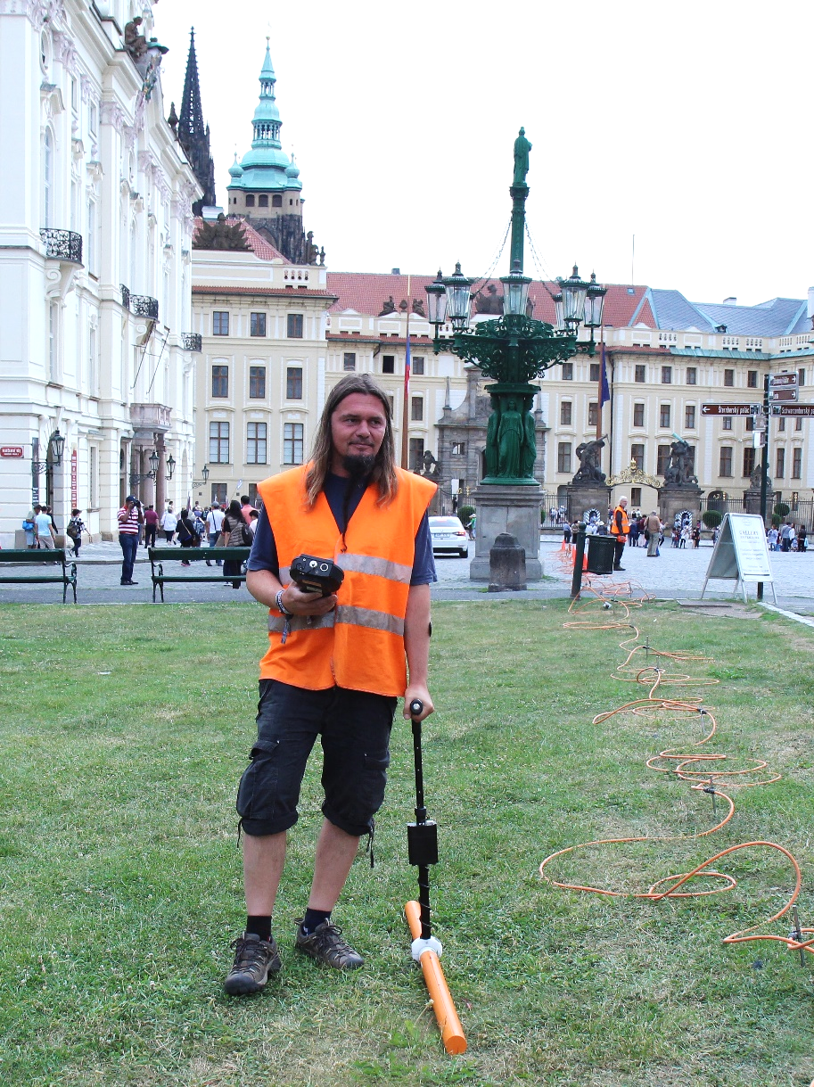
Geophysical methods
DEMP (dipole electromagnetic profiling)
CMD – MiniExplorer, GF Instruments
three pairs of coils, i.e. three theoretical calibrated depths of investigation 0.5, 1 and 1.8 m

Slide 9
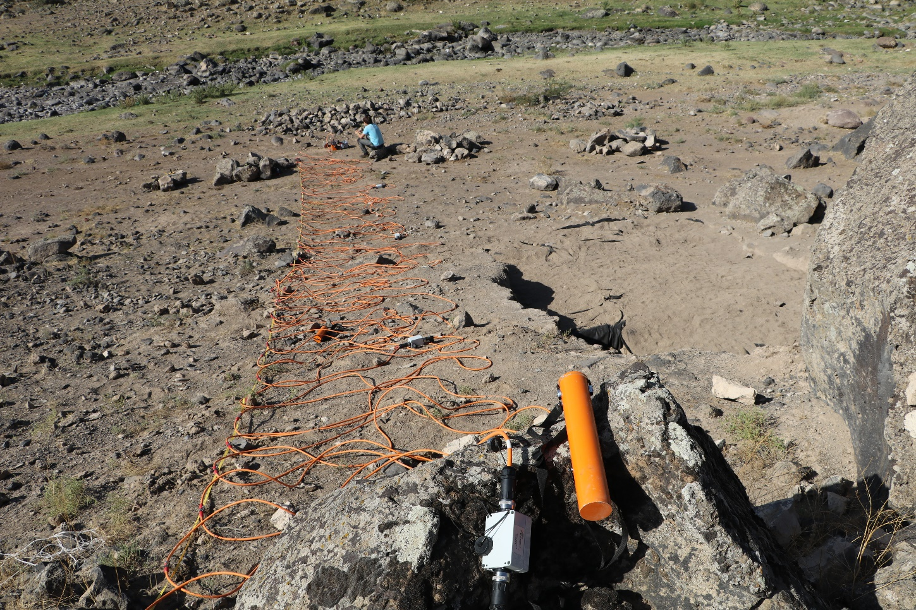
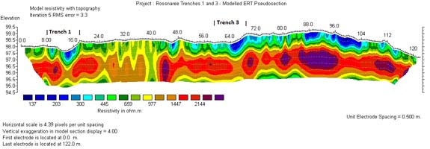
Geophysical methods
ERT
GF Instruments
Multielectrode system
2D/3D
Depth – around AB/5
DC method

Slide 10
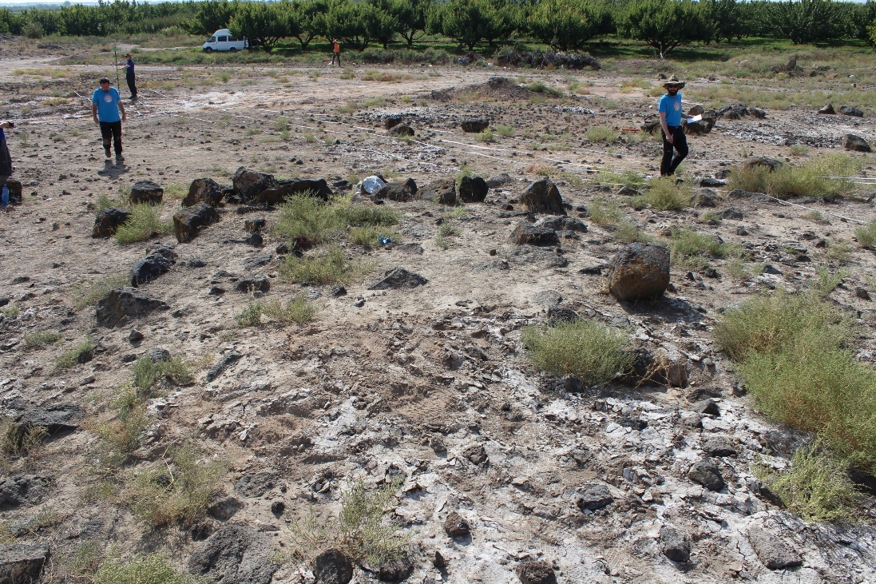
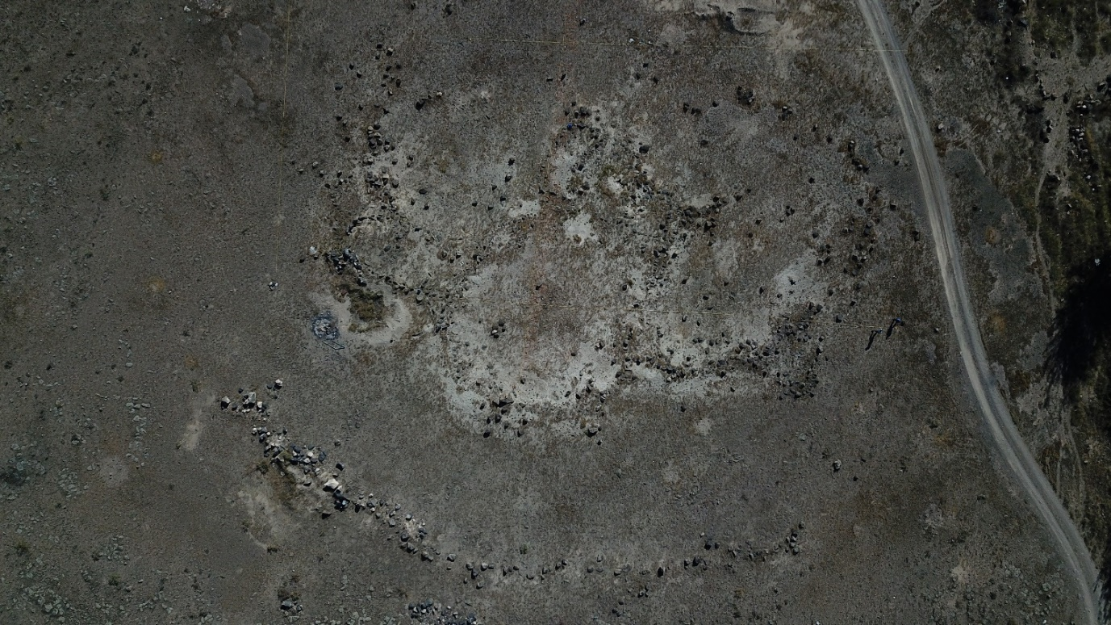
Case studies
Ghanjyan Blur site
volcanic rocks (pumice) covered by sediments
stone objects relics (shapes of medieval houses or prehistoric graves)
sketch and sherd analysis of the site
MAG, DEMP + ERT

Slide 11
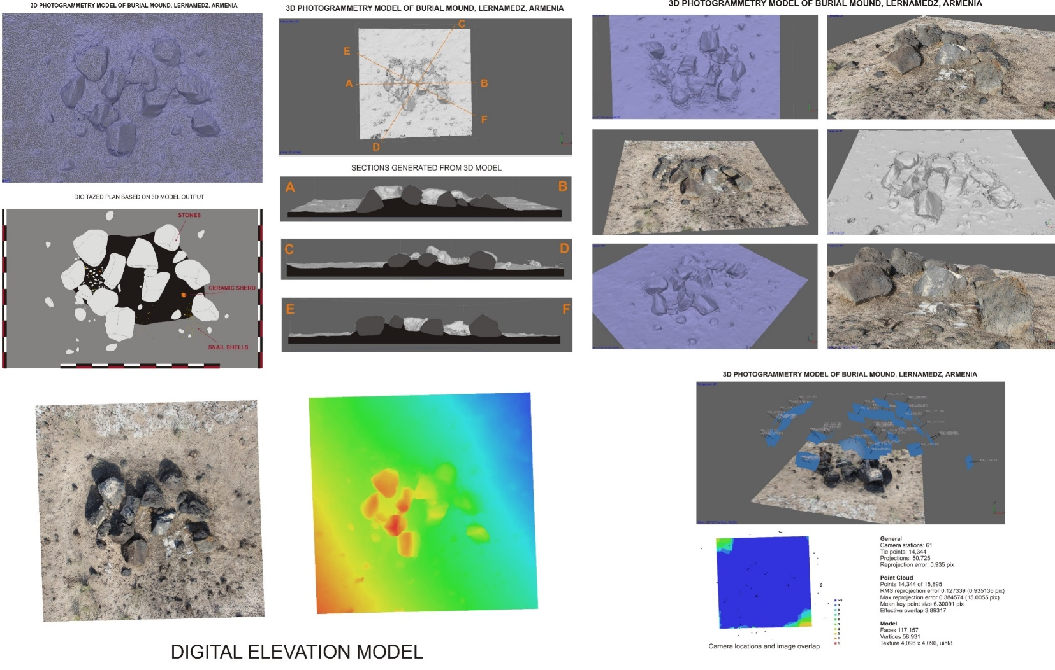
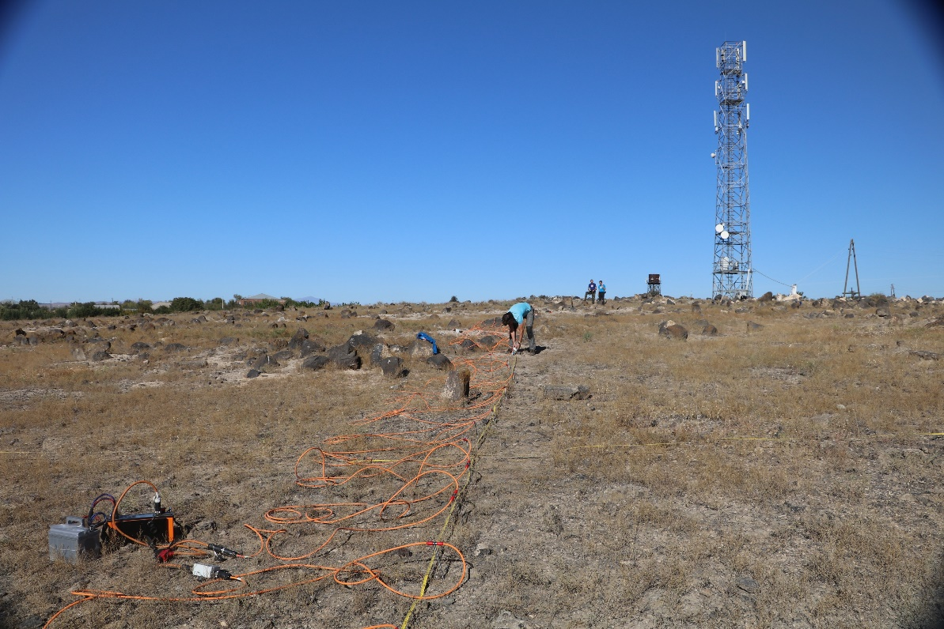
Case studies

Slide 12
Case studies

Slide 13
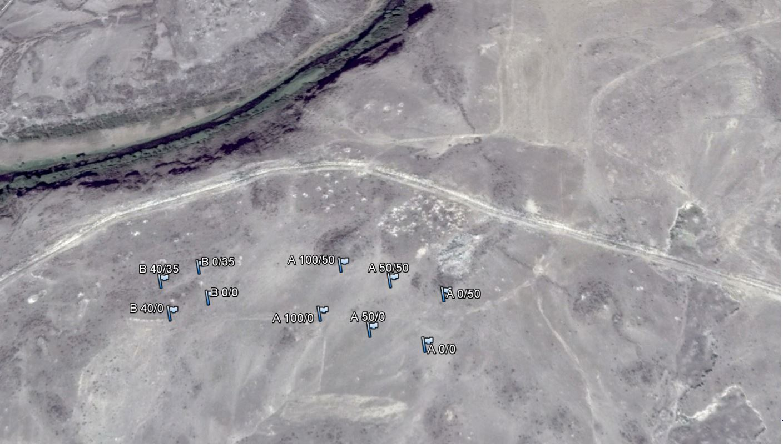
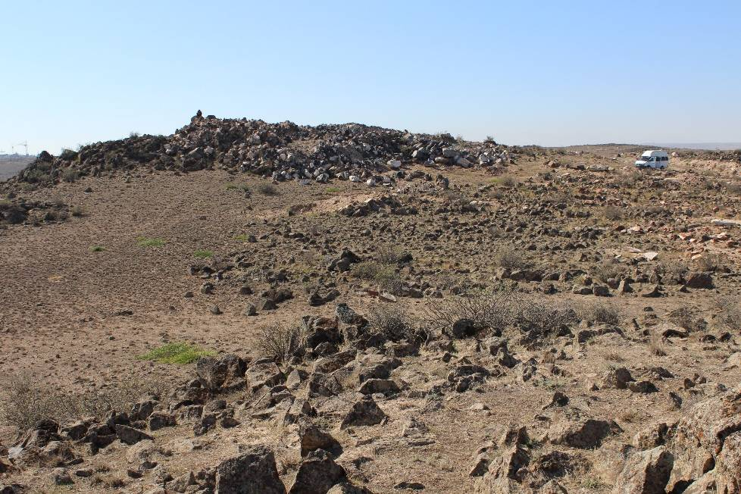
Case studies
Aygeshat site
continuously destroyed site by locals
mythical hillfort site/graves
MAG+DEMP
„B“
„A“

Slide 14
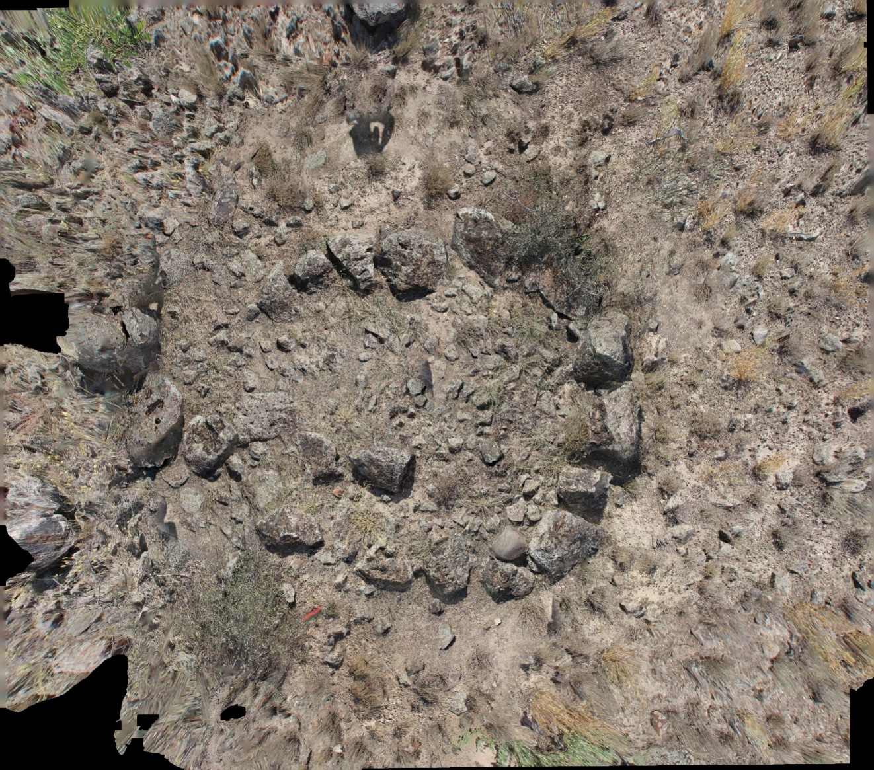
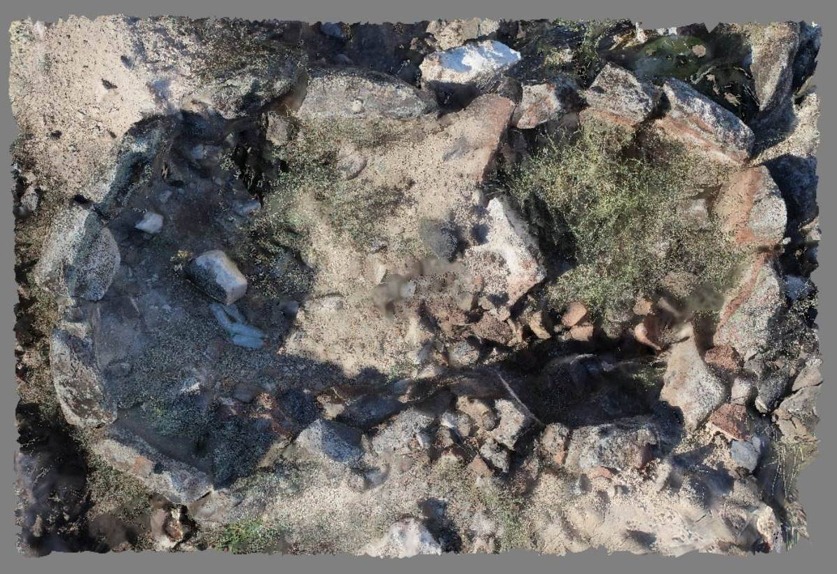
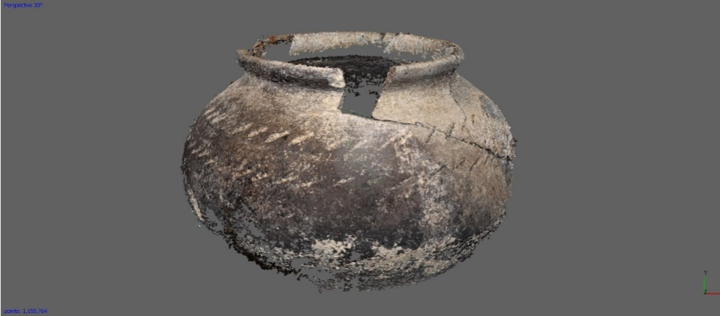
Geophysical methods
Aygeshat site

Slide 15
Geophysical methods
Aygeshat site
mS/m
conti

Slide 16
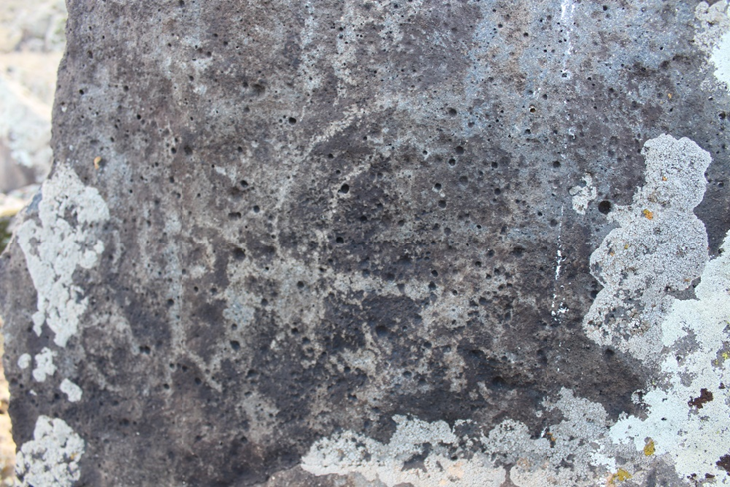
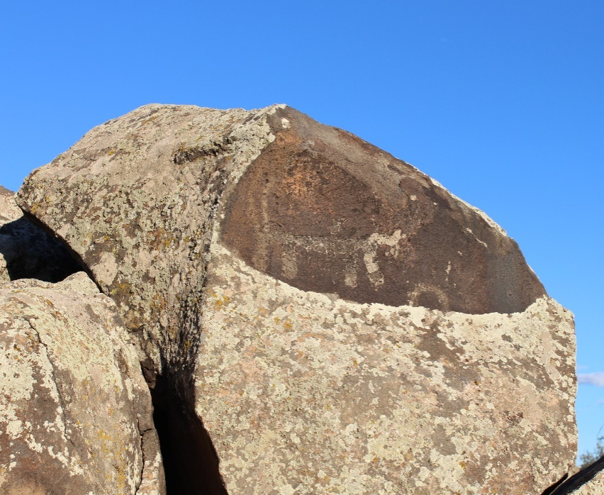
Case studies
Lernamerdz site
Manifestation of prehistorical activities, ring-structures

Slide 17
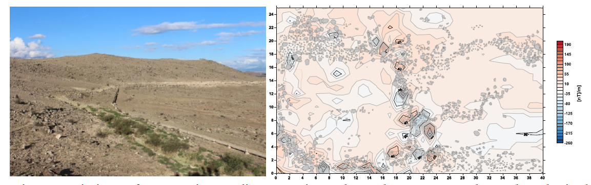
Case studies
Magnetic gradients registered at the Lernamerdz archaeological site

Slide 18
Conclusion
DEMP and magnetometry - quick archaeological survey, even in non-favourable conditions of highly resistive volcanic rocks
we mostly worked with the lowest calibrated depth of 1.8 m, which was less noised
Magnetometry - interesting results in case of the gradient measurements
comparing to the DEMP results the magnetometry described deeper structures at the sites and was not that sensitive to the noise sources
it would be interesting to uncover some of the geophysical anomalies, but…

