Slide 1



Workshop 1
(Prague, 30/Sep - 01/Oct 2019)
Twelve centuries long iron smelting pollution record – A unique archive
of mining and industrial history at Moravian Karst
by Milan Gazdić,
Jaroslav Kadlec,
Hana Grison
Topic 2 (Integrated approaches combining geophysics and soil science at archaeological sites)
This research was realized in scope of networking support of the COST Action SAGA as a Short Term Scientific Mission and with a support of the program INTER-EXCELLENCE of the Ministry of Education, Youth and Sports of the Czech Republic (MEYS), grant No. LTC19029.

Slide 2

Aims of the study
- examination of pollution record
- assessment of differences between ancient and recent magnetic pollution
- explanation of human impacts to the local environment

Slide 3
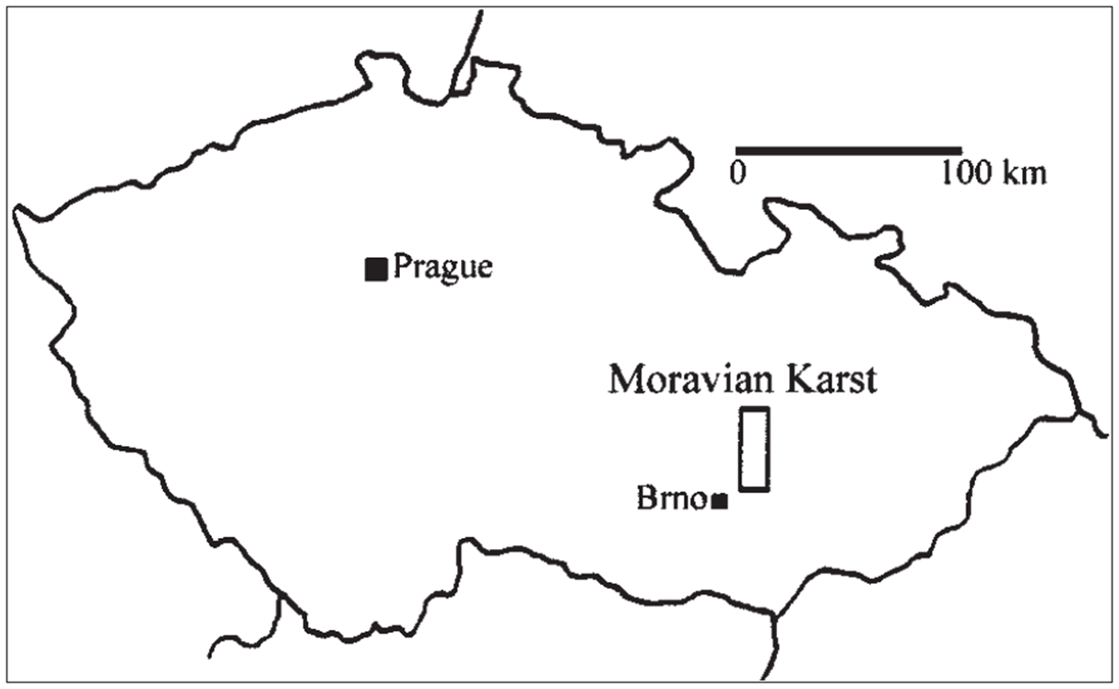
Study area
Germany
Poland
Austria
Slovakia

Slide 4
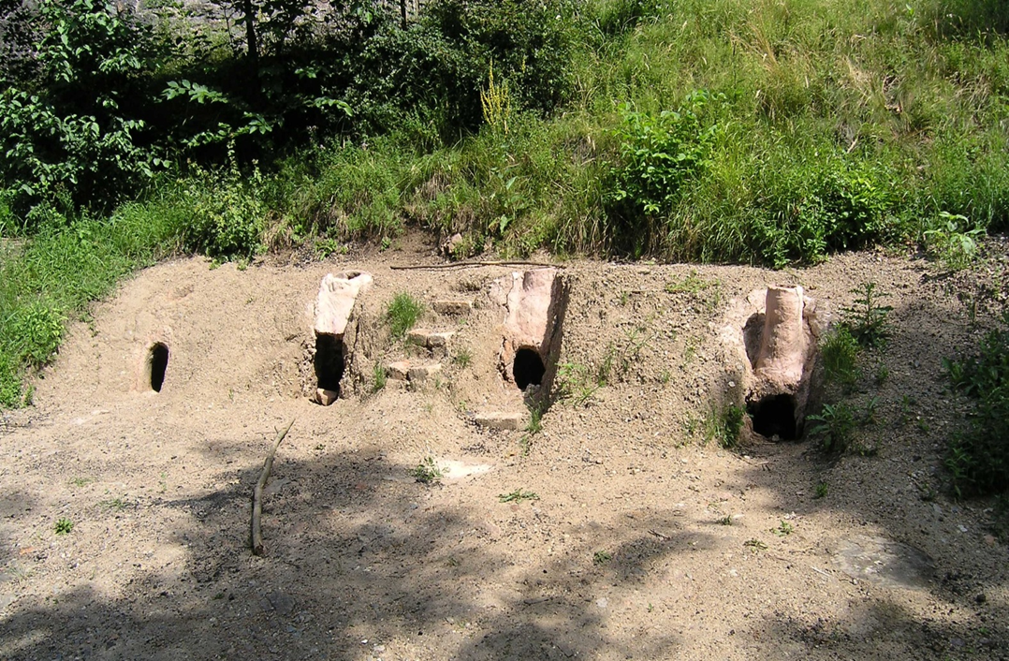
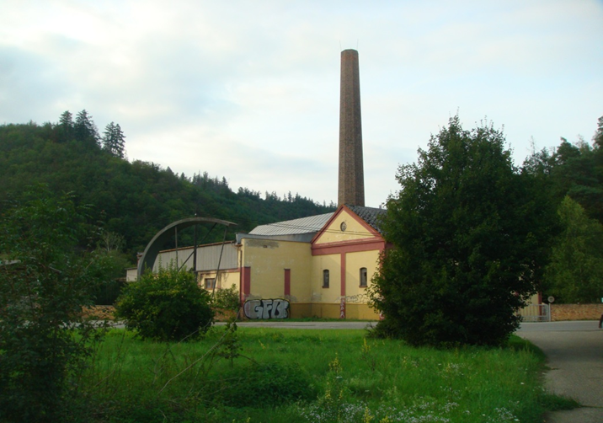
Differences
Primitive 8-10th century
Modern 18-19th century

Slide 5
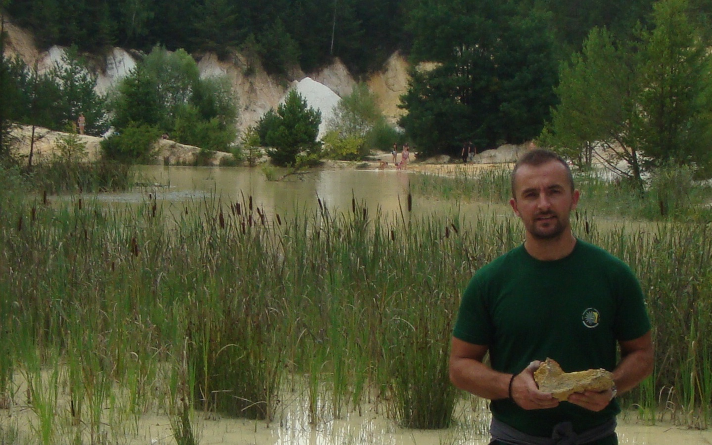
Ore source

Slide 6
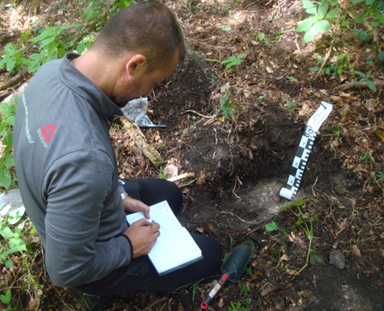
Field work
-Topsoil magnetic susceptibility was measured by using Bartington MS2, pocket meter SM30 (ZH Instruments)
-Vertical distribution of magnetic
susceptibility was measured up
to 40cm using SM400

Slide 7
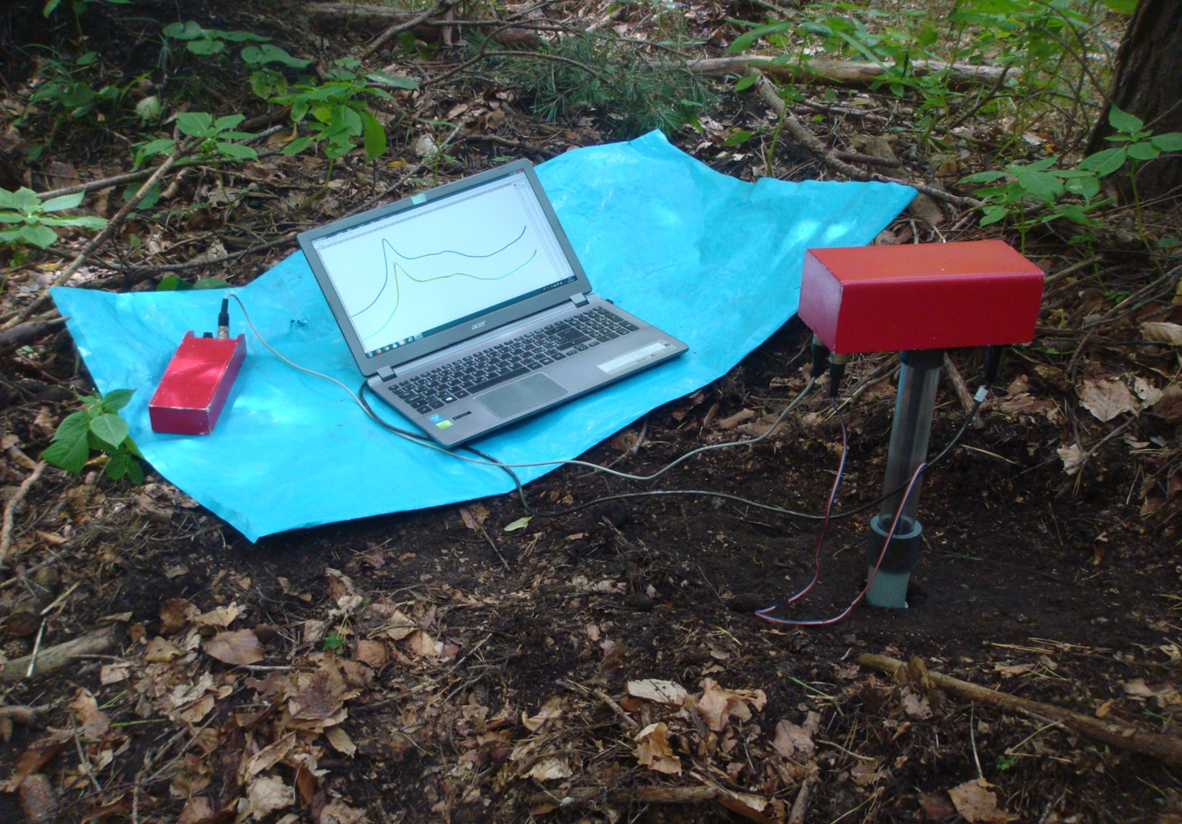
SM 400
-18 sampling points

Slide 8
Laboratory work
Sample preparation by sieving using 0.5 mm sieve, preparation of magnetic extracts using permanent magnet;
Measure of magnetic susceptibility under different frequencies (AGICO Kappabridge MFK1-FA)
Measure of temperature-dependent magnetic susceptibility (AGICO KLY-4S Kappabridge with CS3/CSL Furnace Apparatus)
Hysteresis and remanence properties (ADE Corporation, Vibrating Sample Magnetometer EV9 VSM 2900 )
Summary of Methods | No. of samples
MS under different frequencies | 42
Temperature-dependent MS | 8
Hysteresis and remenence | 15
MS of cores – by MS2C | 18

Slide 9
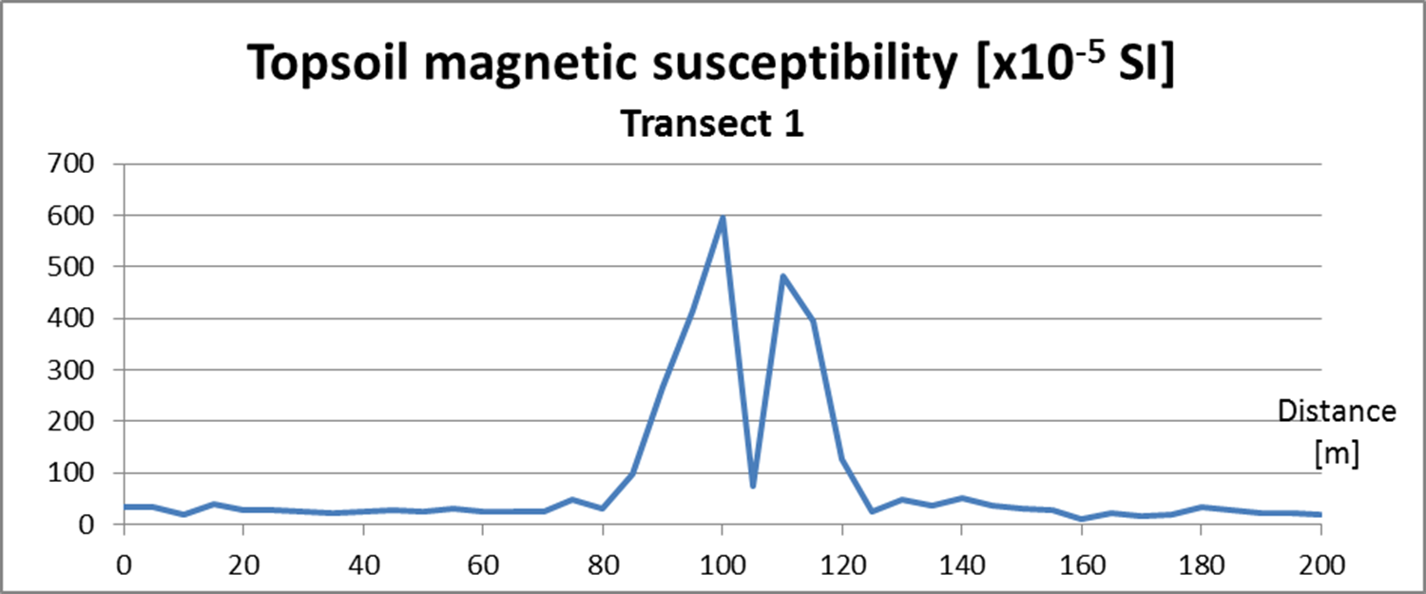
Results - Magnetic mapping
-transect 1 was 200 m long
-measurement was performed at each 5 m
-Bartington MS2

Slide 10
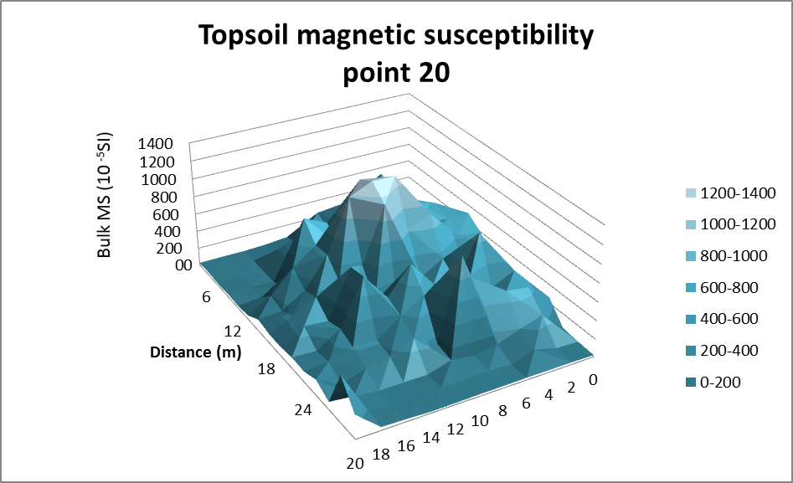
Results - Magnetic mapping
Testing of the Method of magnetic mapping in
measurement network 20x28 m,
measurement grid at each 2 m

Slide 11
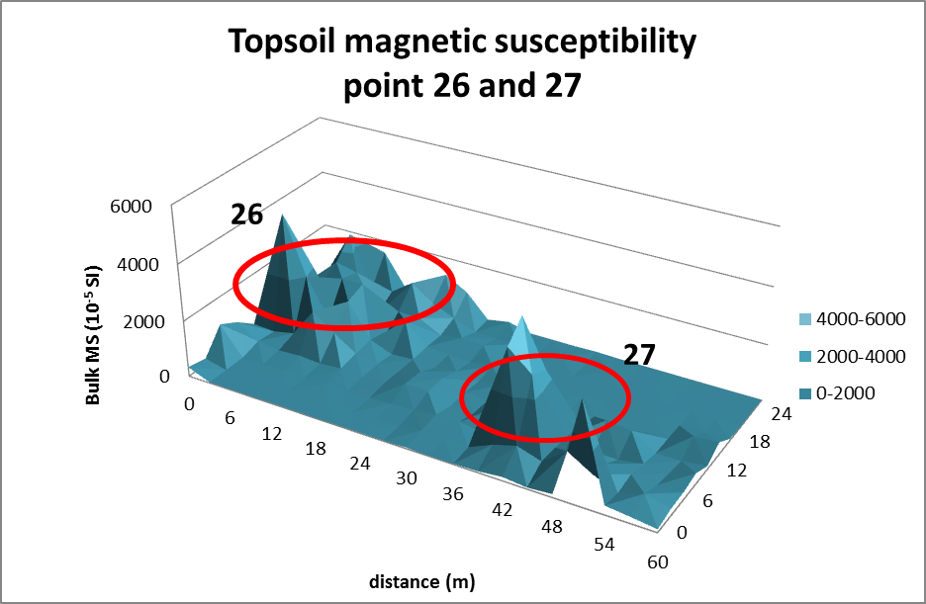
Results – Magnetic mapping
Testing of the method of magnetic mapping in network
27 x 60 m,
measurement performed at grid of 3 m

Slide 12
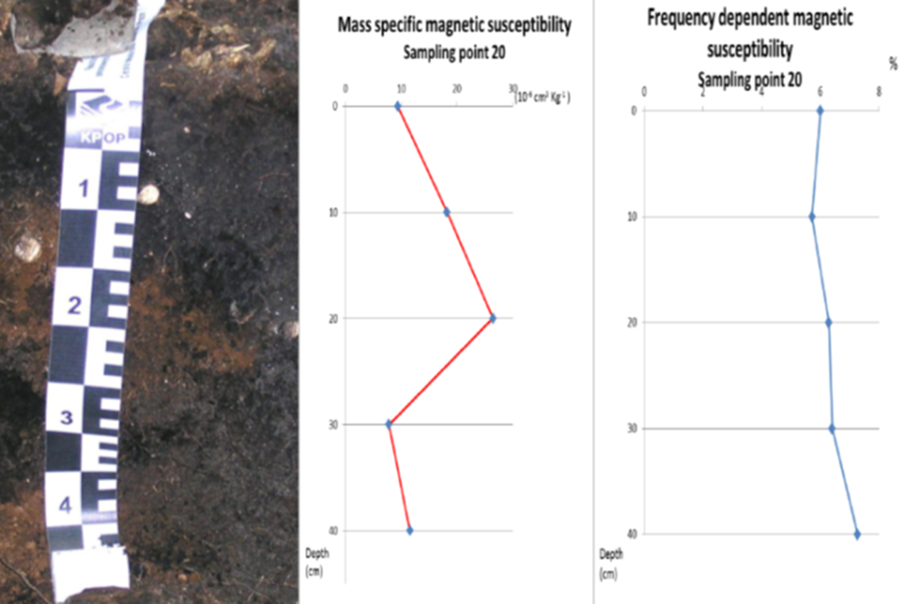
Results
Soil profile near to medieval furnace

Slide 13
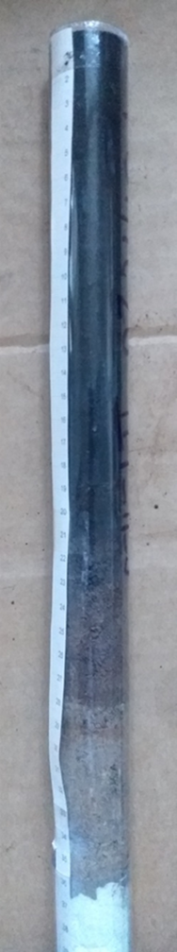
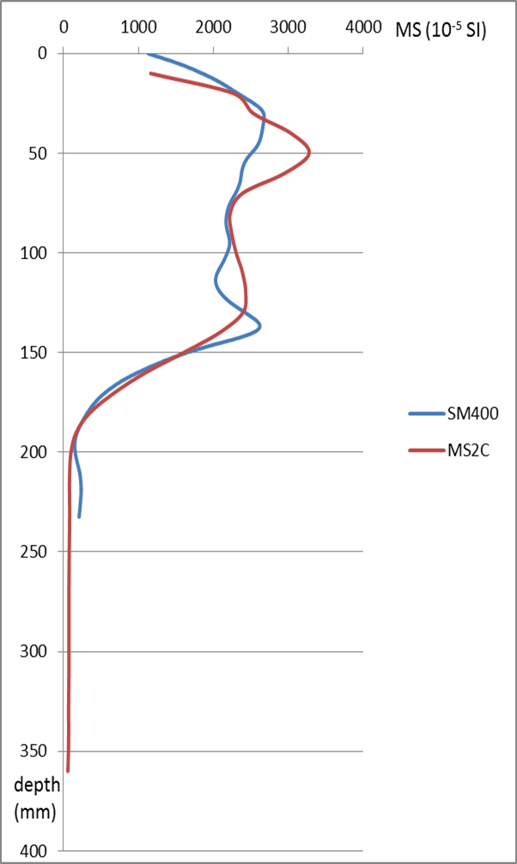
Results
Comparison of the vertical distribution of Magnetic Susceptibility measured in-situ and in laboratory

Slide 14
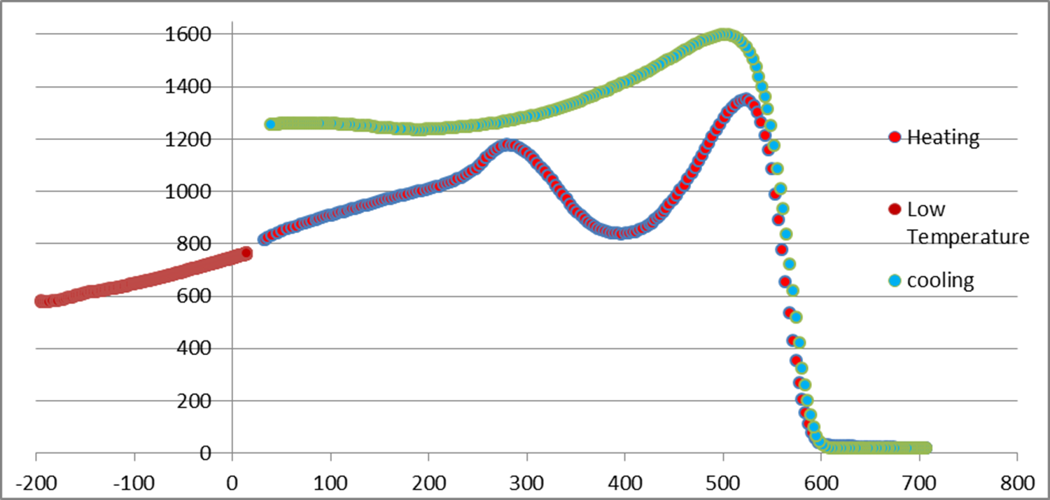
Results - Magnetominerology
Curie temperature
Verwey transition
-Curie temperature of magnetite at 580°C
-Verwey transition of magnetite at -150°C

Slide 15
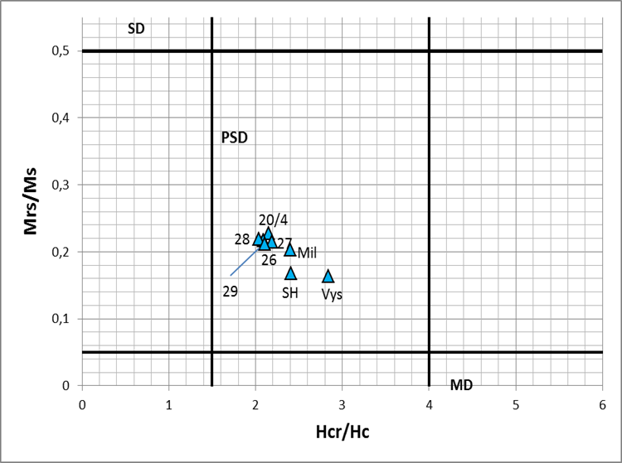
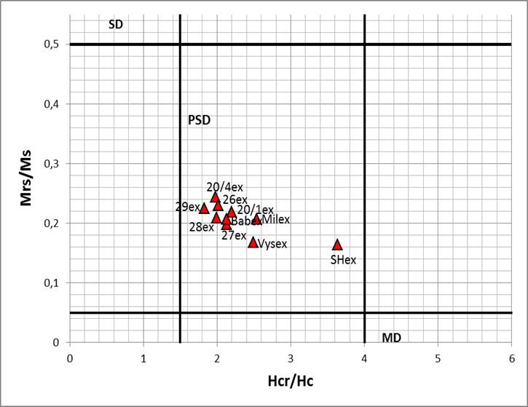
Results – magnetic grain size
Day plot composed for samples of soil fraction <0.5 mm.
Day plot composed for samples of magnetic extracts.
-magnetic particle are pseudo single domein particle size

Slide 16
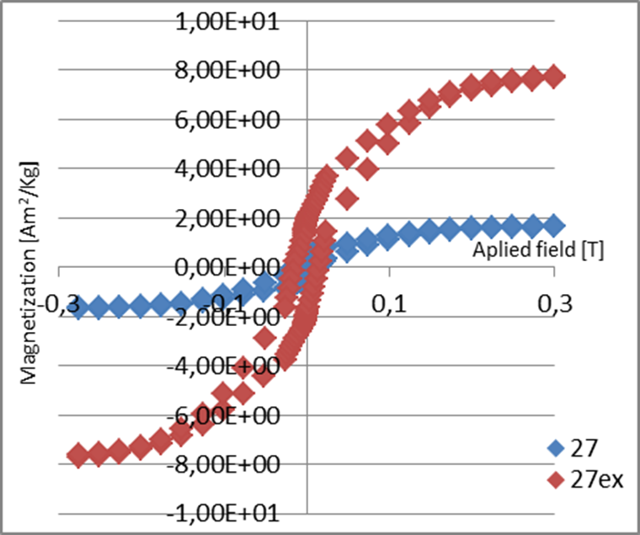
Results - hysteresis curves
Comparison of hysteresis curves of soil samples (fine fraction) and its magnetic extract at sampling point 27 in range of applied field - 0.3 T and 0.3 T

Slide 17
Conclusions: examination of pollution record
  Method of magnetic mapping can be efficiently used
  as an indicator of soil pollution in the investigated area because:
High values of magnetic susceptibility are connected to iron smelting activities which were performed in different time periods.
  Industrial magnetic spherical particles, produced of iron smelting, were found.
    Magnetite is dominating magnetic mineral in all investigated samples.

Slide 18
Conclusions: assessment of differences between ancient and recent magnetic pollution
In magnetic extracts, the industrial magnetic spherical particles were found, both rich in magnetite and glass, produced of iron smelting.
In material from Medieval iron smelting place
the presence of glass particles in a larger quantity indicates probably more primitive smelting technology.

Slide 19
To be continued
Explanation of human impacts to the local environment :
Effect of deforestation
Magnetic analysis of samples from modern industrial zones and from areas out of forest zones
Chemical composition of magnetic spherules

Slide 20
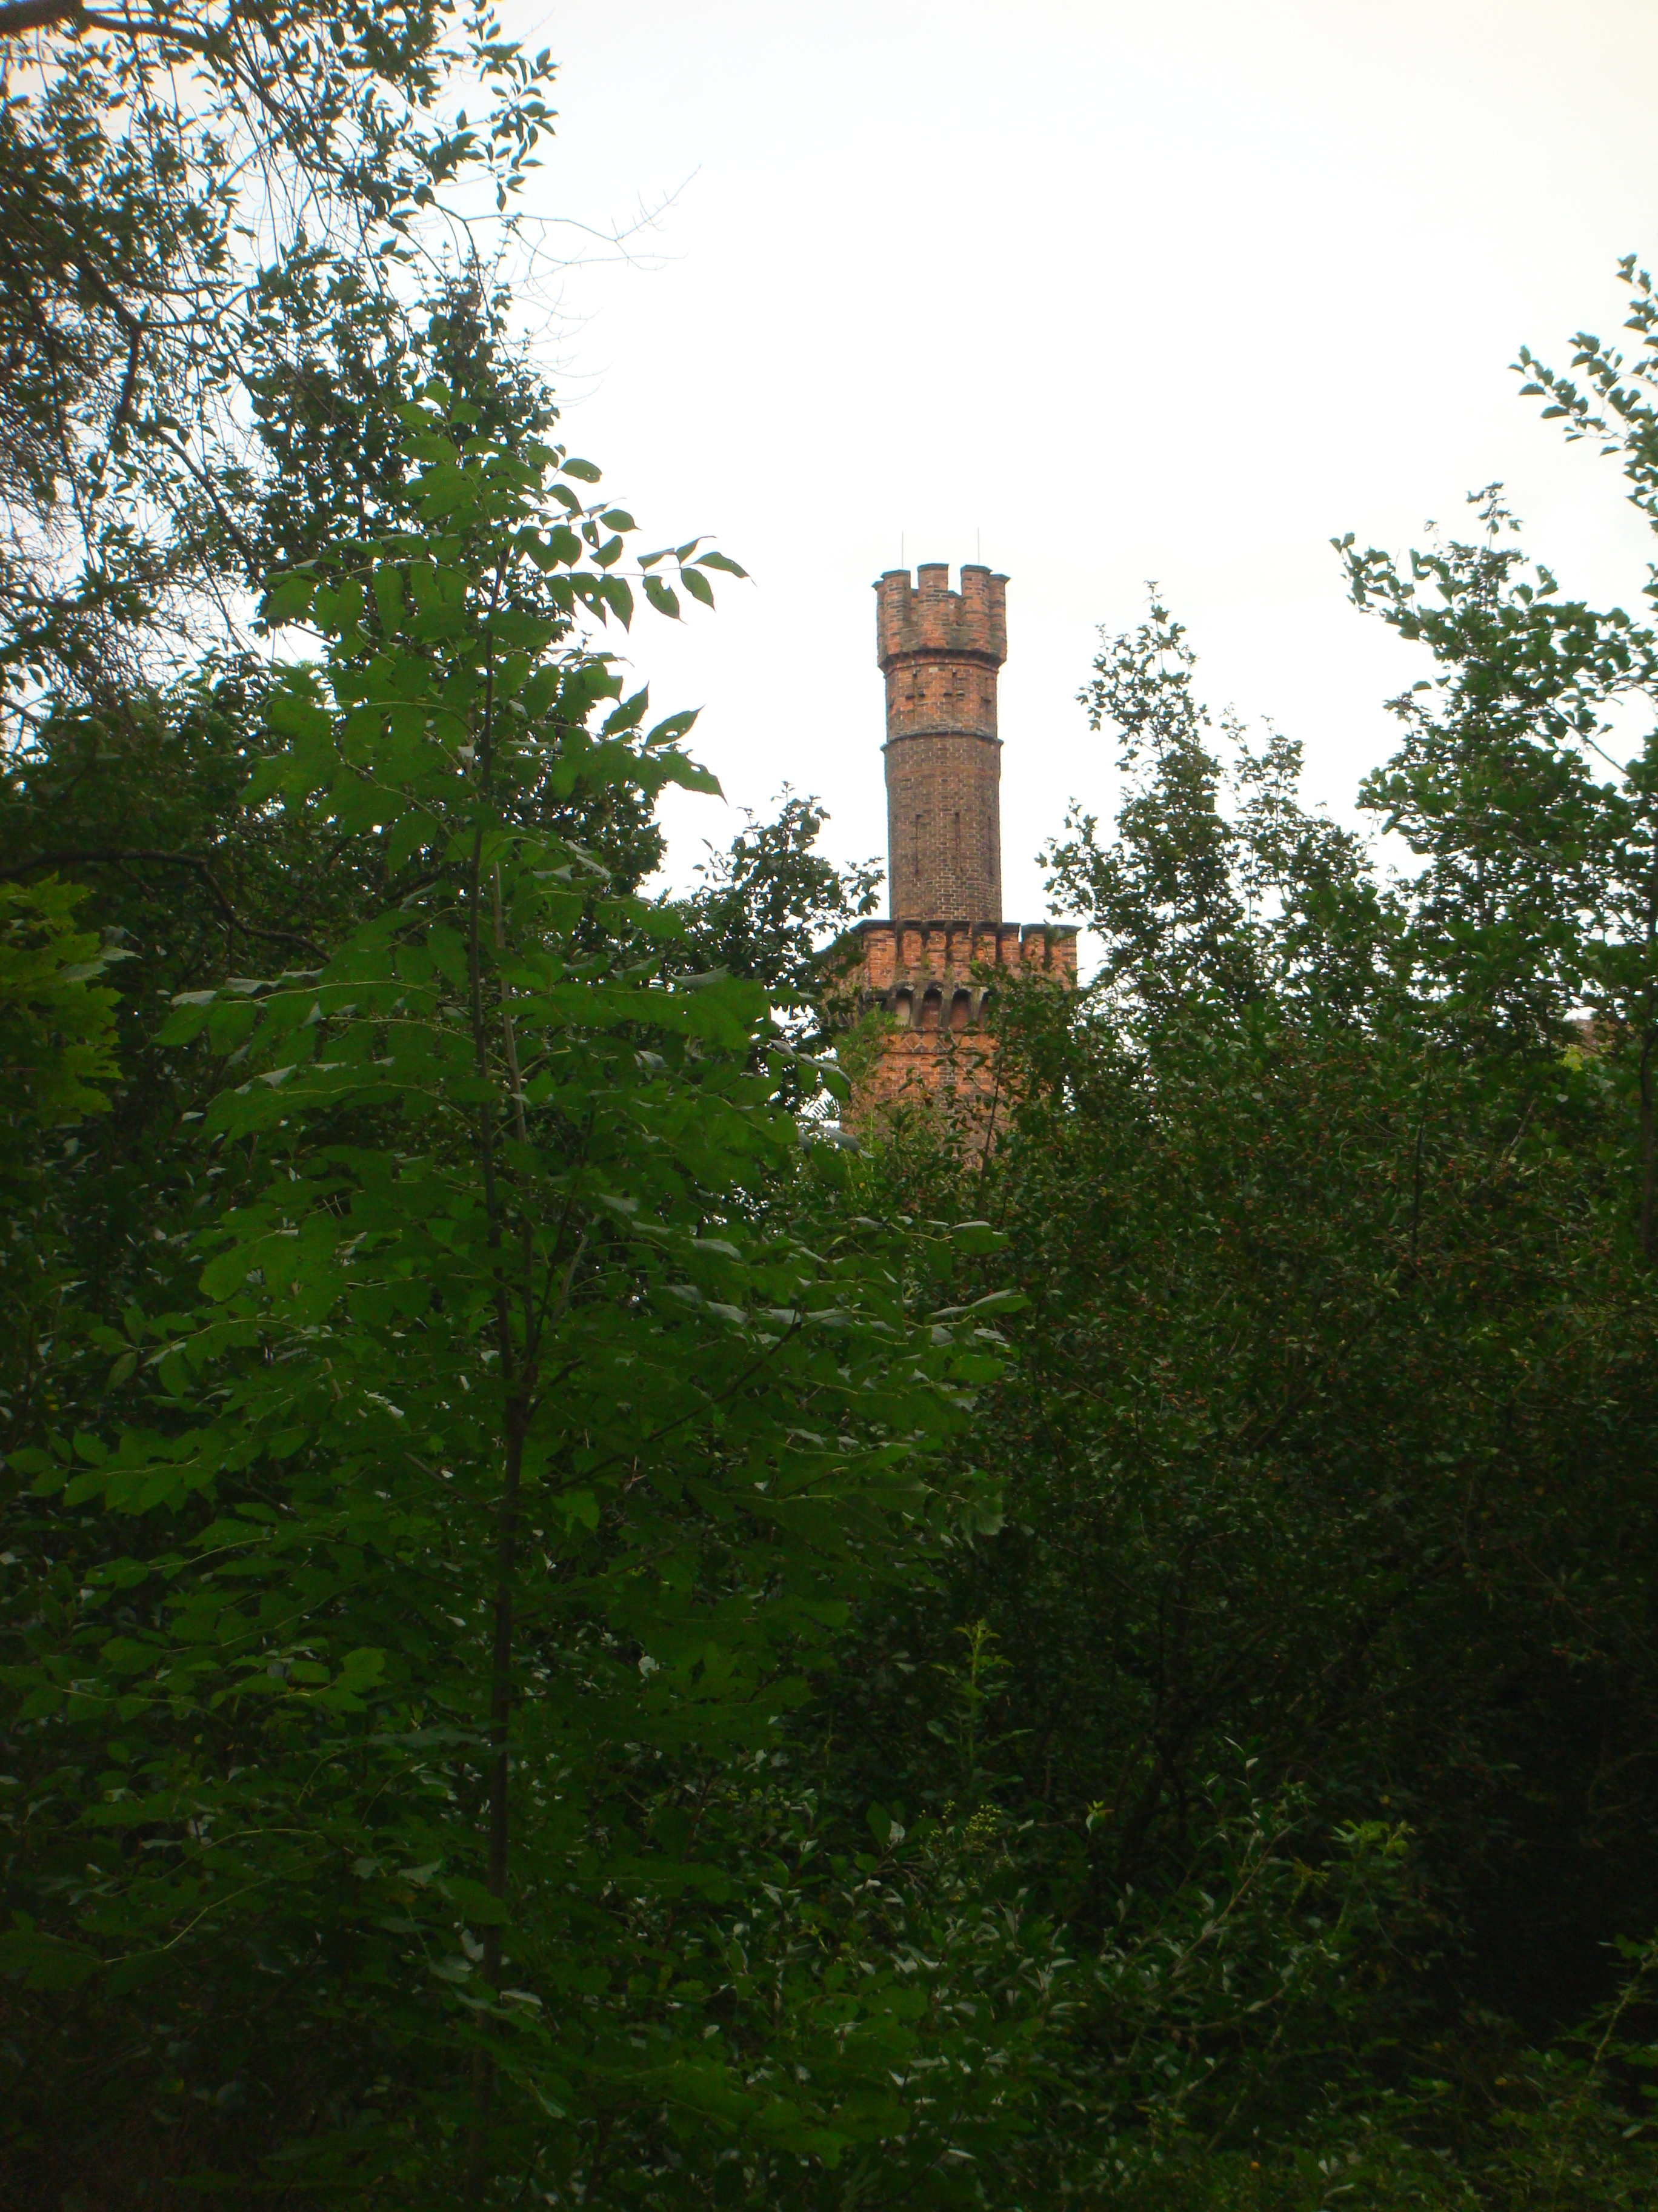
Thank you for your attention!

