Slide 1

Workshop 1
(Prague, 30/Sep - 01/Oct 2019)
MAGNETIC SUSCEPTIBILITY – WHAT IS IT?
PHYSICAL PRINCIPLES
by Eduard Petrovsky
Topic 1 (Developing a common ground)

Slide 2

Aim & Objectives
What is magnetic susceptibility?
Equation
Meaning
Mechanisms
Measurements

Slide 3


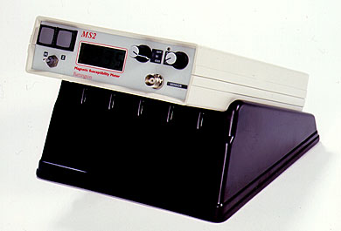
What is it?
The number on display of Bartington, when we press the button

Slide 4
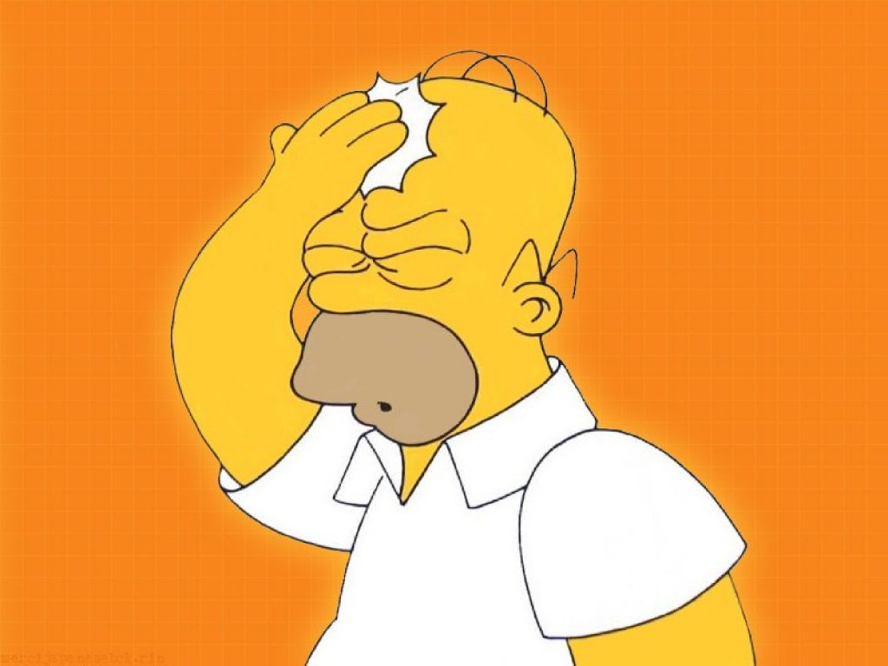
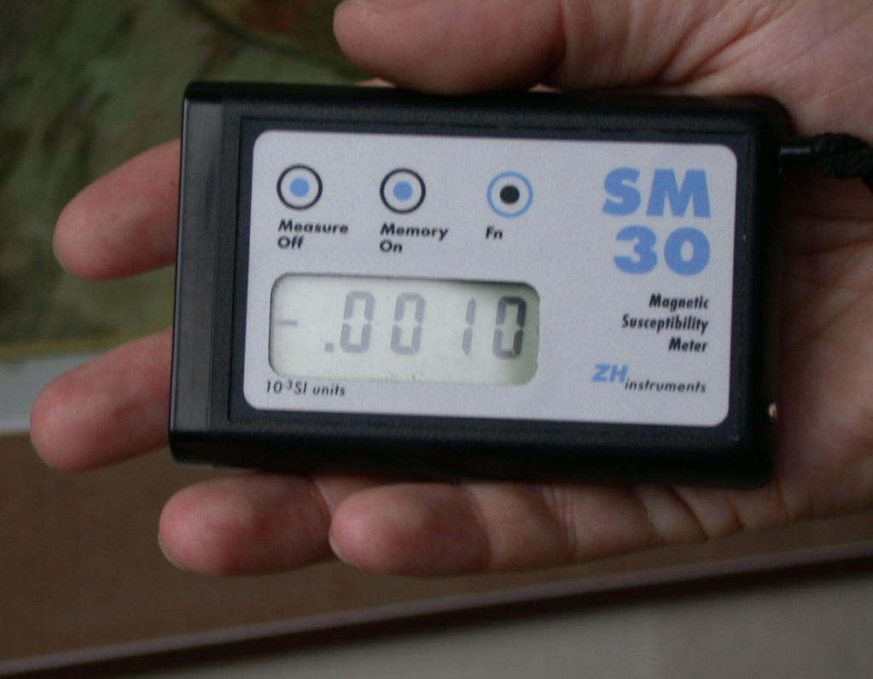
What is it?
But … what does it mean???

Slide 5
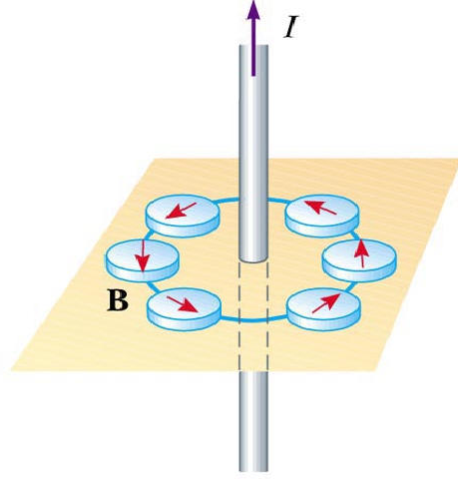
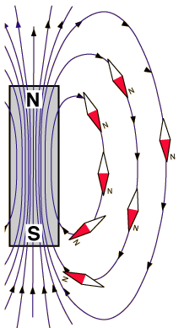
Equation

Slide 6
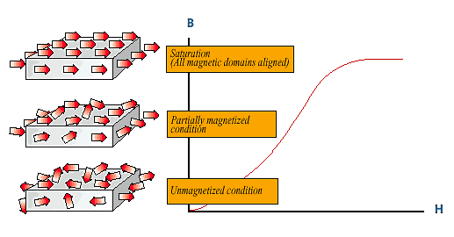
Equation
B = μ₀(H + M) in SI, or B = H + 4πM in cgs
and
M = μ₀κH

Slide 7
Meaning
B = μ₀(H + M) in SI, or B = H + 4πM in cgs
and
M = μ₀κH
B is sometimes considered as more fundamental. It depends on the rate of change of magnetic flux (often called flux density, lines of force cutting a particular area). Thus, sum of M and H is important namely inside ferromagnets. Outside a magnetized material M = 0, B and H are parallel and
B/H = μ₀, the permeability of vacuum (= 4π × 10-7 H/m;
= 1 in cgs). Numerical values of B (in Tesla in SI and gauss in cgs) and H (in A/m in SI and oersted in cgs) are very different for the same field.
Magnetic susceptibility (κ or χ) represents …

Slide 8
Meaning
Magnetic susceptibility is used to classify substances with respect to their behavior in magnetic field.
Diamagnetism
Paramagnetism
Ferromagnetism

Slide 9
Meaning
Diamagnetism:
Moving charge – electron – experiences in a magnetic field B Lorentz force ev × B. As a result, due to gyroscopic effect the orbit axis makes precession about B – Larmor precession, which represents additional motion of the electric charge, producing a negative induced magnetic moment.
Magnetic susceptibility:
χ_{d} = M/H = (nμ_{d})/(B/μ₀) = -(μ₀nZe²r²)/(6m_{e})
n is the number of atoms, Z number of electrons, and r is the average orbit radius. This is classical Langevin definition of diamagnetism.
Most non-iron bearing minerals, such as quartz, calcite, feldspars, as well as water, are purely diamagnetic.
Small, negative and temperature independent
This property is proper of all materials.

Slide 10
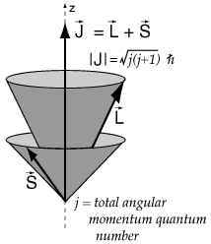
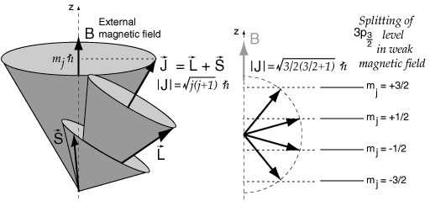
Meaning

Slide 11
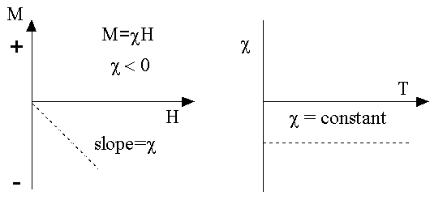
Meaning

Slide 12
Meaning
Paramagnetism:
At room temperature spontaneously disordered permanent magnetic moments (of atoms) are (partially) aligned in the direction of applied field B. Only thermal perturbations prevent perfect alignment of the moments with B.
In classical theory, magnetic moment M of an ensemble of atomic moments μ is determined by
M = nμ L(α) = nμ [coth(α) - (1/α)]
where α = μB/kT and L(α) is the so called Langevin function. The basic meaning is that M is positive, i.e. M and B are parallel, and decreases with increasing temperature.
Because atomic moments μ are small, for most fields and temperatures μB << kT, the alignment is slight and M is a fracture of theoretical total saturation moment nμ. At ordinary temperatures, a field of some 100 T is needed to reach this saturation.

Slide 13
Meaning
Paramagnetism:
Magnetic susceptibility: By expanding L(α) into series and neglecting “very” small members, we get paramagnetic susceptibility as
χ_{p} = M/H = (nμ²μ₀)/(3kT) = C/T
Curie law, C = (nμ²μ₀)/(3k) is Curie constant.
Most iron-bearing sulphides, carbonates and silicates are paramagnetic, with susceptibilities (absolute values) 10÷100 times larger than those of diamagnetic minerals.

Slide 14
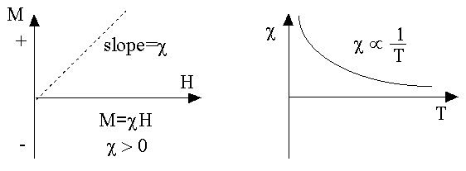
Meaning

Slide 15
Meaning
Ferromagnetism:
Field of some 10⁻² T (100 G) - enough to reach saturation magnetization in some materials. Moreover, when the field is removed, a non-zero remanent magnetization remains. Weiss in 1907 postulated the existence of an internal “molecular” field H_{m} = λM so strong that it almost perfectly aligns atomic moments.
If there is no external field, H_{m} is the only acting field on μ and
E_{m} = -μ₀μ H_{m} = -μ₀μ λMcosφ ⇒ M = nμL(α)
with α= (μ₀μ λM)/(kT) ⇒ M = (kTα)/(μ₀μ λ)
Simple estimate of H_{m} gives value of about 8.5 × 10⁶ Oe, which represents such a strong field that it cannot be due to magnetostatic interactions between neighboring atoms (this is about 3000 Oe).

Slide 16
Meaning
Ferromagnetism:
With increasing temperature, decrease in M causes also decrease in H_{m}, thus provoking further decrease in M. At Curie temperature T_{c} – transition from spontaneously ordered ensemble to paramagnetic disorder.
For T above T_{c}, spontaneous alignment of magnetic moments vanishes due to thermal excitations and susceptibility behaves like in case of paramagnetism, but with individual atomic moments coupled rather than individual.

Slide 17
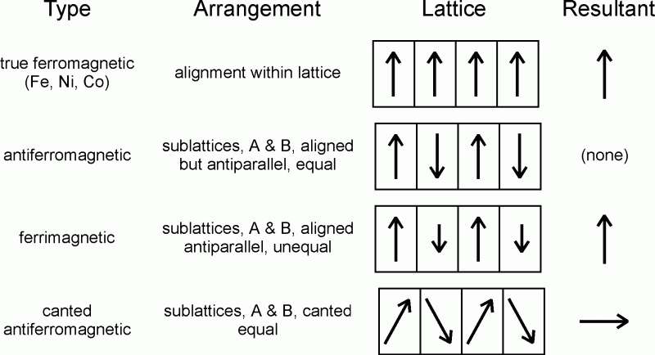
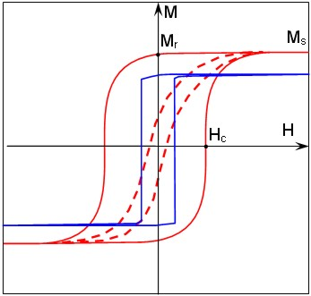
Meaning

Slide 18
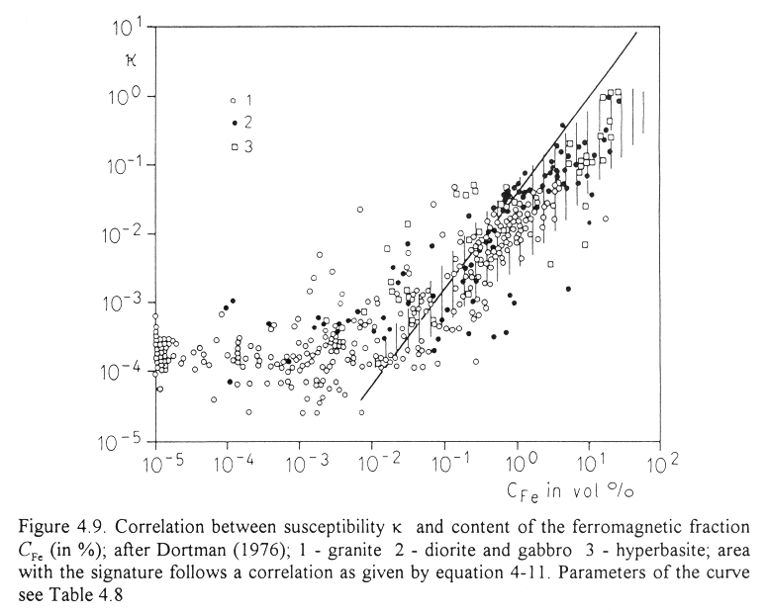
Meaning

Slide 19
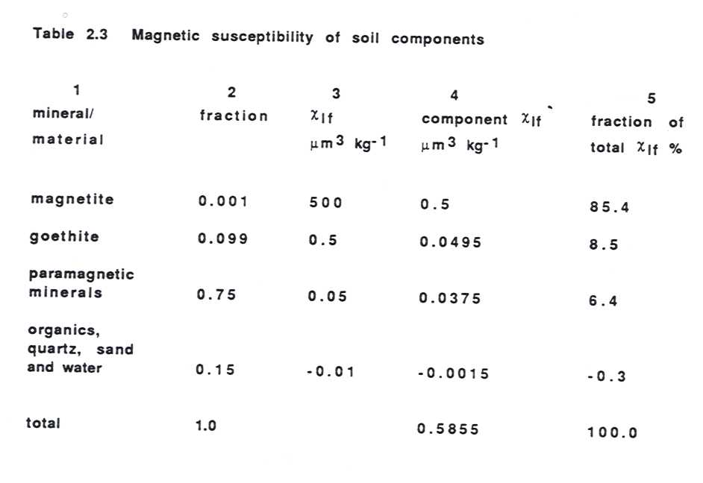
Meaning

Slide 20
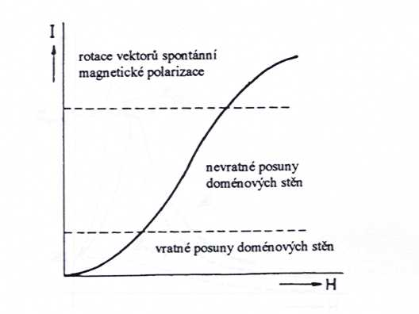
Mechanisms
Rotation of vectors of atomic magnetic moments
Irreversible movement of domain walls
“Barkhausen jumps”
Reversible movement of domain walls

Slide 21
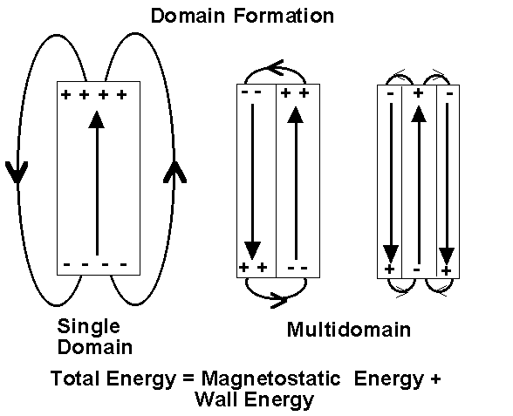
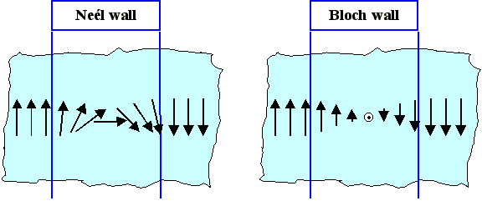
Mechanisms

Slide 22
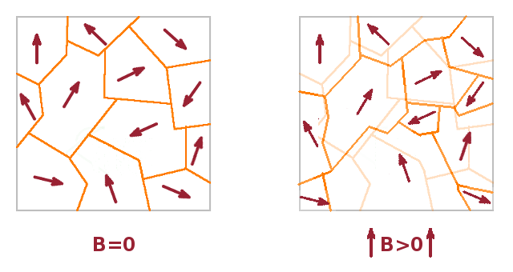
Mechanisms

Slide 23
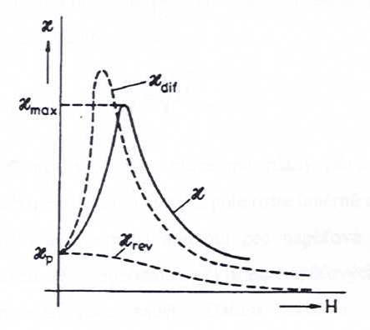
Measurements

Slide 24
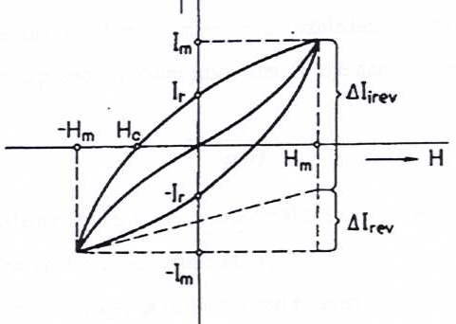
Measurements
Rayleigh region
I = μ₀κ₀H + αH ²
= I/(μ₀H) = κ₀ + (α/μ₀)H

Slide 25
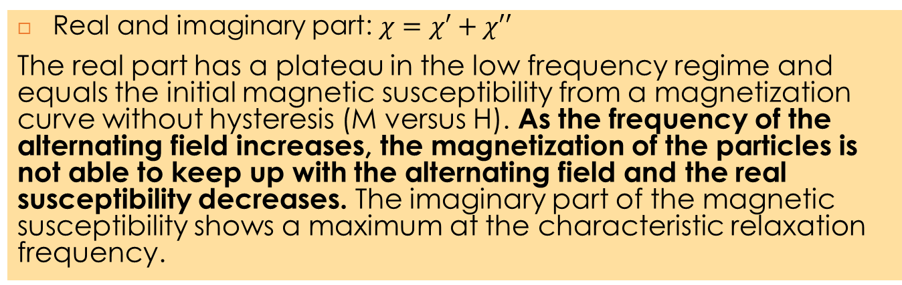
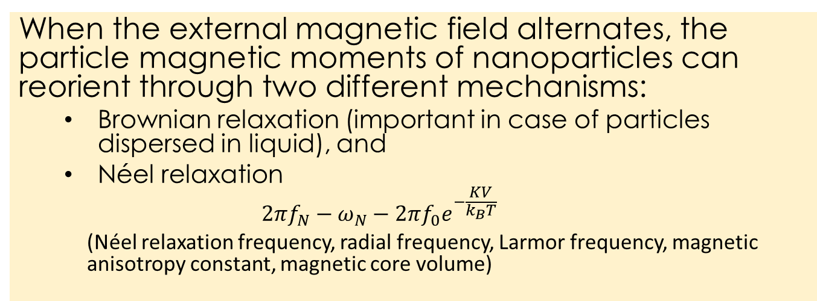
Measurements
When the external magnetic field alternates, the particle magnetic moments of nanoparticles can reorient through two different mechanisms:
  Brownian relaxation (important in case of particles dispersed in liquid), and
  Néel relaxation
    $$2πf_{N}−ω_{N}−2πf_{0}e^{−\frac{KV}{k_{B}T}}$$
    (Néel relaxation frequency, radial frequency, Larmor frequency, magnetic anisotropy constant, magnetic core volume)
  Real and imaginary part: $χ=χ′+χ′′$
The real part has a plateau in the low frequency regime and equals the initial magnetic susceptibility from a magnetization curve without hysteresis (M versus H). As the frequency of the alternating field increases, the magnetization of the particles is not able to keep up with the alternating field and the real susceptibility decreases. The imaginary part of the magnetic susceptibility shows a maximum at the characteristic relaxation frequency.

Slide 26
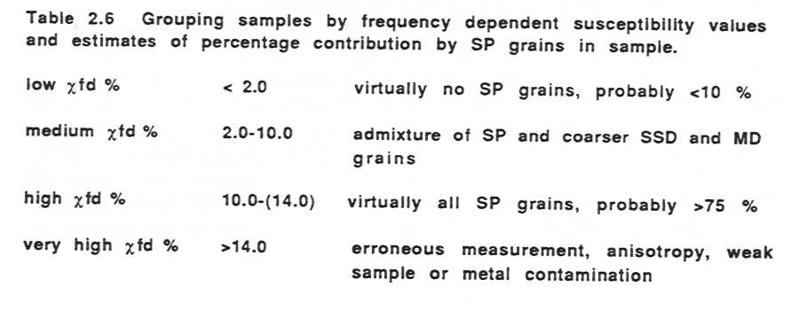
Measurements

Slide 27
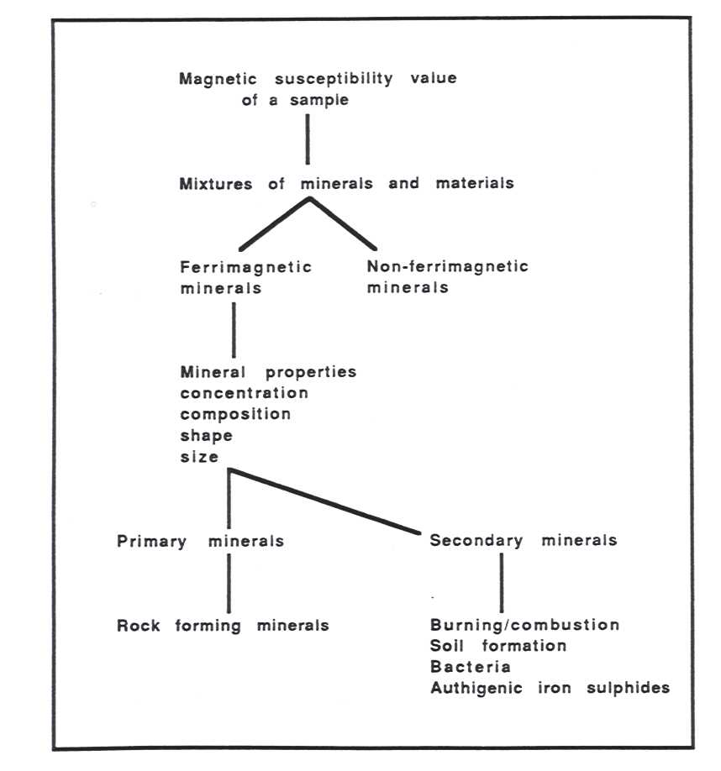

Measurements

Slide 28


Measurements
Border-zone Burghausen
(chemical industries)
40 km
40 km

Slide 29
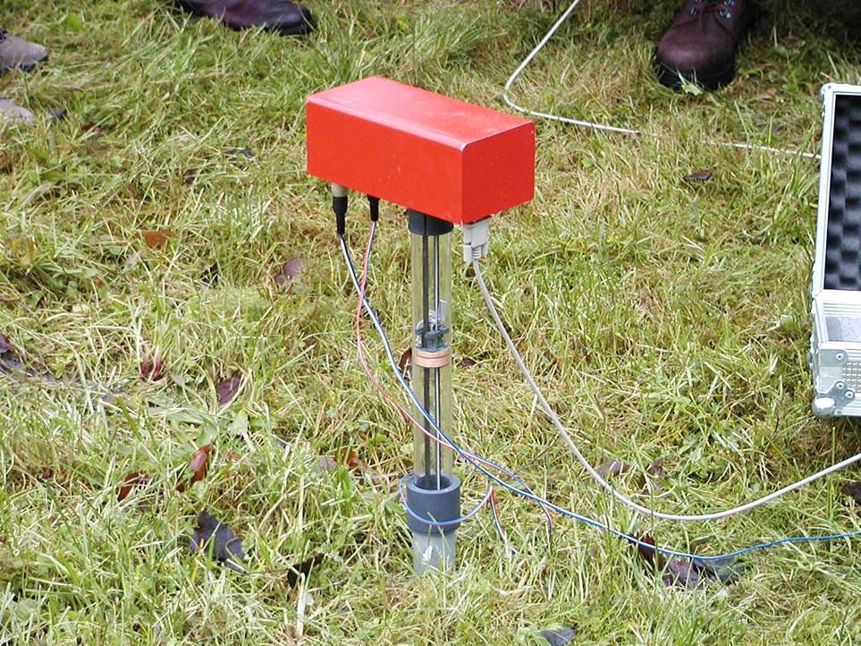
Measurements

Slide 30


Pros et Cons
High sensitivity relative to iron oxides
Easy to be measured
Fast
Flexible design
Cheap
Lot of data
Volume measurement
Penetration depth
Too many factors play role
Data representativeness
Data interpretation

