Slide 1
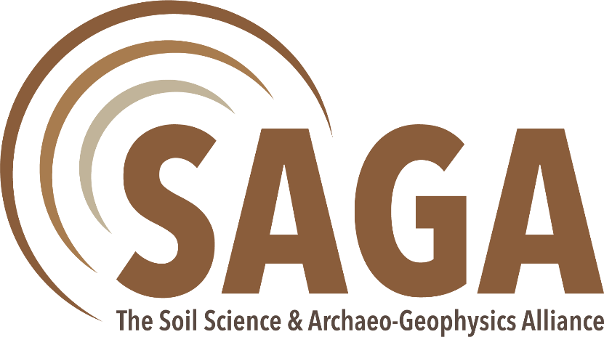
Workshop 1
(Prague, 30/Sep - 01/Oct 2019)
TRANSFORMATIONS OF ARCHAEOMAGNETIC MAPS BY MEANS OF HIGHER DERIVATIVES EVALUATION
by Roman PAŠTEKA
Comenius University, Bratislava, Slovakia
Topic 1 (Developing a common ground)

Slide 2

Content Archaeomagnetic Maps and Higher Derivatives
introduction
higher derivatives and their ratios (as edge detectors)
stabilisation of numerical derivatives (regularization)
optimum regularization parameter selection (C-norms)
examples of regularized higher derivatives ratios
conclusions and outlooks

Slide 3
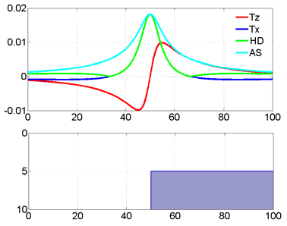
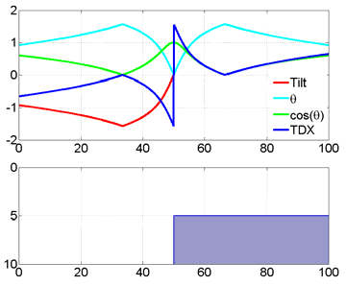
Introduction Archaeomagnetic Maps and Higher Derivatives
magnetometry belongs to the most important archaeogeophysical methods,
beside the fact that we often use devices for magnetic vertical gradient acquisition
(with better spatial resolution than TMI field), there are still often used
higher derivatives (and their ratios) for better delineation of object borders.
(modified figures from from Fairhead and Williams, 2006;
red curve in the left-hand figure is the original field)

Slide 4
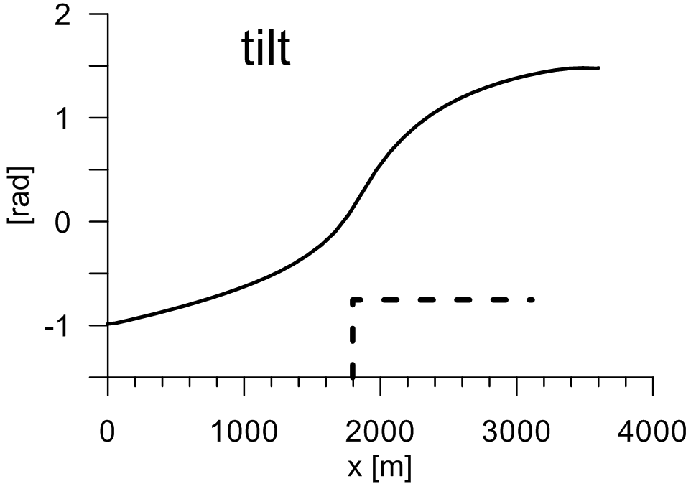
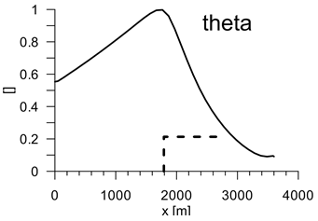
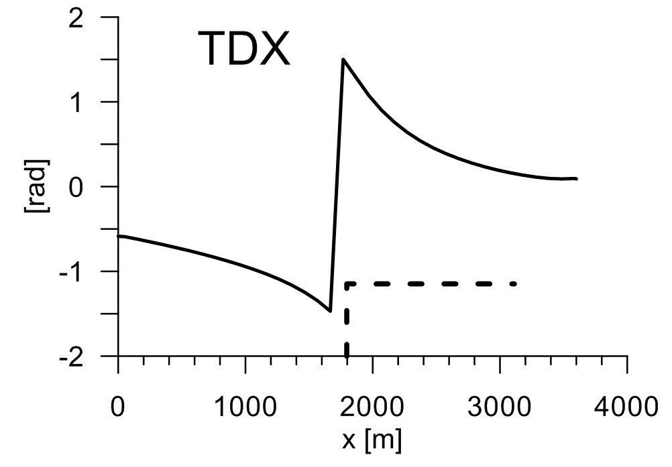
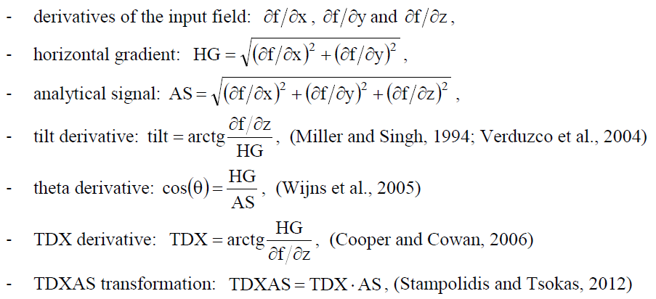
Higher derivatives (and their ratios)
horizontal gradient
analytical signal
tilt derivative
several operations (ratios)
with higher derivatives were
published with the aim
to enhance anomalous
features in interpreted fields:

Slide 5
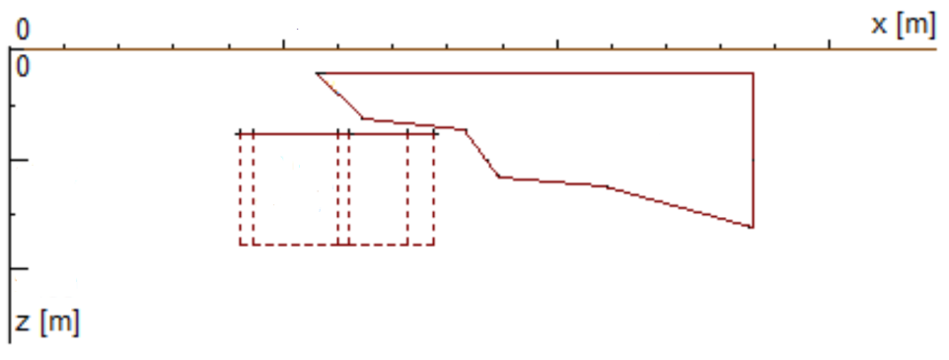
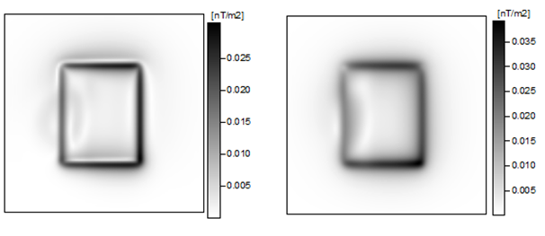
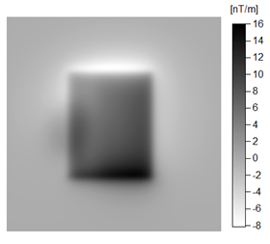
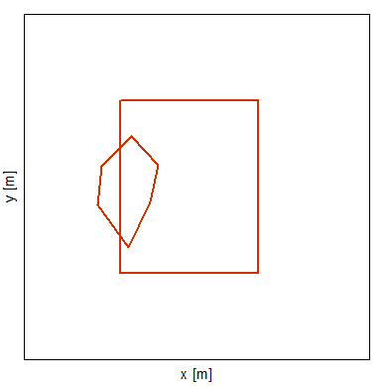
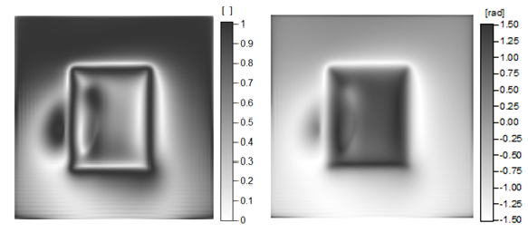
Higher derivatives (and their ratios)
synthetic model study: model with 2 overlaying prisms
front view
horizontal gradient
analytical signal
original field
(vertical gradient of TMI)
plan view
theta derivative
tilt derivative

Slide 6
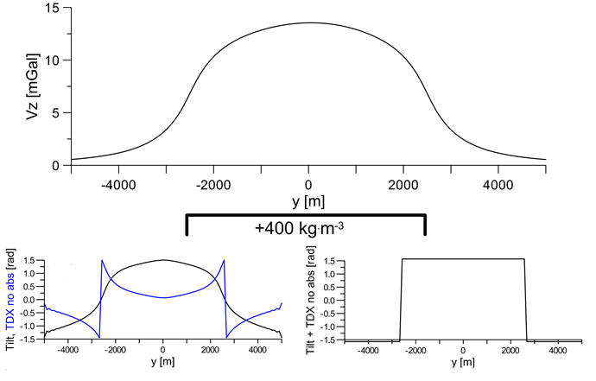
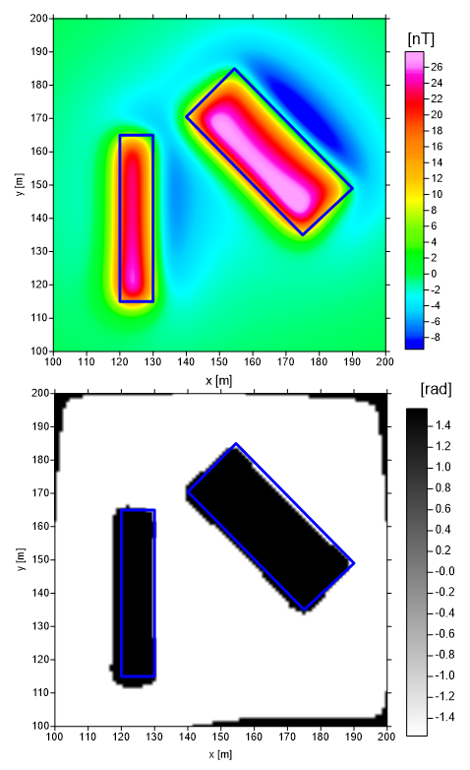
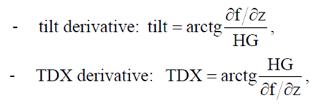
Higher derivatives (and their ratios)
synthetic model study: model - 2 separated prisms
a new (very simple) transform: Tilt derivative plus and TDX angle
reaches values +π/2 over sources
and -π/2 outside them

Slide 7
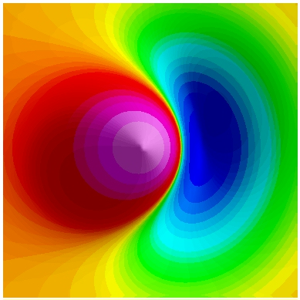
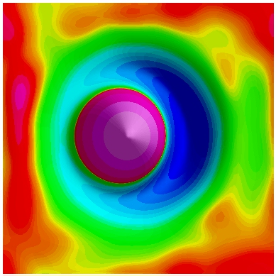
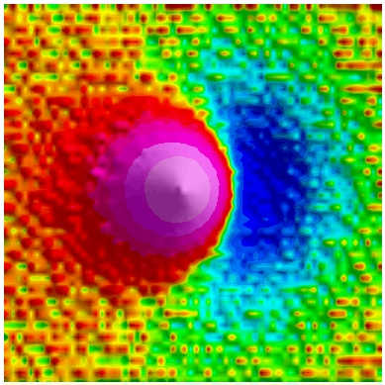
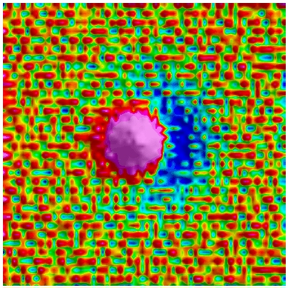
Problems with higher derivatives
strong noise/errors amplification during higher derivatives evaluation
(in other words – evaluation of numerical derivatives is an instable operation)
synthetic magnetic
field of a sphere
(without noise)
numerically
evaluated
vertical derivative
numerically
evaluated
vertical derivative
(intensive noise
amplification)
synthetic magnetic
field of a sphere
(with 5% Gaussian
noise)

Slide 8
One possible solution – Tikhonov regularization
Tikhonov regularization:
In a mathematical way it combines the classical solution with a smoothed solution – brings them both in an equilibrium stage.
α
classical solution smoothed solution
α – so called regularization parameter

Slide 9
One possible solution – Tikhonov regularization
The most important task in regularization techniques – selection of the optimum value of regularization parameter,
there exist a variety of methods, we use the so called C-norm approach (Tikhonov et al., 1968)
optimum value of α
(local minimum of the C-norm function)

Slide 10
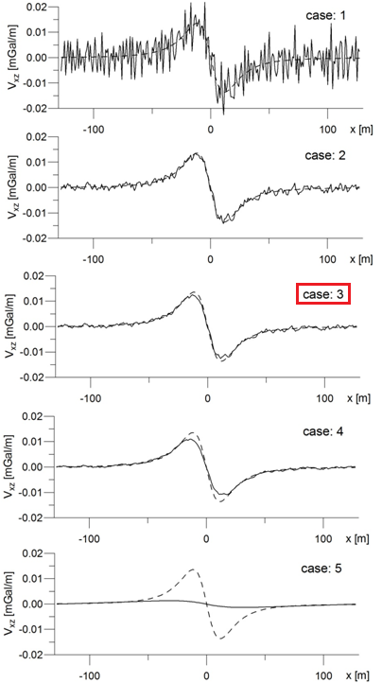
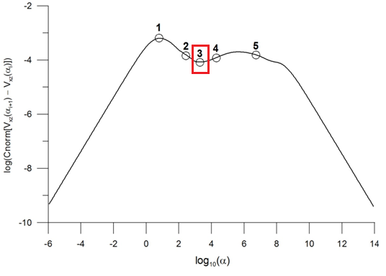
synthetic model study: 2D cylinder, gravimetry
original field
C-norm function analysis
(example for x-derivative of 1D gravitational acceleration field – a horiz. cylinder effect)
RESULTS
C-norm
optimum solution
under-regularized
solution
over-regularized
solution

Slide 11
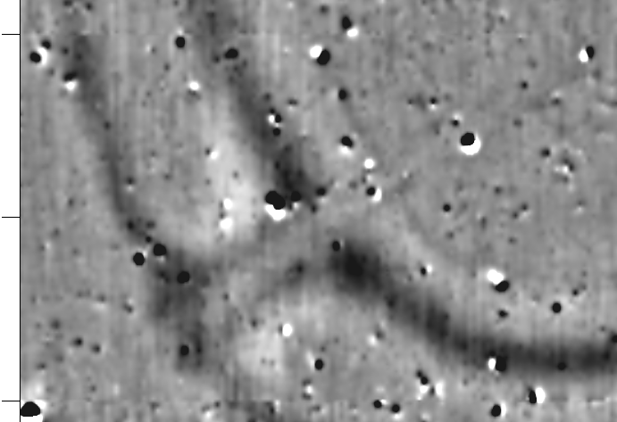
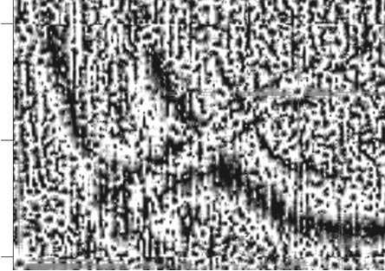
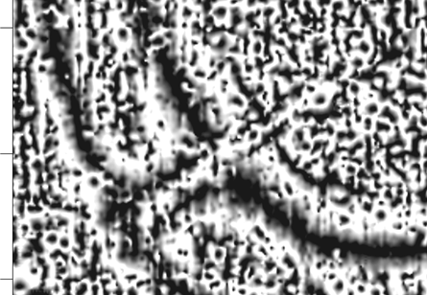
detail – original field
stable derivatives evaluation
(Tikhonov regularization)
- example
x-derivative (without regularization)
x-derivative (with regularization)

Slide 12
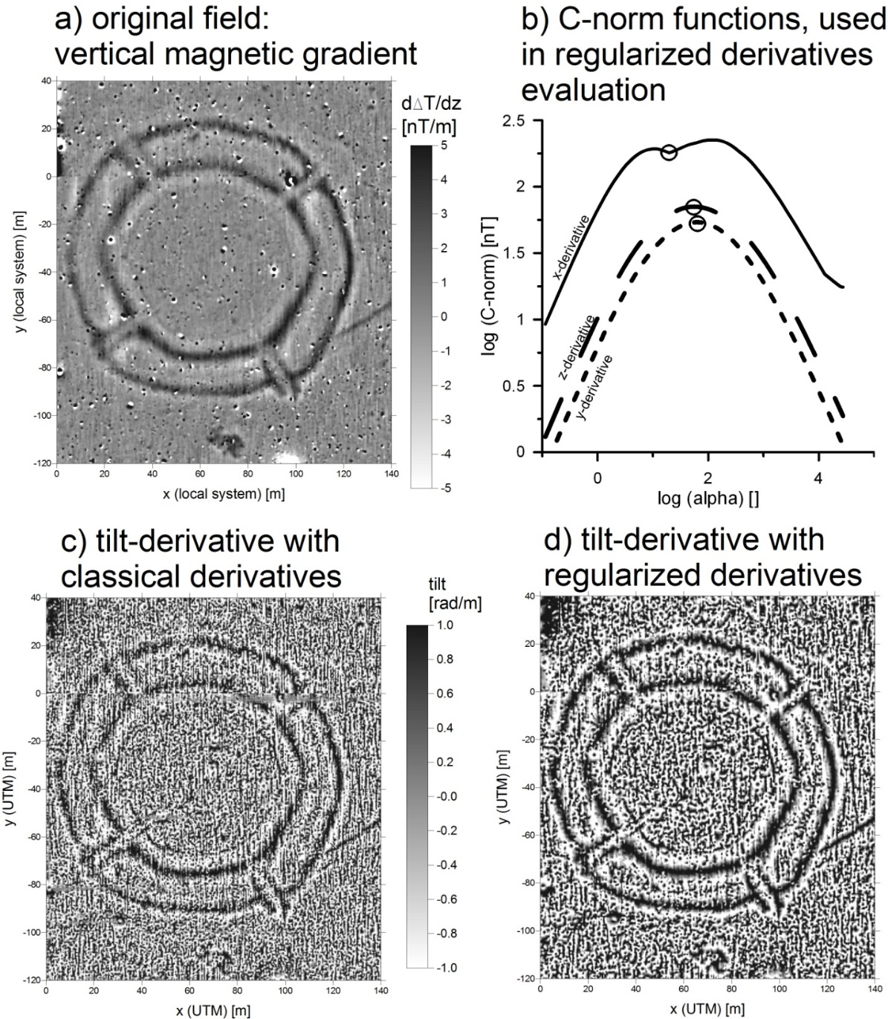
Examples Archaeomagnetic Maps and Higher Derivatives
1. case-study – Milovice
(Czech Republic),
Lengyel culture
roundel structure,
magnetic gradiometry
data set (data from Peter
Milo, Brno University)
(fluxgate magnetometer
Ferex 4.032 DLG
Foerster with four
sensors,
line distance: 0.5 m,
sampling interval: 0.25 m).

Slide 13
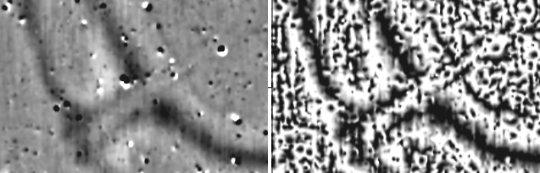
Examples Archaeomagnetic Maps and Higher Derivatives
1. case-study – Milovice
(Czech Republic),
detail
original field (vert. gradient)
tilt-derivative

Slide 14
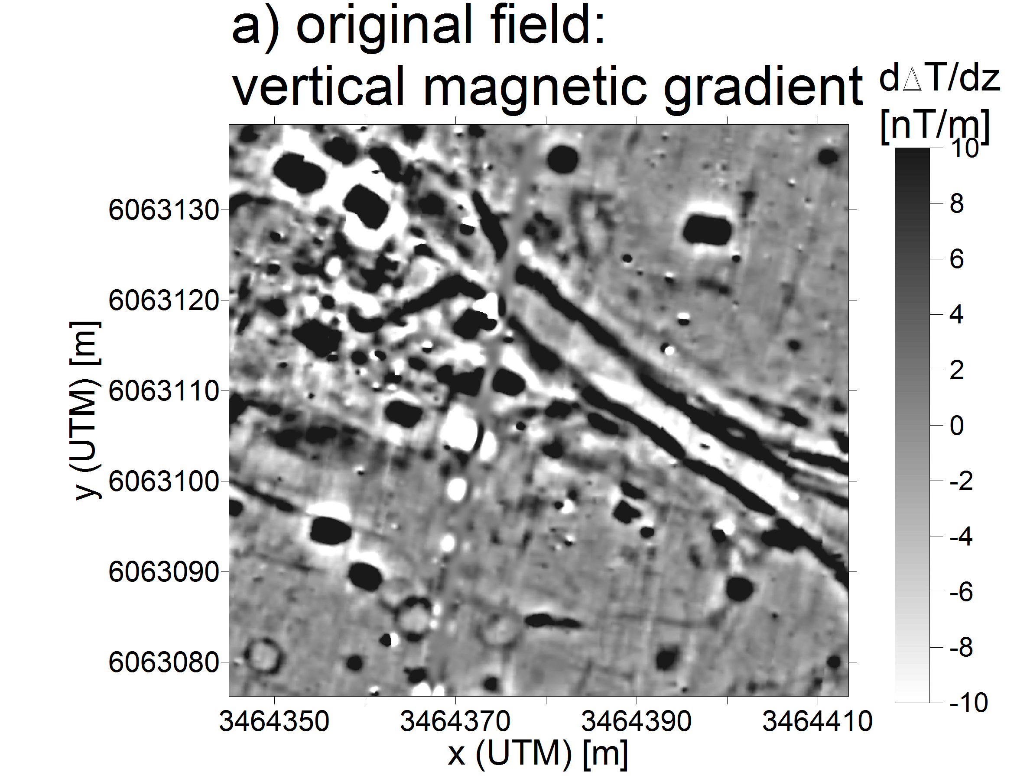
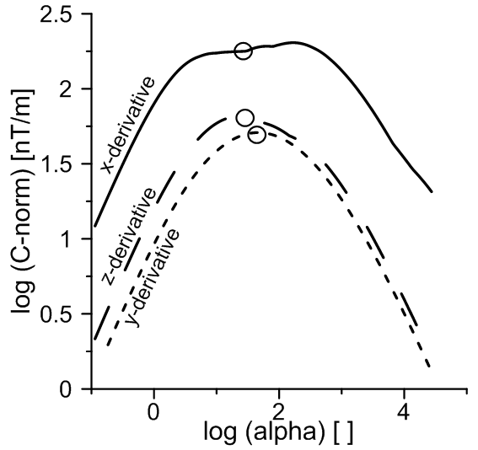
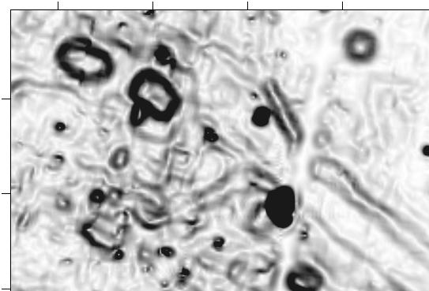
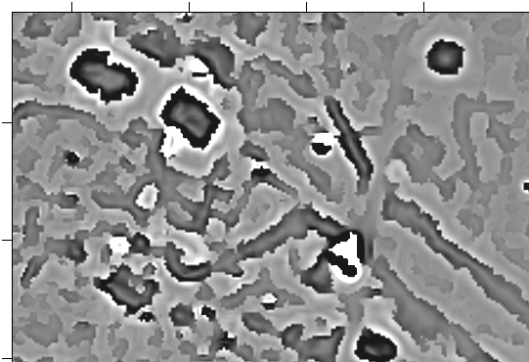
Examples Archaeomagnetic Maps and Higher Derivatives
2. case-study – Witsnum, island
Föhr (northern Germany),
early-medieval settlement,
magnetic gradiometry
data set (data from Harald Stümpel, Kiel University)
(fluxgate magnetometer
Ferex 4.032 DLG
Foerster with four
sensors,
line distance: 0.5 m,
sampling interval: 0.25 m).
hor. gradient
TDXAS transf.

Slide 15
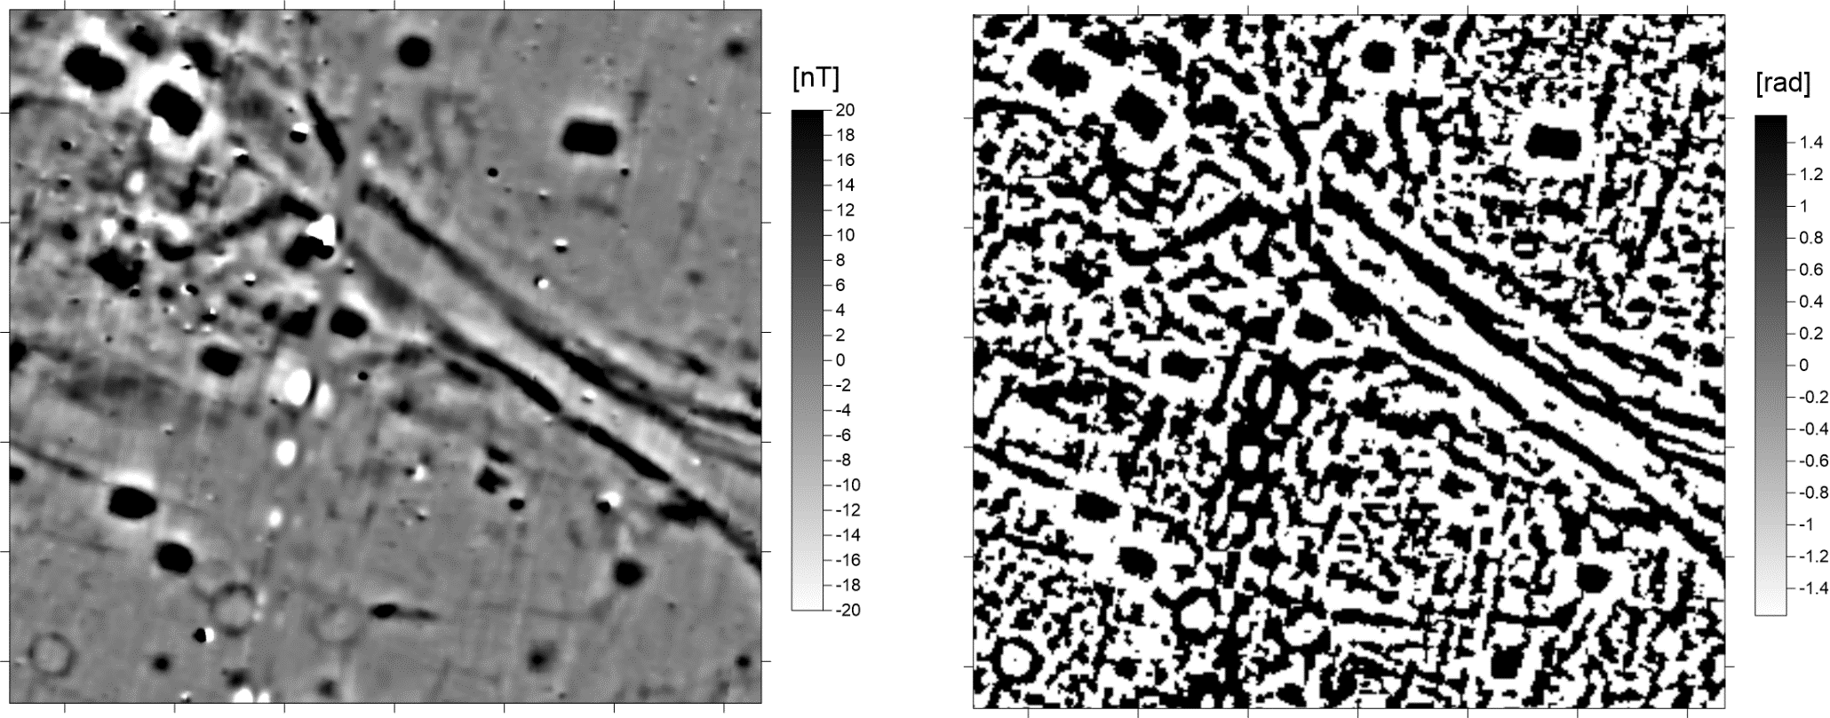
Examples Archaeomagnetic Maps and Higher Derivatives
2. case-study – Witsnum, island
Föhr (northern Germany),
detail
original field (vert. gradient)
tilt deriv. plus TDX

Slide 16
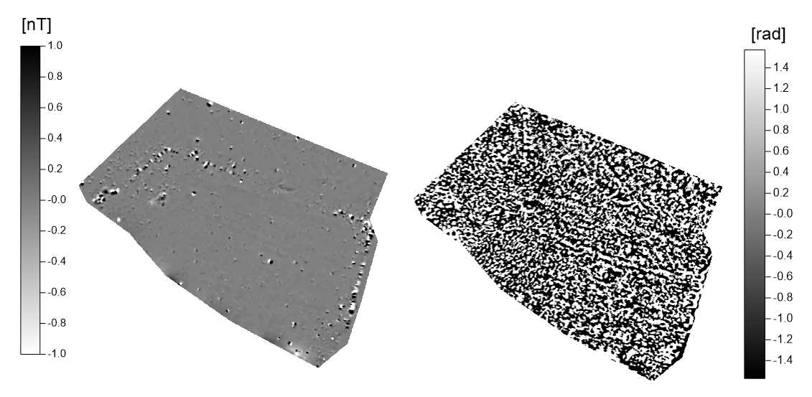
Examples Archaeomagnetic Maps and Higher Derivatives
3. case-study – surroundings of former monastery, Katarínka (western Slovakia),
original field (vert. gradient)
tilt deriv. plus TDX

Slide 17
Conclusions and outlooks Archaeomagnetic Maps and Higher Derivatives
higher derivatives ratios (edge mappers) can give new insights
into the magnetometric data-sets interpretation,
regularized derivatives can improve properties of this kind
of edge mappers and remove artifacts and noise amplification,
in general we are not able now to recommend “the best” edge
mapper – usually we calculate all of them and analyse,
these operators can not distinguish between natural anomalies
(soil, geology) and anthropogenic objects manifestation but could
be helpful with semi-automated interpretation (machine learning),
- we are looking for next anomalies (to be processed and interpreted).

Slide 19
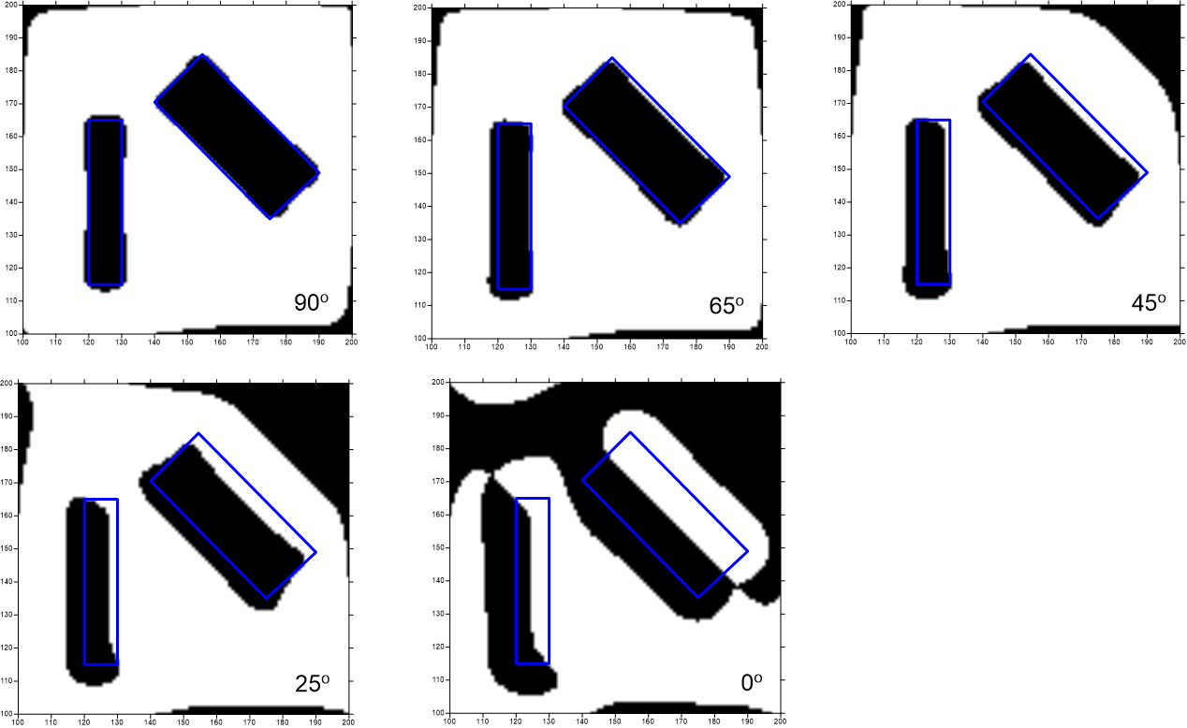
a new (very simple) transform: addition of tilt and TDX angles

