Slide 1

Workshop 1
(Prague, 30/Sep - 01/Oct 2019)
The evolution of relict phaeozems related to Chalcolithic settlements from Eastern Romania
Radu Gabriel PÎRNĂU¹, Andrei ASĂNDULESEI²
1 Romanian Academy, Iaşi Branch, Geography Group, Iași, Romania (radupirnau@yahoo.com)
2“Alexandru Ioan Cuza” University of Iaşi, Interdisciplinary Research Department – Field Science, Arheoinvest Research Centre, Iași, Romania (andrei.asandulesei@yahoo.com)
TOPIC 2: INTEGRATED APPROACHES COMBINING GEOPHYSICS AND SOIL SCIENCE AT ARCHAEOLOGICAL SITES

Slide 2

Some introductory thoughts
Soils with very thick humus-rich, mollic topsoil horizons with a patchy distribution occur in the eastern and central part of Romania.
Although, in these areas, the actual climatic conditions favor the development of forest soils, the morphology and chemical proprieties show soils characteristics much closer to those of Phaeozems.
In Romanian literature, the idea of the anthropogenic influence in development and evolution of these soils has been propose a long time ago but this approach was not systematically investigated so far. Considered the most controversial soil type!

Slide 3
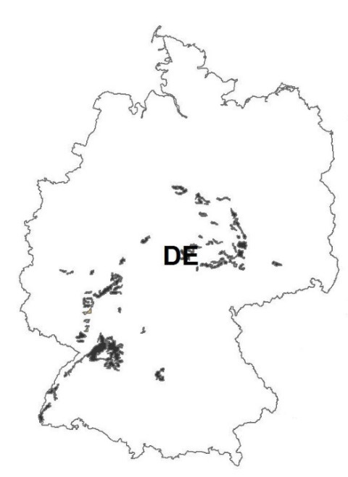


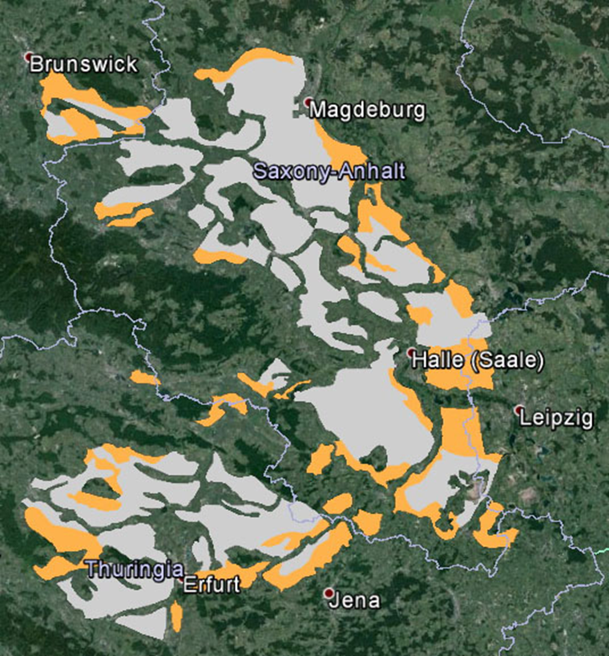
Some introductory thoughts
Soils with similar properties, considered as relict chernozems/phaeozems, are found on significant surfaces in Central Europe as well, but although there is a relative consensus on the taxonomic classification and the relict character of these soils, hypotheses about their genesis and age are often contradictory:
CH / PH were formed in Boreal-Subboreal range, most likely in the Atlantic (7800-5700 bp) (Laatsch, 1934);
The first Neolithic inhabitants (LBK: 7500-7000 BC) settled in Central Europe in regions where CH / PH already existed, a prerequisite for the beginning of agriculture (Luning, 2000);
CH / PH were formed during Boreal (Hilgers, 2003);
CH / PH were formed between the Mesolithic and the Middle Ages (Gerlach, 2003);
CH / PH from Central Europe are relict soils, formed in Preboreal-Boreal (10000-7500 BP) (Lorz, 2011);
Chernozem-like soils are man-made and natural Chernozem formation can be excluded (Kasielke et al., 2019).
Soil Geographical Database of Eurasia
(SGDBE, version 2)
Notes:
CH= chernozems / PH= phaeozems

Slide 4
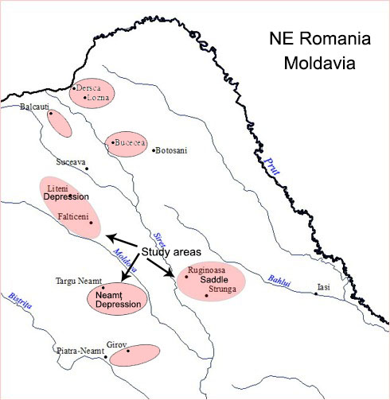
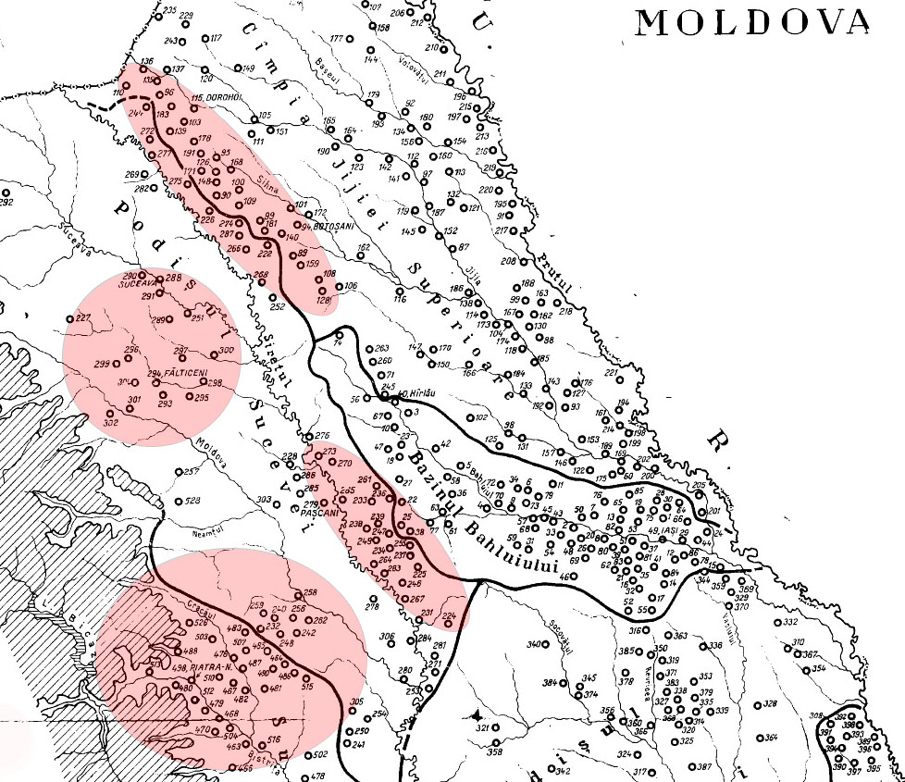
Study area - Moldavian Plateau (NE Romania)
Cambic Phaeozems areas
Archaeological sites (Zaharia, 1970)
Notes:
Patchy distribution of Cambic Phaeozems in NE Romania in relation with spatial distribution of archaeological sites

Slide 5
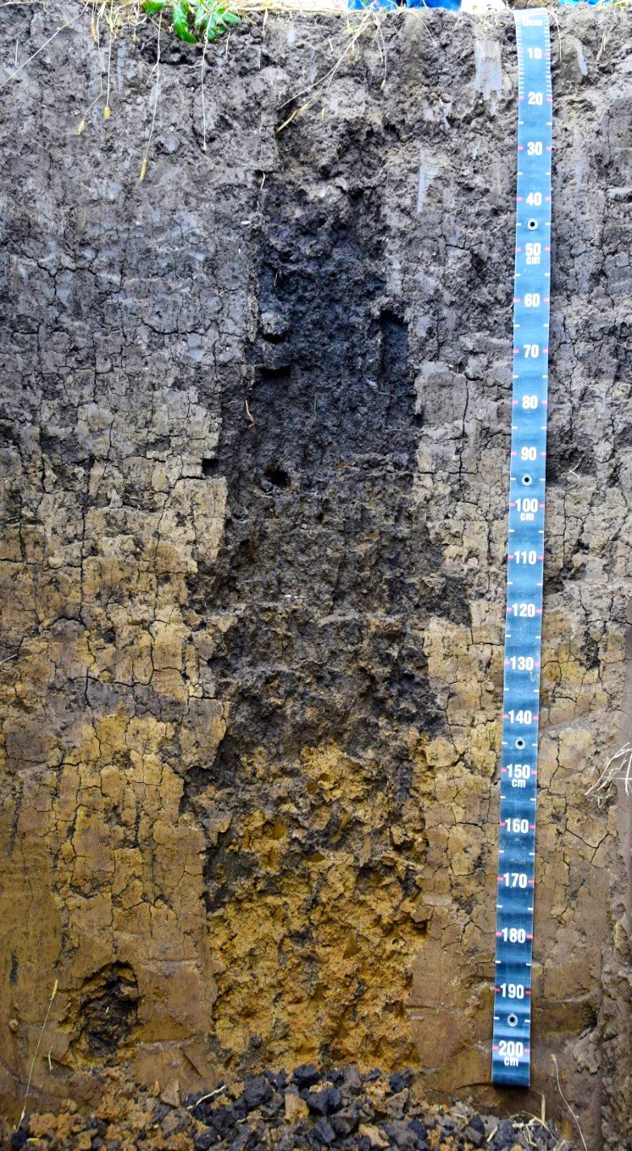
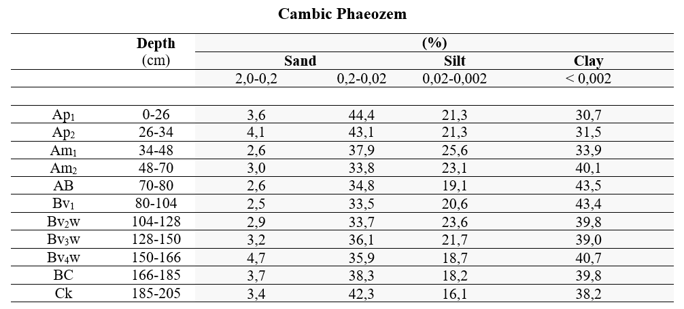
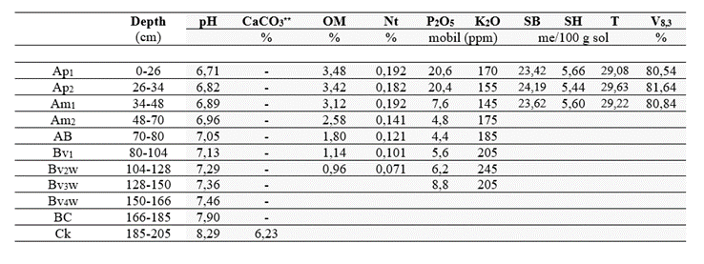
Diagnostic horizons and properties
Soils with very thick humus-rich, Amollic topsoil followed by deep cambic horizon:
  Amollic horizon (70-80 cm);
  OM: 3,5-6,5%, with values above 1% till 100-110 cm;
  CaCO3 bellow 170-180 cm;
  features acquired by recent processes (increased clay content in AB-Bv), while others (OM amount) are probably inherited from the past.
Notes:
OM = organic matter; CaCO3 = calcium carbonates

Slide 6
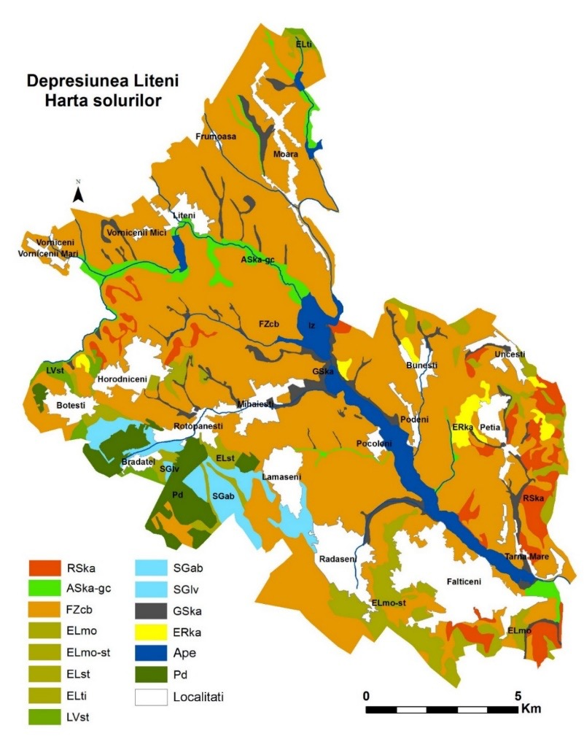
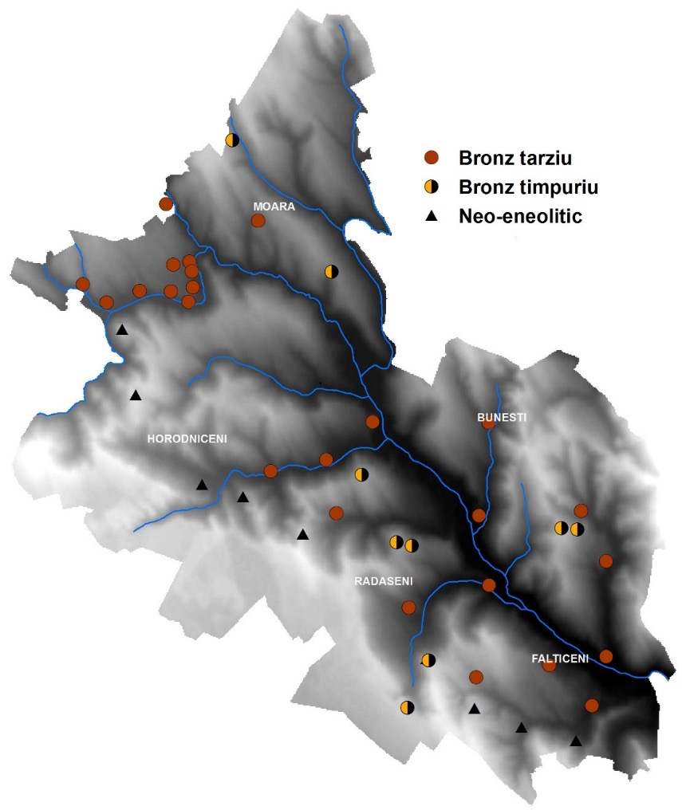
Case study 1 - Liteni Depression
1. Liteni Depression
Notes:
Cambic Phaeozems are dominant soils in this depression. Most of the archaeological sites occupy these soils, but part of them are situated, like in other cases, at the contact with forest soils.

Slide 7
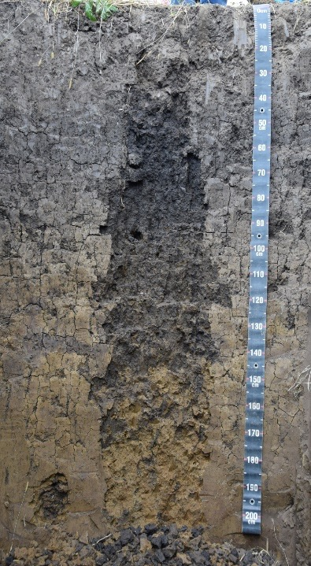
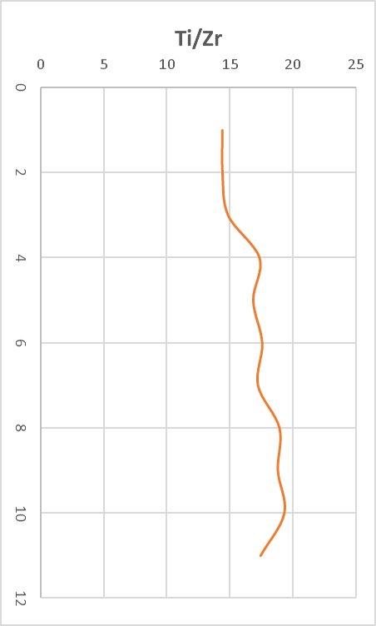
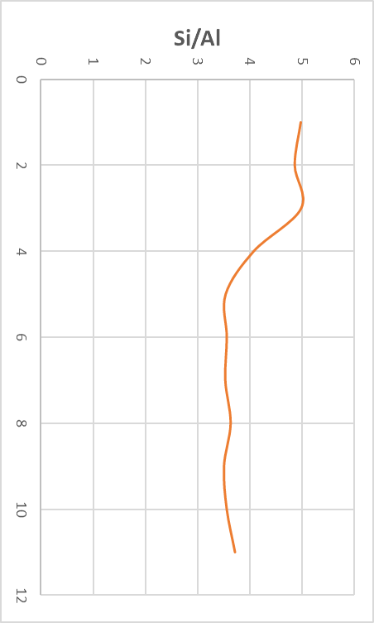
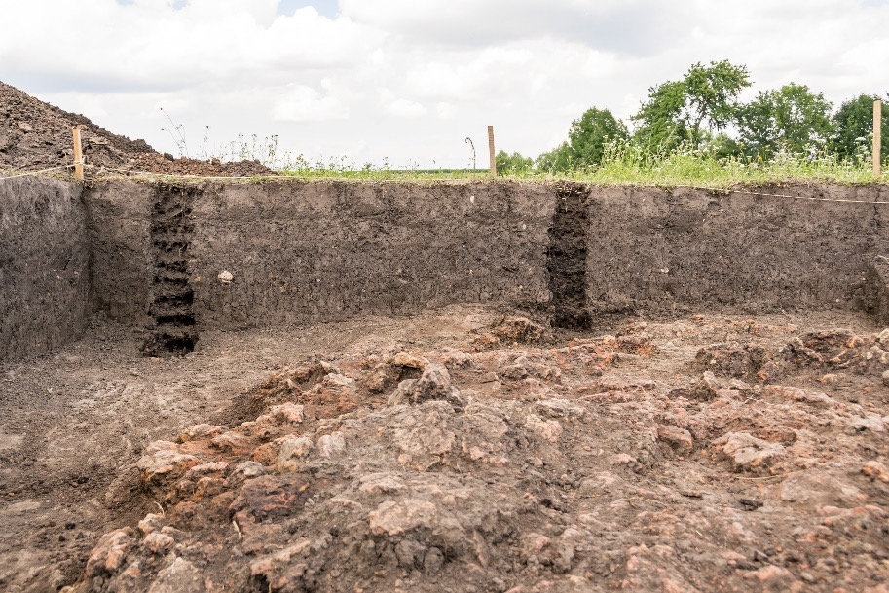
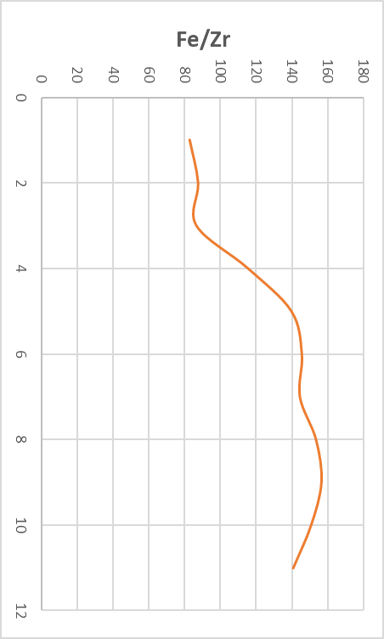
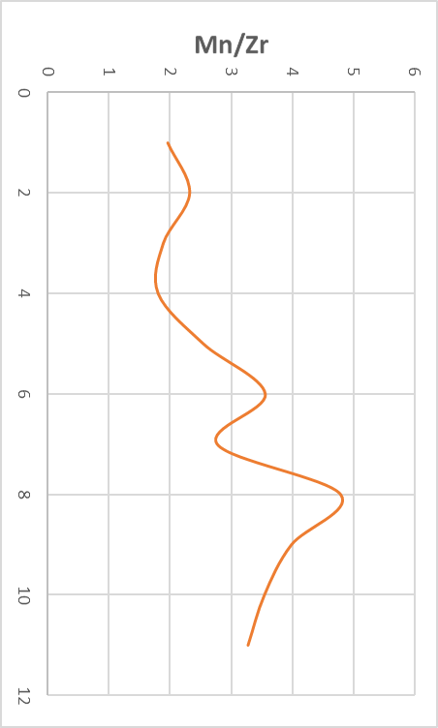
Case study 2 - Neamț Depression
Weathering indices calculated using pXRF measurements:
Cambic Phaeozem-near
Tîrpești settlement
Vertical distribution of elemental ratios:
Elemental ratio of elements
resistant to weathering (Ti/Zr ratio)
Ruxton index
Cambic Phaeozems-
Precucuteni settlement (Topolița)
Notes:
Neamt depression – the dominant soils are also the cambic phaeozems. Work in progress: at Tirpesti and Topolita (precucuteni settlement), common soil analysis and pXRF

Slide 8
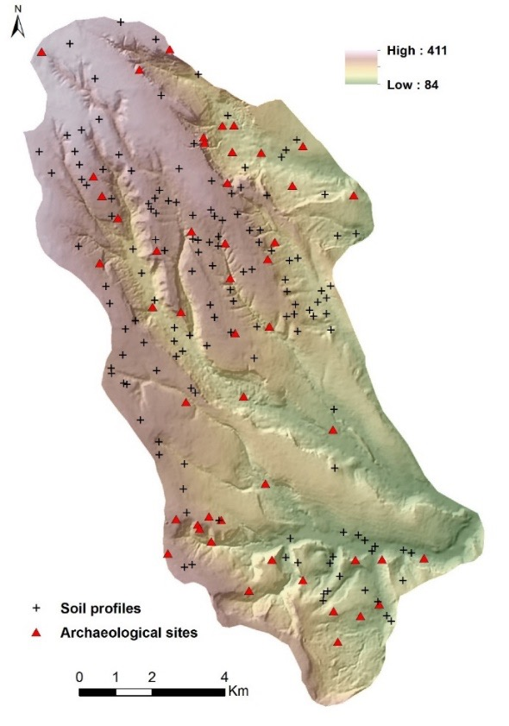
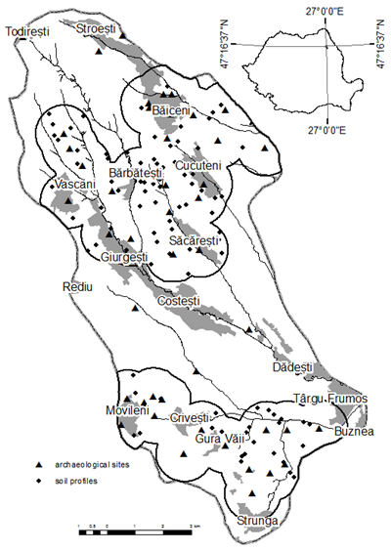
Case study 3 - Ruginoasa-Strunga saddle
Buffer zone around archaeological sites with 1 km radius
Two distinct regions occurred with high density of settlements, especially at the contact between Cambic Phaeozems and forest soils

Slide 9
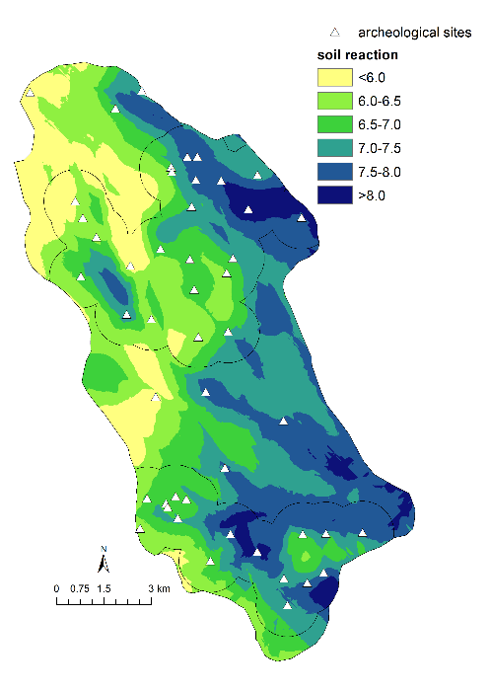
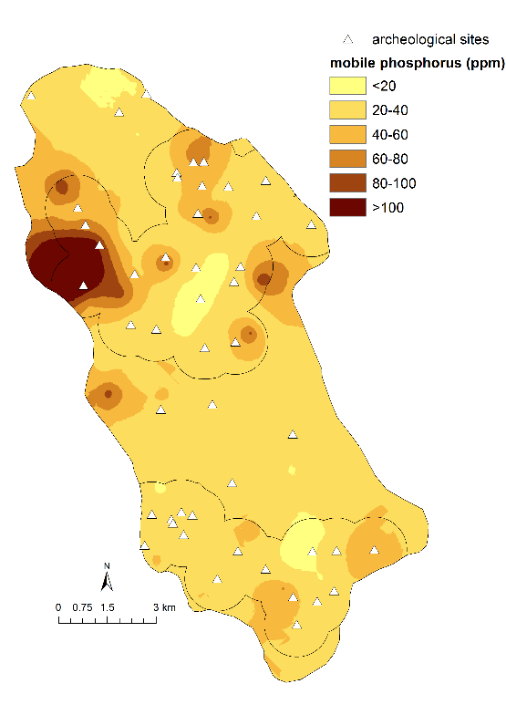
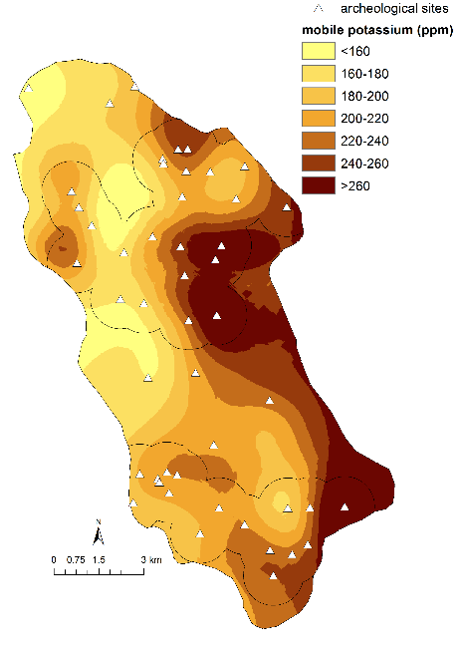
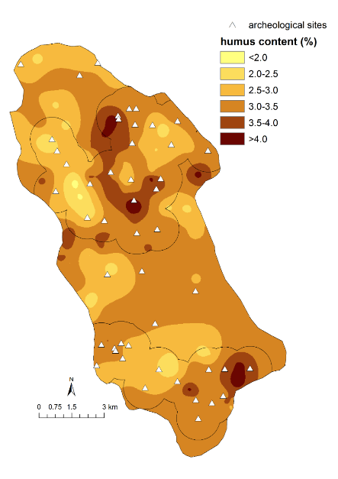
Spatial variability of soil parameters
Soil reaction
Modelled by regression-kriging, with altitude and X and Y coordinates as predictors
Regression model explains 39% of pH variance
pH values generally decrease as altitude increases (with 0.9 units / 100 m) and increase from West to East
Phosphorus
Modelled by ordinary kriging
Vertical variability of phosphorus presents a strong anomaly in relation with normal distribution in a typical soil profile
Pronounced maximum values (>200 ppm) are found in the proximity of several archaeological sites, suggesting that this high concentration may be partially related to ancient settlements
Potassium
Modelled by universal kriging
There is a weak but statistically significant correlation with distance from archaeological sites (R = -0.273), suggesting that potassium content tends to increase slightly in their proximity, due to ancient human activities
Humus content
Modelled by ordinary kriging
It doesn’t show any relationship with the locations of archaeological sites
Notes:
Classified spatial distribution of soil parameters considered as indicators for long term human influence

Slide 10
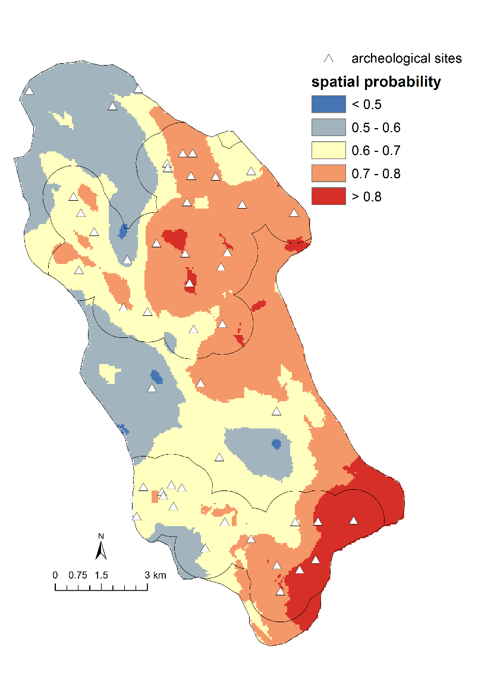
Estimation of spatial probability of archeological sites occurrences
Modeled by binary logistic regression
Spatial probability model is derived from pH, potassium and clay content:
Probability = 1 / [1 + e-(-4.02738 + 0.39221 pH + 0.00585 K + 0.03244 Clay)]
Probability increases for soils with higher values of pH, potassium and clay content
The model has a moderate prediction capability (area under ROC curve = 0.702), but it is statistically significant, demonstrating the potential of such an approach and of soil data to predict the probable location of archaeological sites.

Slide 11
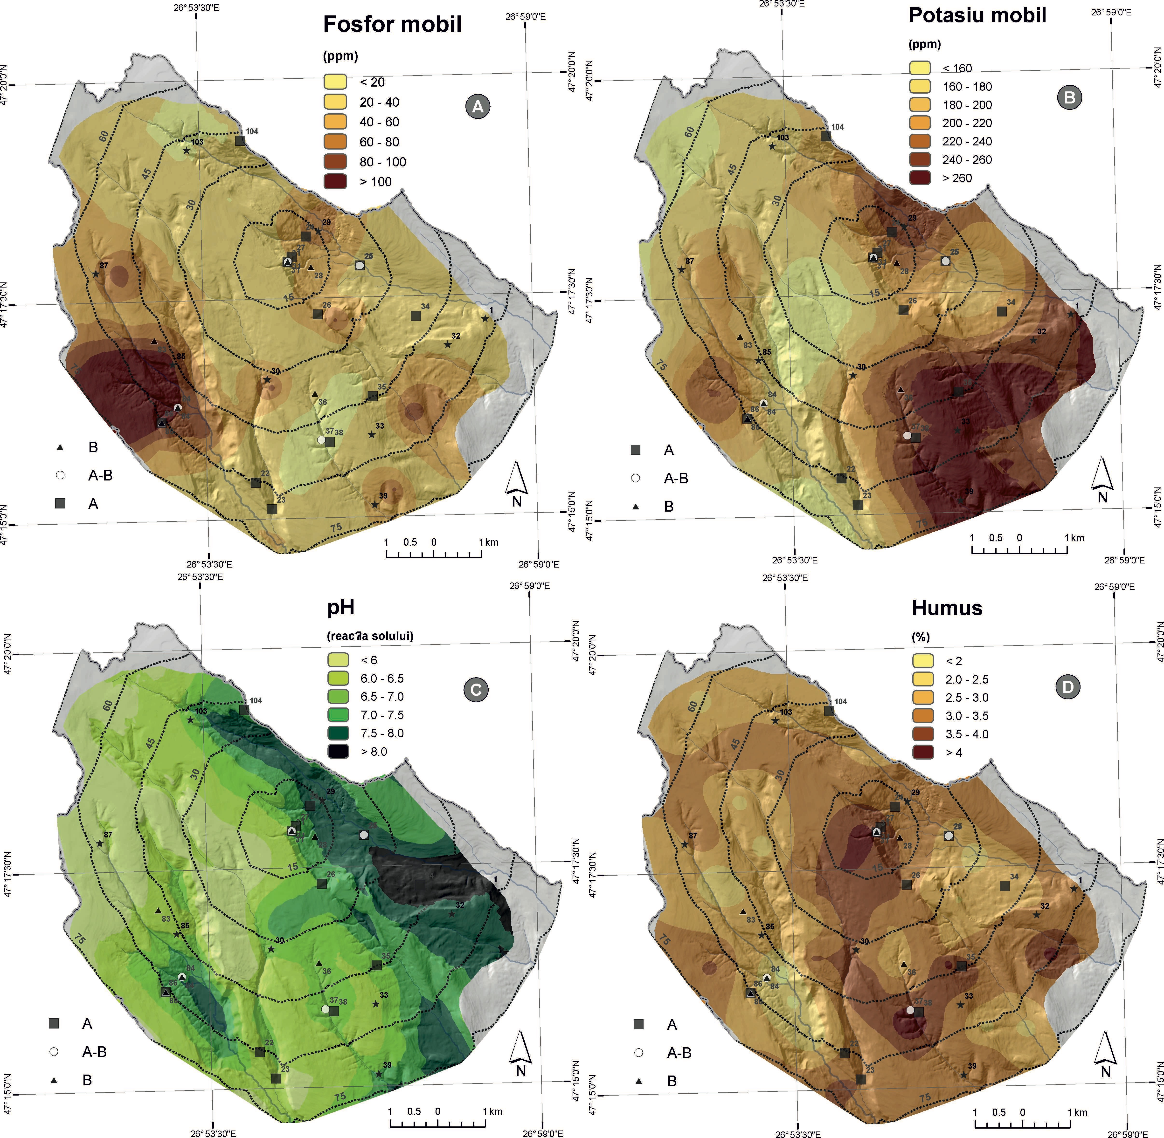
Estimation of spatial probability of archeological sites occurrences
Site catchment area for
Cucuteni, Cetățuie archaeological site

Slide 12
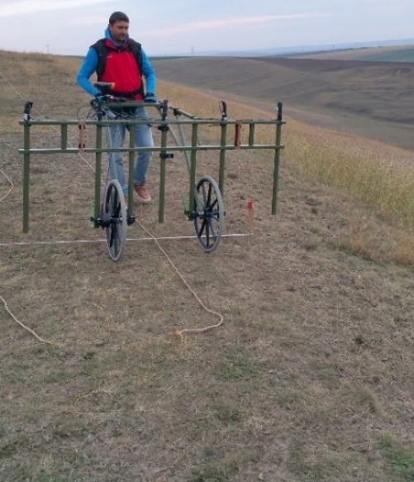
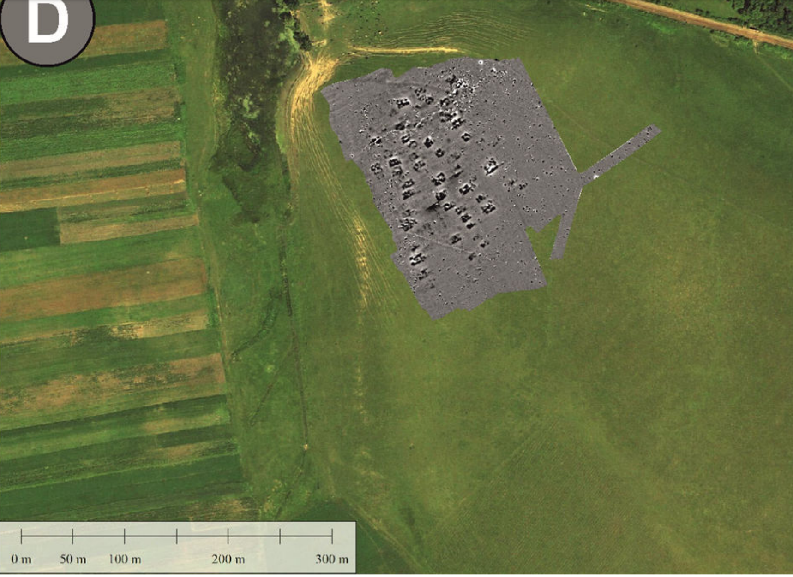
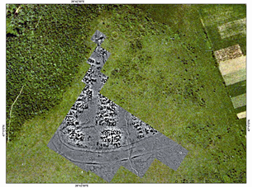
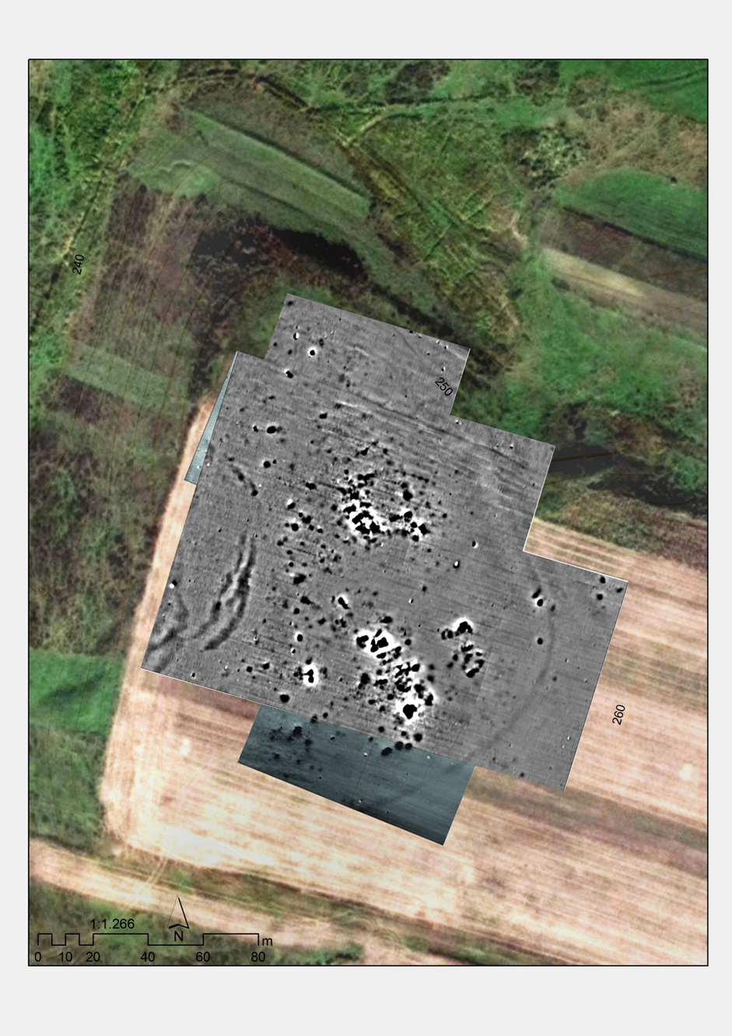
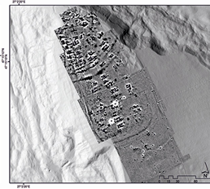
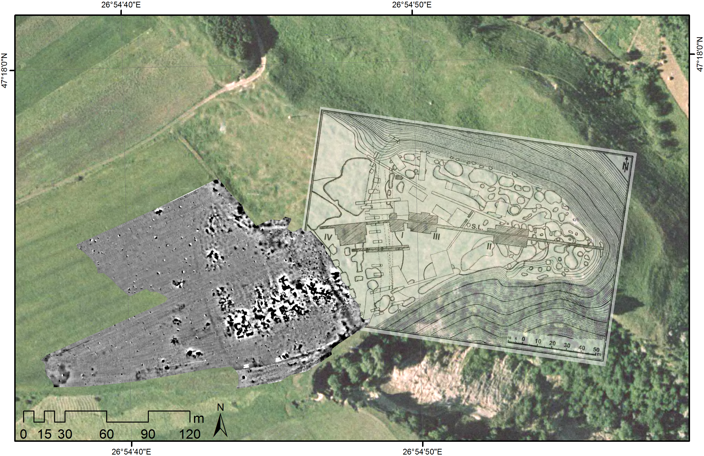
Geophysical surveys in areas with high content in P and K

Slide 13
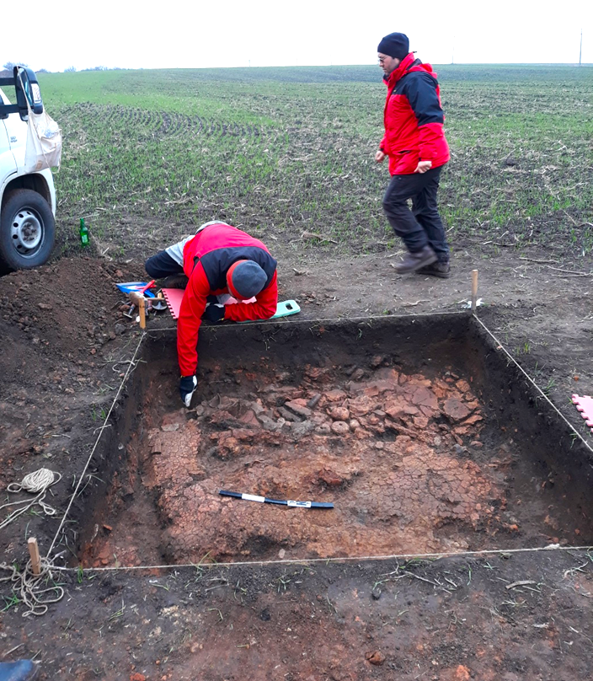
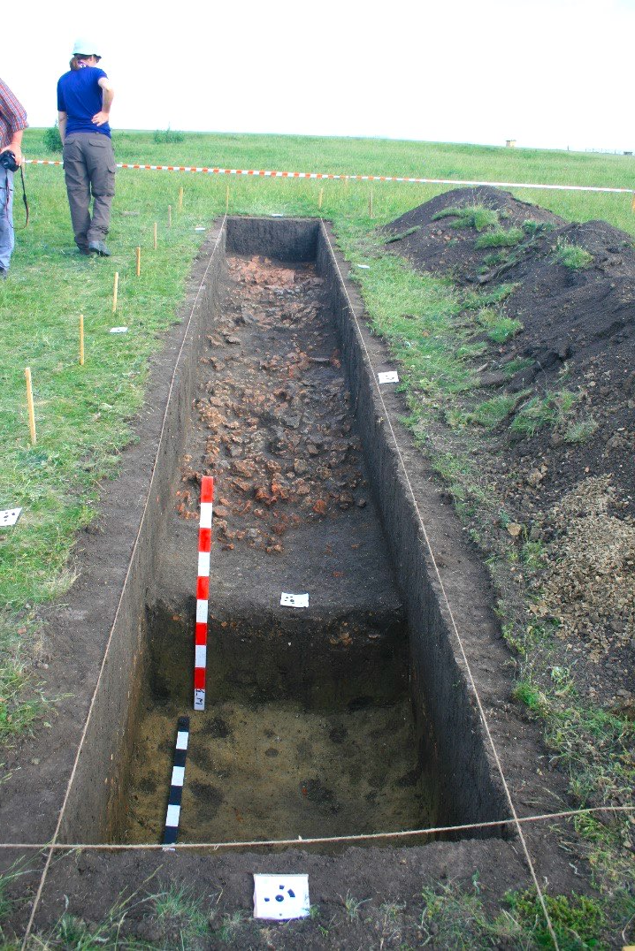
Unknown sites revealed by geophysical surveys in areas with high content in P and K

Slide 14
Conclusions
Cambic Phaeozems from NE Romania are relict soils
The characteristics of these soils might be explained by:
  High calcium carbonate content of the parent material and, also an important input of CaCO3 through lateral soil water flow;
  Initial hydromorphic conditions with pasture vegetation specific for these areas, reflected in actual high organic matter reserve;
  Ancient and long-term agricultural practices which preserves initial soils characteristics

