Slide 1

Workshop 1
(Prague, 30/Sep - 01/Oct 2019)
Diagnostic and Monitoring of Cultural Heritage: Heracles project experience
by Ilaria CATAPANO, Francesco SOLDOVIERI, Giuseppina PADELETTI
Topic 4 (Experimental/Monitoring projects (conducted at archaeological sites or related to archeo-geophysics)

Slide 2

Aim & Objectives
The HERACLES project.
HERACLES methodologies for wide area surveillance and site diagnosis and monitoring.
HERACLES diagnostic protocols.
Validation at the Consoli Palace of Gubbio (Italy).

Slide 3
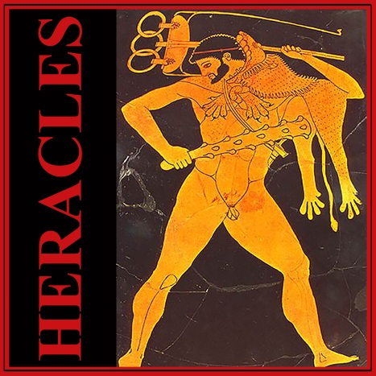


The HERACLES project
HERACLES
HEritage Resilience Against CLimate Events on Site
This project has received funding from the European Union’s Horizon 2020 research and innovation program under grant agreement No 700395
General aim: Design, validation and promotion of responsive system/solution for effective resilience of Cultural Heritage (CH) against climate change effects, considering as mandatory an holistic, multidisciplinary approach through the involvement of different expertise (end-users, industry/SMEs, scientists, conservators / restores and social experts, decision and policy makers).
Operative goals: Development of a system exploiting an ICT platform able to collect and integrate multisource information in order to effectively provide complete and updated situational awareness and support decision for innovative measurements improving CH resilience, including new solutions for maintenance and conservation.
Design and validation of manageable methodologies also for the definition of operational procedures and guidelines for risk mitigation and management.

Slide 4
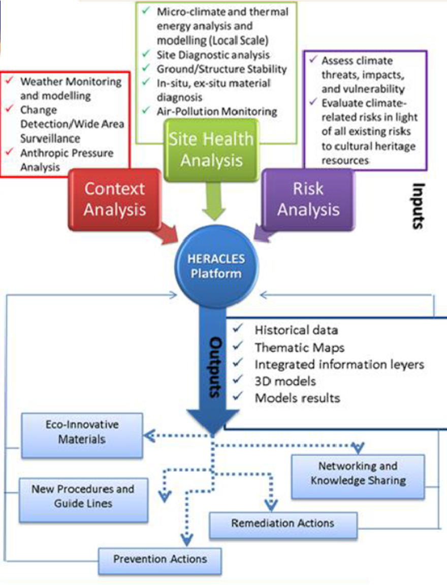
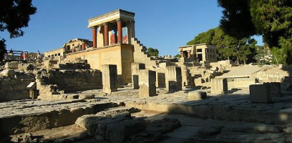
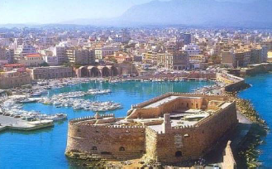
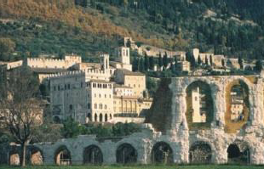
The HERACLES project
METHODOLOGY
TEST SITES
Knossos Palace – Crete
Koulse Fortness – Crete
Gubbio – Italy

Slide 5
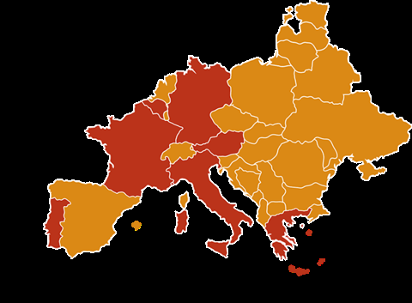
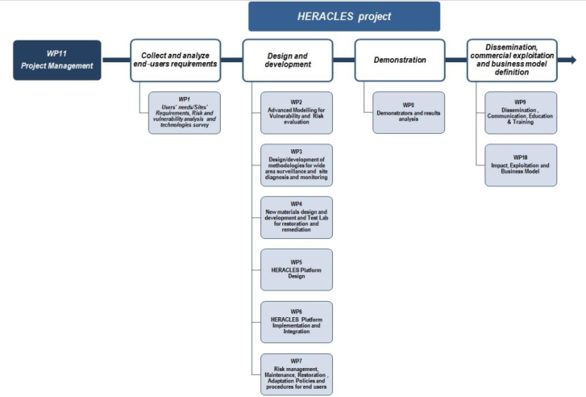
The HERACLES project

Slide 6
The HERACLES project

Slide 7
HERACLES methodologies
for wide area surveillance and site diagnosis and monitoring
General aim: adoption and optimization of many and different sensors and diagnostic instruments (satellite based, airborne based and in-situ technologies), most of them complementary in terms of acquired information type. The involved technologies, indeed, operate at different spatial and temporal scales and aim at:
monitoring the environment where CH assets are located by accounting for both land deformations and meteorological changes;
performing structural assessments as well as characterizing materials degradation and weathering state.
Main Objectives
overview of advantages / limits of the involved sensing technologies;
assessment of the available state of art regarding the most recent developments/advances concerning them;
design / adoption of innovative devices, methodologies and data processing strategies to improve performances;
definition of the systematic protocols for test sites diagnostics and monitoring.
Task 1: | Satellite based technologies for wide area surveillance
Task 2: | Airborne based technologies for monitoring
Task 3: | Non-invasive and non-destructive site diagnosis and monitoring (ground based technologies)

Slide 8
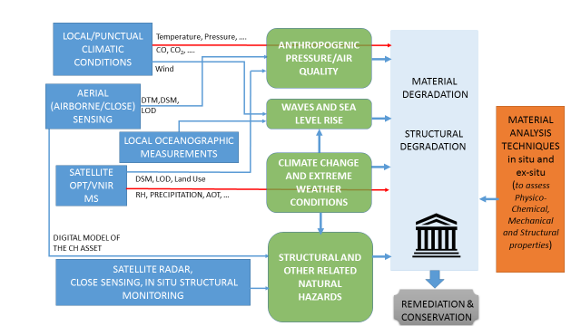
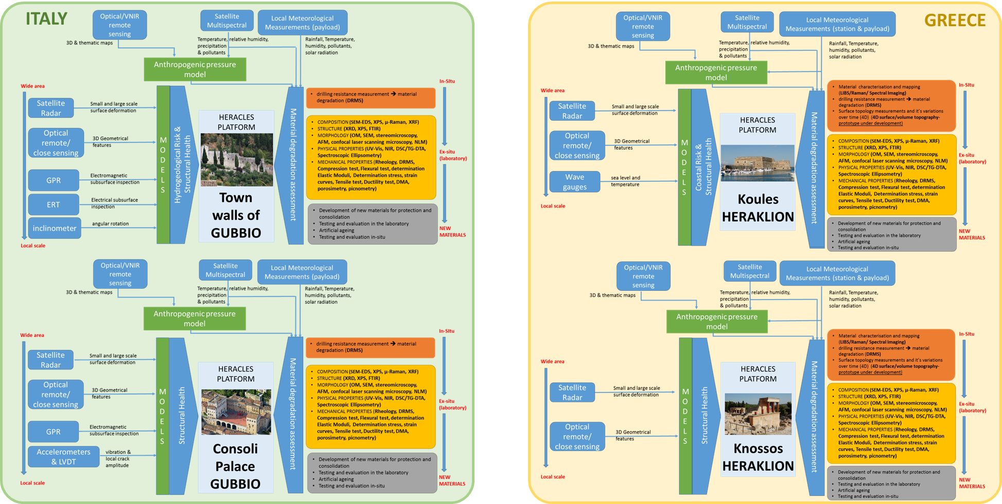
HERACLES diagnostic protocols
general protocol
global protocols specified for the test sites

Slide 9
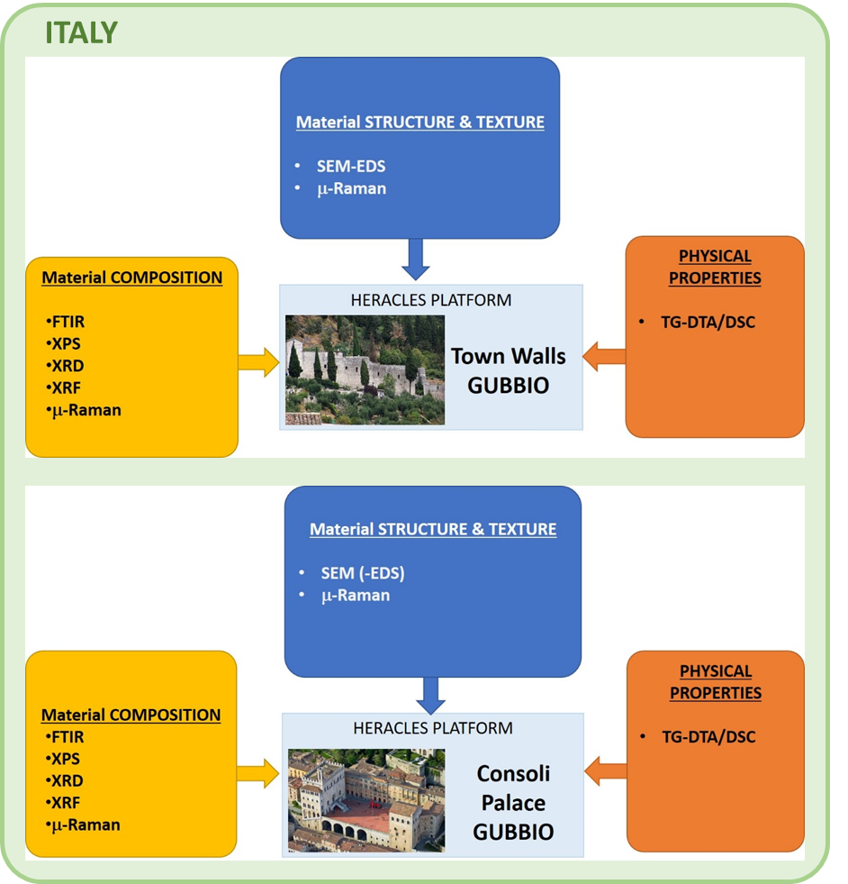
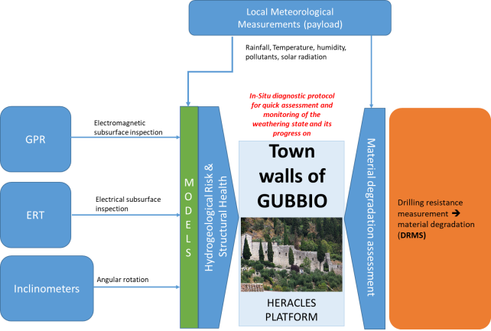
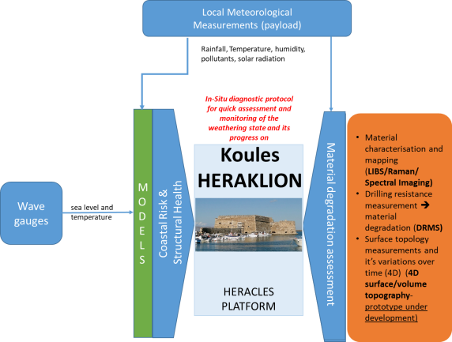
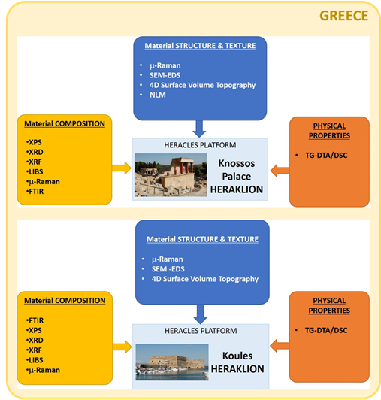
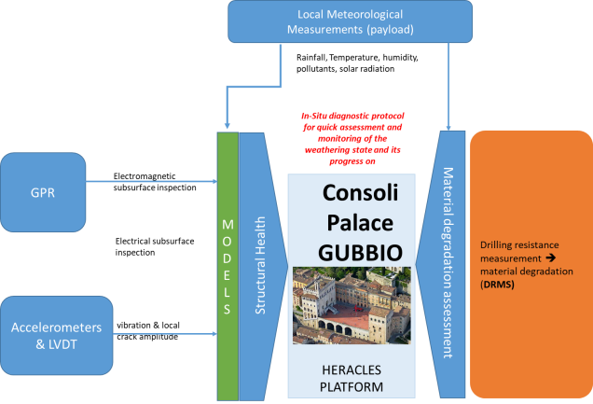
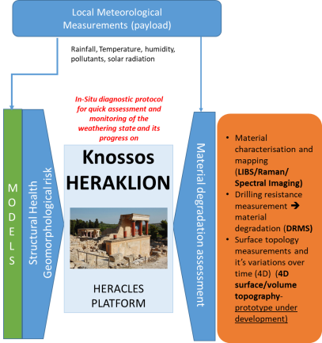
HERACLES diagnostic protocols
in-situ diagnostic protocols
ITALY
GREECE
Protocol for laboratory analysis

Slide 10
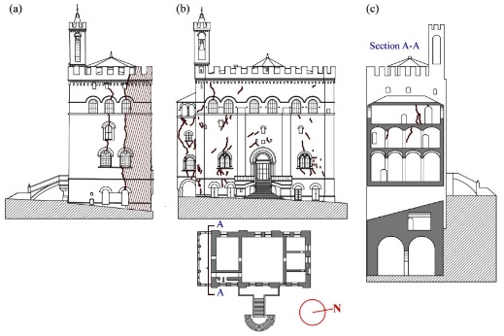
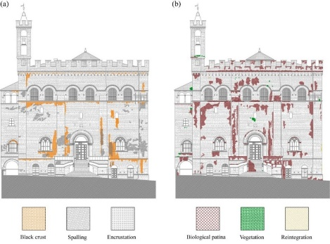
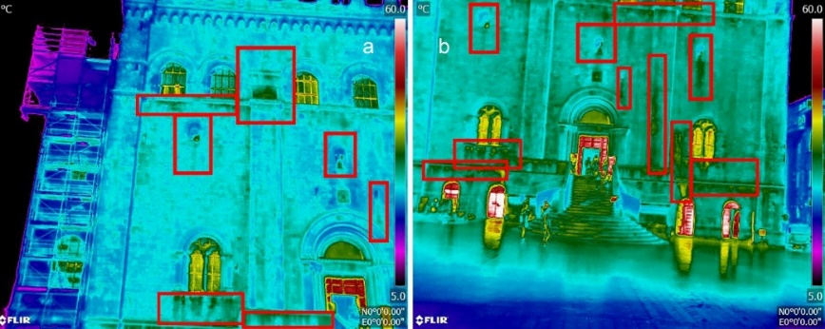
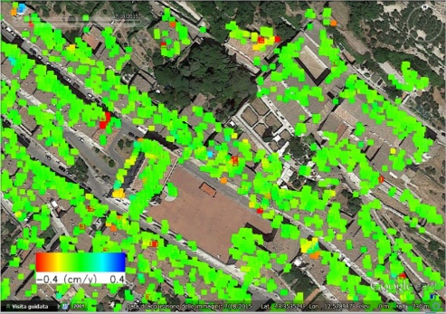
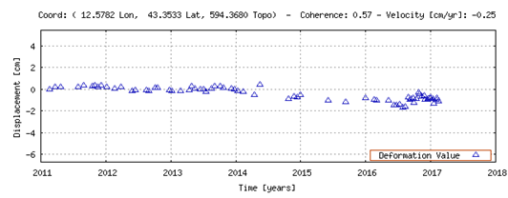
Validation at the Consoli Palace of Gubbio
Visual and thermographic inspections
STRUCTURAL HEALTH
cracks related to overturning of the North-West corner (a), cracks of the East façade showing the overturning of the loggia on the South side (b) and a section (A-A) on the loggia (c).
Material detachment due to rainfall (a) and superficial organic growth due to condensation (b)
thermographic nocturnal view of the Consoli Palace façade and highlight on black crusts and water retention
A moderate/significant crack pattern on the whole building has been highlighted and mapped in details including indoor and outdoor environments - Moderate/significant degradation conditions over the main façade have been detected and mapped in details
SAR analysis
The time series for a pixel on South-West corner highlights the temporal gap between 2014 and 2015 and a limited (maximum 1cm) deformation starting from 2014
Results of the satellite radar monitoring relevant to the descending orbits. Mean deformation velocity along the line of sight achieved by means of the TMS analysis
Time series of the deformation along the line of sight of a relevant point on the South-West facade
Consoli Palace is not affected by significant deformation - very limited deformation are visible on some pixels of the West façade in the top part of the building

Slide 11
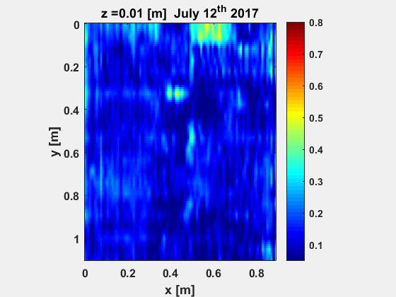
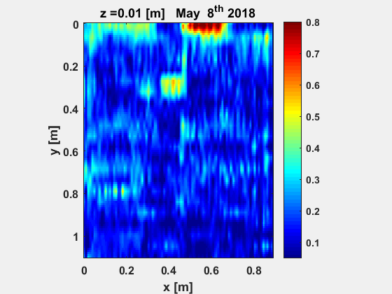
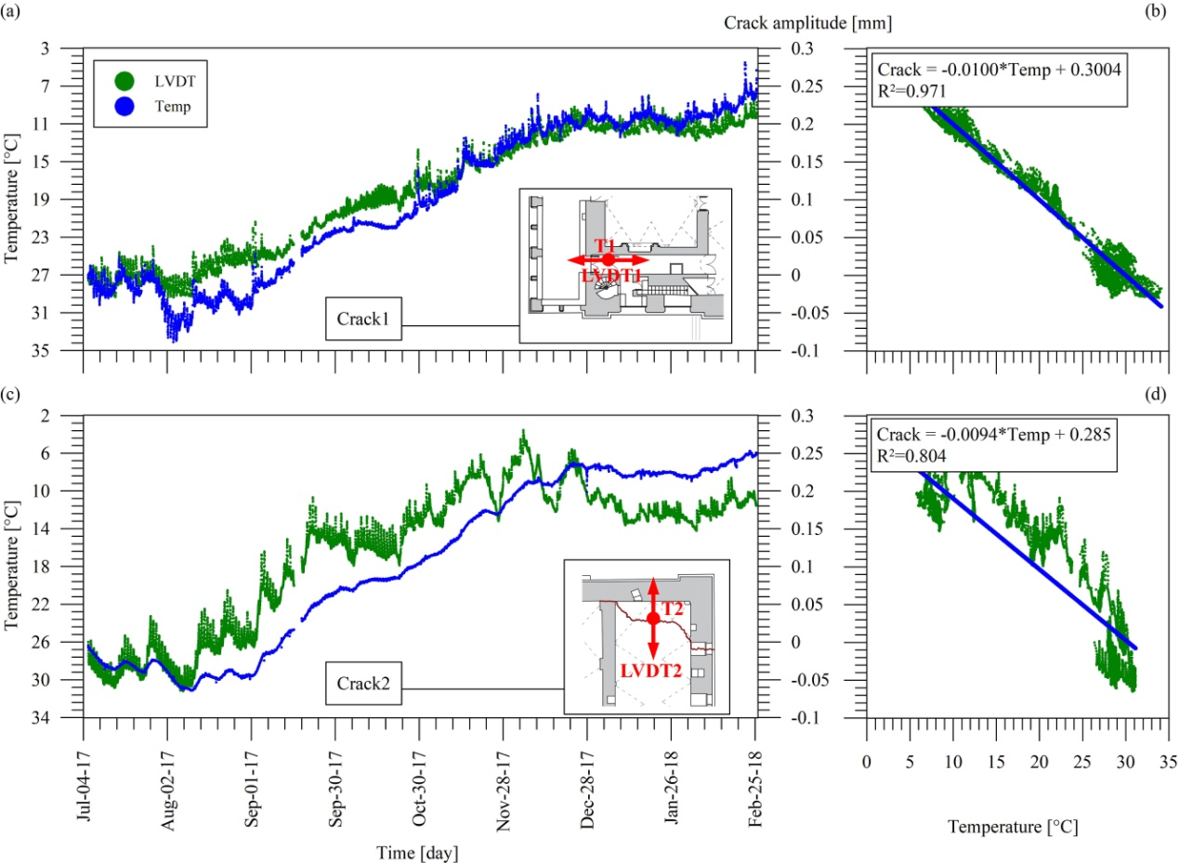
Validation at the Consoli Palace of Gubbio
STRUCTURAL HEALTH
GPR surveys
Provided information on the structural elements, such as wall texture.
No critical elements affecting the Consoli Palace floor structure were detected.
The crack affecting the wall of the cross-hall leading to the Loggia is as deep as the first layer of stones and did not appear critical at the moment of the surveys (2 GPR surveys in July 2017 and May 2018).
Tomographic images at increasing depths of the facture affecting the cross-hall leading to the Loggia
Long-term static and vibration-based Structural Health Monitoring
Natural frequencies of Consoli Palace, as well as major crack amplitudes, have been tracked in time and environmental (temperature) effects on such static and dynamic response parameters have been characterized and removed through statistical filtering.
A control chart tool has been constructed that will highlight in the future if structural damages able to modify the dynamic properties of the building or the amplitudes of major cracks occur.
Evolution in time of two monitored cracks’ amplitude of Consoli Palace and temperatures during the first months of monitoring

Slide 12
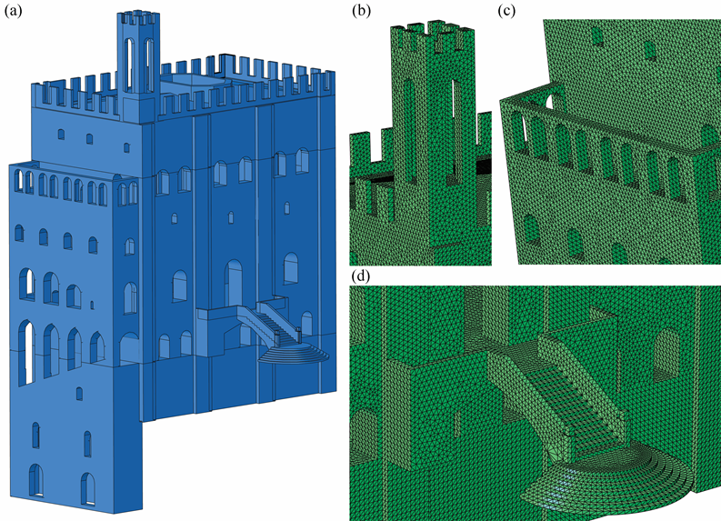
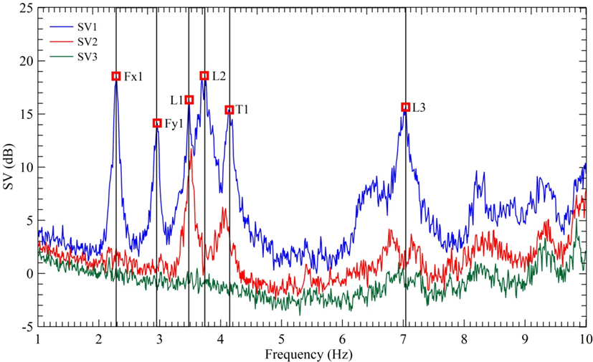
Validation at the Consoli Palace of Gubbio
STRUCTURAL HEALTH
Ambient Vibration Testing and Operational Modal Analysis
Finite element modelling and model calibration
Baseline modal parameters have been obtained and are available as benchmark for future tests with comparative diagnostic purposes
Numerical model of Consoli Palace: general view (a), detailed view of the bell-tower (b), the lodge (c) and the fan-shaped staircase entrance (d).
First three singular values (SV) of spectral matrix and identified resonant peaks with related modes of vibration
A structural FEM model of Consoli Palace has been built and calibrated on the basis of experimental results.
The model is available for structural analysis under any type of loading, such as a future strong wind event or earthquake.
Finite element structural analysis under vertical and lateral (earthquake) loading
The existing damage pattern (cracks) in the building has been interpreted by identifying the cause of each crack and in particular identifying those caused by vertical loads (virtually stable cracks) and those caused by past earthquakes (potentially unstable ones).

Slide 13
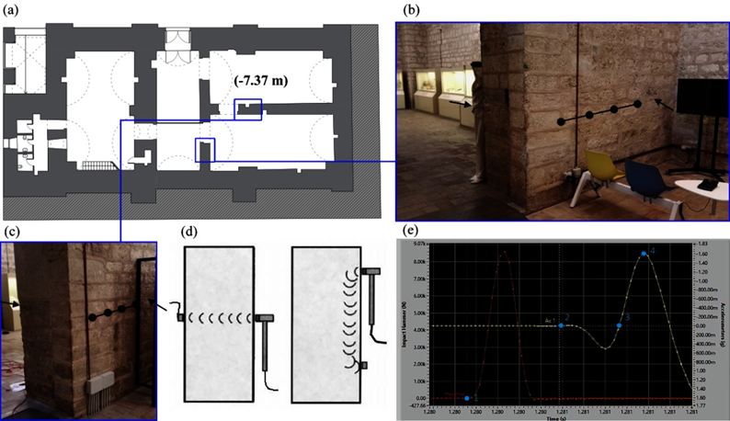
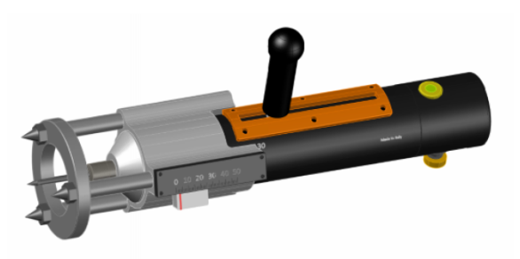
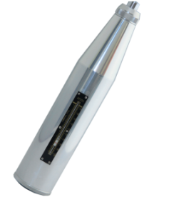
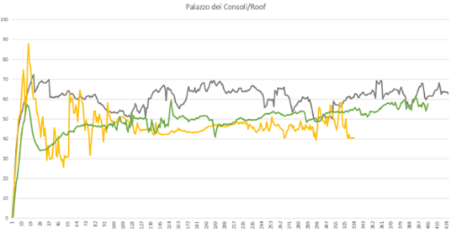
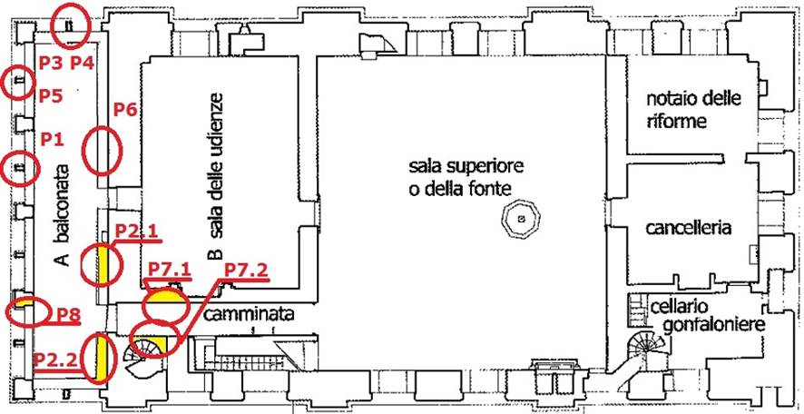
Validation at the Consoli Palace of Gubbio
MATERIAL CHARACTERISATION
In-situ microclimate environmental measurement campaign
Local environmental conditions on the main façades of Consoli Palace have been characterized, highlighting the most critical zones regarding each specific climatic forcing driving material degradation (e.g. solar radiation, temperature fluctuations and more).
In-situ sonic tests
Estimates of equivalent elastic properties of materials within the basement
sonic tests (a), two portions of investigated masonry (b) and (c), direct and indirect sonic test scheme (d) and typical graphical sonic test result (hammer in red and response wave in yellow) (e).
In-situ non-destructive tests on stones
DRMS measurements has been carried out to test the conditions of the building stones of Consoli Palace in different environmental exposure conditions
Penetrometer (left) and sclerometer (right) used for NDE tests on mortars
representative measurement acquired from a stone located in the internal surface of a merlon on the east crenelation on roof. The gray line is a measurement acquired from an unweather reference sample
in red the codes of the mortar specimens collected during the first sampling campaign or for comparative purposes. The codes P1-P3-P4-P5-P6 are referred to previously carried out sampling of stones; P8 is a new sample

Slide 14
Validation at the Consoli Palace of Gubbio
MATERIAL CHARACTERISATION
Ex-situ materials characterization
Mortars, black crusts and biological colonization phenomena have been characterized to define the building materials weathering state, with different time demanding laboratory techniques.
SEM micrograph of Consoli Palace black crust sample (a) 500 X; (b) 5.0 kX
Observation of black crusts by optical microscopy. Sample 1, direct observation and in polished section, dark field, 5x magnification. Sample 2 observed in bright field, with 10x; in polished section, the sample was observed under dark field, 20x magnification. The observation of micro-particles was made in polarized light, 50x (the two photos of the lower part of the figure).
FTIR-ATR spectrum for a sample of mortar and for a sample of black crus

Slide 15
Validation at the Consoli Palace of Gubbio
Degradation state and proposed solutions
the results of numerical structural analysis suggest that the structure is vulnerable to earthquakes and does not meet the safety level that would be required for a new building. Structural repair interventions are needed, such as injections of mortars with suitable properties, such as those developed in WP4
evolution in time of the actual damage state also needs to be monitored to understand its stability
the detailed survey of the existing degradation conditions suggest the clear climate-driven nature of most of the active degradation mechanisms
restoration and improvement of the environmental protection through elimination of the actual degradation state and the deployment of suitable protective agents, starting from the material solutions developed within WP4

Slide 16

Validation at the Consoli Palace of Gubbio
Degradation state and proposed solutions
the results of numerical structural analysis suggest that the structure is vulnerable to earthquakes and does not meet the safety level that would be required for a new building. Structural repair interventions are needed, such as injections of mortars with suitable properties, such as those developed in WP4
evolution in time of the actual damage state also needs to be monitored to understand its stability
the detailed survey of the existing degradation conditions suggest the clear climate-driven nature of most of the active degradation mechanisms
restoration and improvement of the environmental protection through elimination of the actual degradation state and the deployment of suitable protective agents, starting from the material solutions developed within WP4

