Slide 1

Workshop 1
(Prague, 30/Sep - 01/Oct 2019)
CHARACTERIZATION OF ARCHAEOLOGICAL SITES USING GPR SIGNAL FORWARD MODELLING
by Mercedes SOLLA
merchisolla@cud.uvigo.es
Defense University Center
Spanish Naval Academy
Topic 5 (Multivariate proxy data analysis and/or forward modelling)

Slide 2

Introduction
The interpretation of GPR data can be complex due to the coexistence of several disturbing factors (ringing noise, reflection multiples).
Numerical modelling allows for the simulation of different scenarios of the subsurface.
Finite-Difference Time-Domain (FDTD) modelling has been widely used as an assistant tool for helping to understand radar-wave propagation phenomena through media.
Realistic and large-scale models can be created using data obtained from complementary geophysical and/or geomatic techniques, as well as soil characterization.

Slide 3
Aims & Objectives
To show the potential of the GPR signal forward modelling for archaeological interpretations.
Additionally, to serve as example, previous realistic and large-scale models created in civil engineering and geological applications are shown. Notably, these models were elaborated using data obtained from complementary geophysical and/or geomatic techniques in two different ways:
(1) accurate geometry (photogrammetry or laser scanning) and
(2) zonification and media characterization (ERT, gravimetry, IRT, etc.).

Slide 4
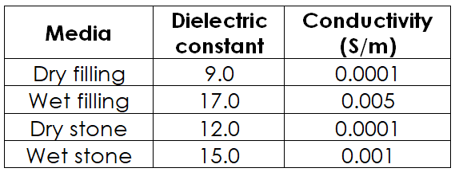
Archaeological application: methodology
Figure 1 presents a basic case study of a rectilinear structure simulating both dry (a) and wet (b) conditions at the bottom right corner (red square).
The GPR survey was simulated using a Gaussian signal, with an antenna frequency of 500 MHz, 5 cm in trace-interval and time window of 60 ns.
To create the 3D model, a constant distance of 10 cm between consecutive GPR lines was considered.
Figure 1. Time-slice at 40 cm depth.

Slide 5
Archaeological application: results
The synthetic data were produced using the GprMax simulator and then exported into a format compatible with ReflexW, which is commercial software used for GPR signal processing and 3D visualization.
Figure 2 presents the synthetic data produced.
Figure 2

Slide 6
Archaeological application: results
Figure 2 c and d shows the 3D cube created when simulating wet conditions. As expected, the bottom right sector (red square) appears deeper due to the time-delay of the GPR signal propagating through wet media.
Figure 2

Slide 7
Archaeological application: conclusions
Further research should be focused on the development of more advanced modelling through the combination of additional geophysical methods and accurate soil properties data.
The technique enables the prior creation of different sections or XZ imaging (models) from a 3D virtual model and next, their elaboration in a Matlab environment, to simulate different media and heterogeneity.
These models can be simulated using dielectric soil properties obtained from analysis or inversion, as well as using back calculation, in which the synthetic data produced is compared to the field data until the best correlation match is achieved (using an iterative process).

Slide 8
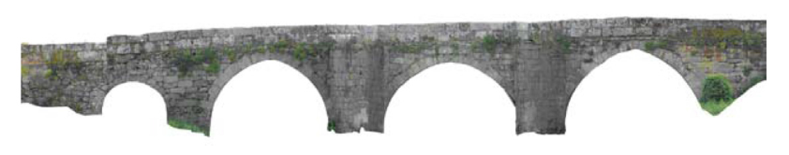

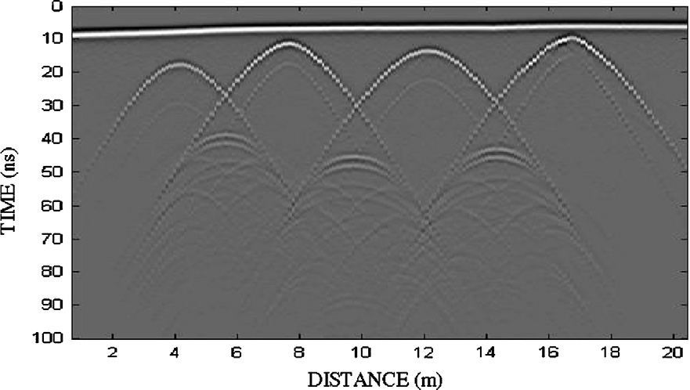
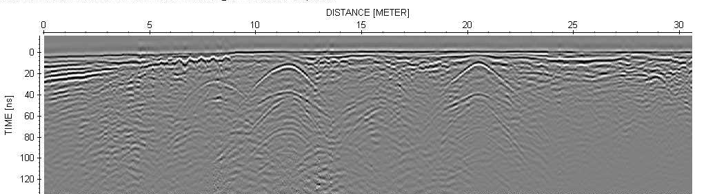
Example 1: Masonry Bridge application
Complex geometries (e.g. gothic arches)
Approach for more realistic and large scale models
Photogrammetry: Real geometry
Binarized image: FDTD model
Synthetic data
Field data

Slide 9
Example 2: Masonry Bridge application
INTEGRATION OF OTHER NDT IN MODELLING
Photogrammetry: its precise geometric data defines the structure in fine detail.
Thermography: enables zoning from differences in heat-emissivity values.
Orthothermogram
FDTD MODEL

Slide 10
Example 2: Masonry Bridge application
To randomly generate layers: Pareto on/off distributions
The final setup in the restored zone led to an average length of 30 cm and thicknesses of 6 and 4 cm for stone and cement, resp. In the pavement structure this setup resulted in an average length of 60 cm and thicknesses of 5 and 3 cm for stone and cement, resp.
Region | Filling materials | Dielectric constant (k)
Pathway | Granite flagstones | 60%: 5-7
 | Cement | 40%: 12-13
Original masonry | Granitic ashlar | 100%: 6-7
Restoration s.XVIII | Granitic masonry | 60%: 7-9
 | Clay | 40%:11-14
Reconstructions.XX | Granitic masonry | 60%: 7-9
 | Cement | 40%:11-14
v
Synthetic data
Field data

Slide 11
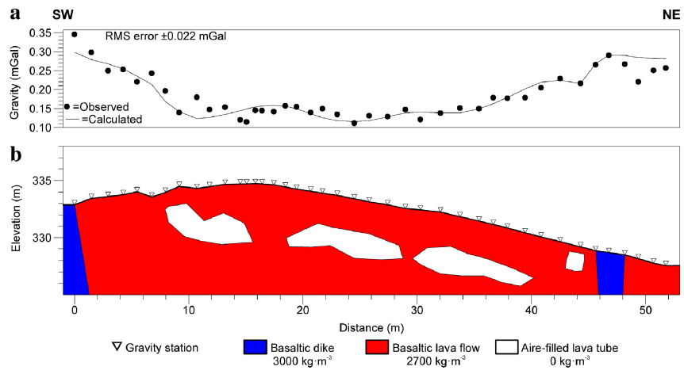
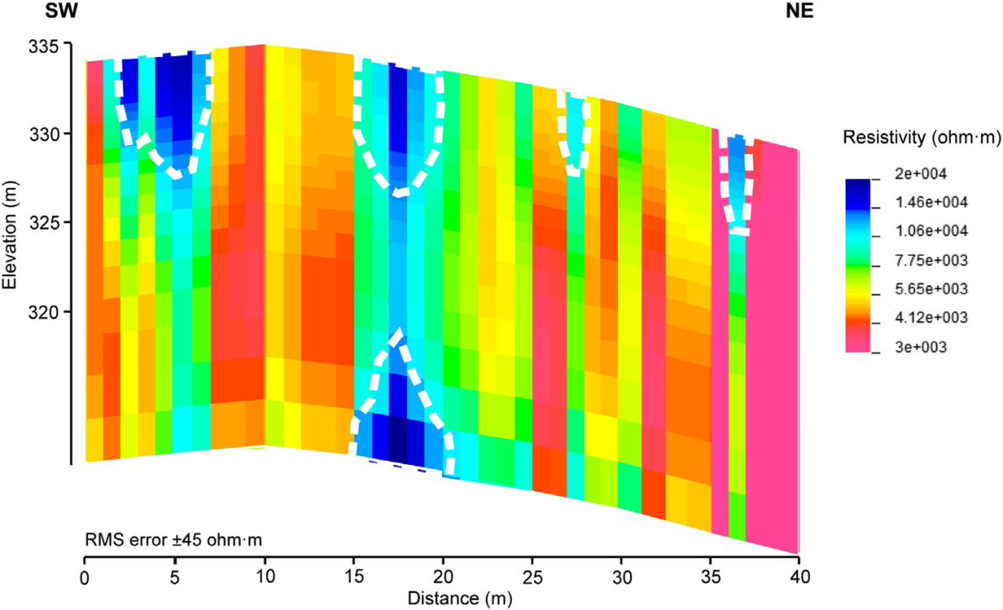
Example 3: Volcanic applications
To detect lava tubes in the Timanfaya National Park (Spain)
The input geometry for synthetic models corresponded to the results obtained from microgravity and electromagnetic resistivity.
The gravity model was created using the interpretation of field GPR data.

Slide 12
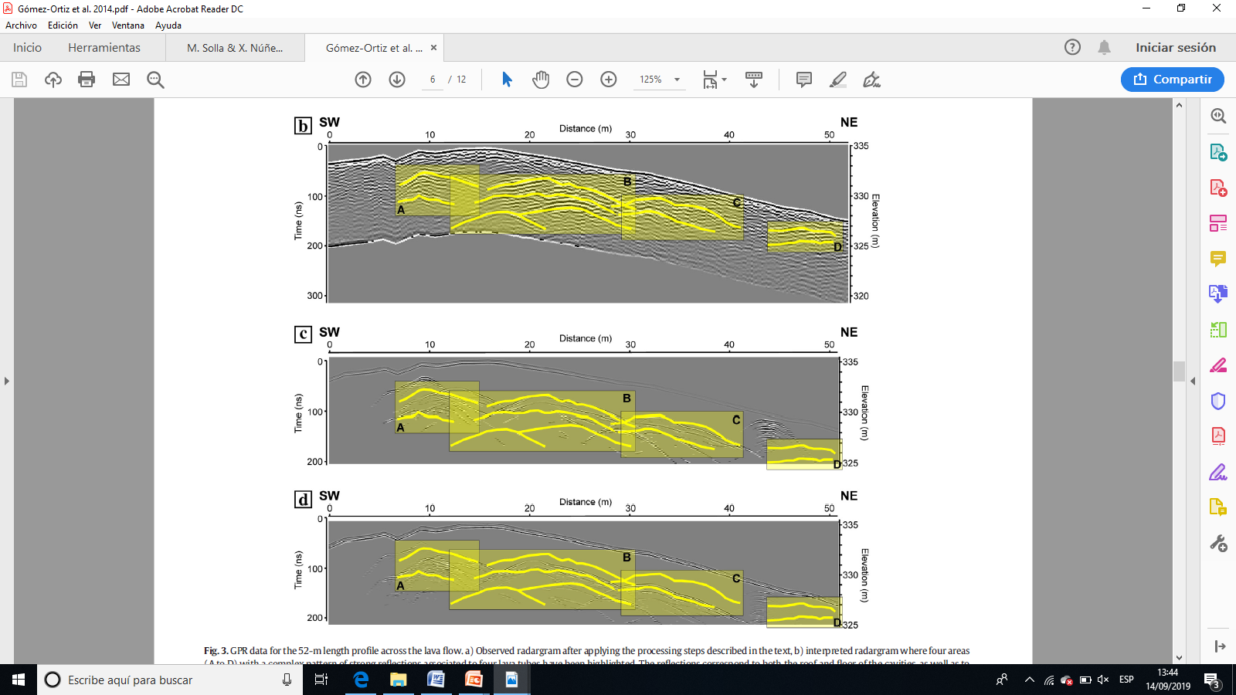
Example 3: Volcanic applications
Fig. b) Field data showing the interpretation of 5 lava tubes.
Field data
Simulation used for media characterization:
Synthetic data
Fig. c) Synthetic radargram (k=11; v=0.09m/ns for recent basaltic lava flows).
Fig. d) Additional synthetic data generated (k = 15; v = 0.078 m/ns) to analyze variations in the dielectric constant of the lava tubes.

Slide 13
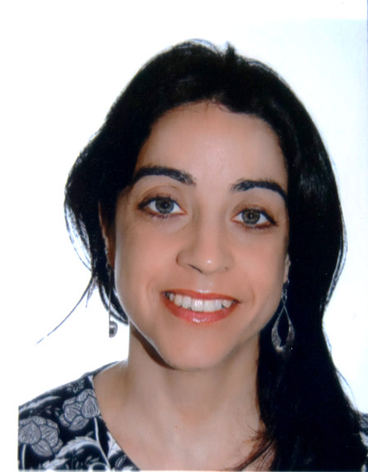
Workshop 1
(Prague, 30/Sep - 01/Oct 2019)
Dr. Mercedes Solla is an associate professor in the Defense University Center (Spanish Naval Academy) and researcher in the Applied Geotechnologies research group at the University of Vigo. She obtained her PhD in Environmental Engineering in 2010. Her research interests include Ground Penetrating Radar and its applications to Cultural Heritage and Civil Engineering, as well as electromagnetic modelling. She is author of more than 150 publications (49 articles indexed in JCR journal), including 25 book chapters and 80 conference proceedings.
For more info, please visit:
https://www.researchgate.net/profile/Mercedes_Solla
Topic 5 (Multivariate proxy data analysis and/or forward modelling)

